Slide 1
Conditional probability
9F
Notes:
https://create.kahoot.it/details/09e57ab7-c955-467b-ad05-7c5c3f2fa542
https://create.kahoot.it/details/dfe09902-52b3-4df4-b5a5-89b871fa8073
https://create.kahoot.it/details/928e8187-a26d-48ef-a757-4e00d55b908a
https://create.kahoot.it/details/c7b621cf-1619-4419-baac-e0fa72d64eef
https://dashboard.blooket.com/set/60875ca9f2d289001b81a603

Slide 2
Conditional probability
The probability of an event 𝐴 occurring when it is known that some event 𝐵 has occurred is called conditional probability and is written Pr(𝐴|𝐵). This is usually read as ‘the probability of 𝐴 given 𝐵’, and can be thought of as a means of adjusting probability in the light of new information.
For example, consider tossing a coin twice. What is the probability that the second toss shows a head, if we know that the first toss shows a head? Is the probability the same as if the first toss was a tail?
Suppose that we define event 𝐴 as ‘the second toss is a head’, and event 𝐵 as ‘the first toss is a head’. Then the probability that the second toss shows a head, given that the first toss shows a head, is written Pr(𝐴|𝐵) and is an example of conditional probability.

Slide 3
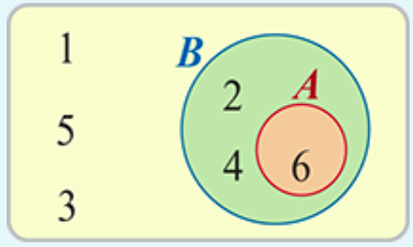
Example
Suppose we roll a fair die and define event 𝐴 as ‘rolling a six’ and event 𝐵 as ‘rolling an even number’. What is the probability of rolling a six given the information that an even number was rolled?
The events 𝐴 and 𝐵 can be shown on a Venn diagram.
We know that event 𝐵 has already occurred so we know that the outcome was 2, 4 or 6. Thus
Pr(six is rolled given an even number is rolled)=$\frac{\text{number} \text{of} \text{favourable} \text{outcomes}}{\text{total} \text{number} \text{of} \text{outcomes}}$ = $\frac{\text{n}\text{(}\text{A}\text{)}}{\text{n}\text{(}\text{B}\text{)}}$=$\frac{1}{3}$

Slide 4
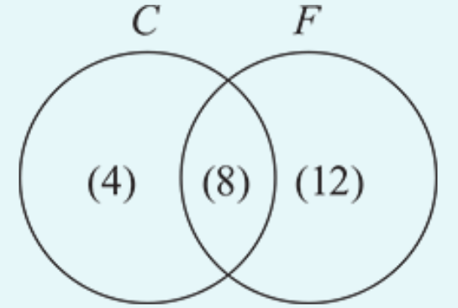
Example
In Stephen’s class 12 students study Chinese, 20 study French, and 8 study both Chinese and French.
1. Given that a student in his class studies Chinese (𝐶), what is the probability that they also study French (𝐹)?
2. Given that a student in his class studies French, what is the probability that they also study Chinese?
Pr(𝐹|𝐶)= $\frac{8}{12}$= $\frac{2}{3}$
Pr(𝐶|𝐹)= $\frac{8}{20}$= $\frac{2}{5}$

Slide 5
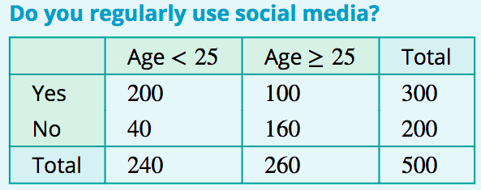
Example
500 people were questioned and classified according to age and whether or not they regularly use social media. The results are shown in the table.
One person is selected at random from these 500. Given that the selected person is less than 25 years of age, what is the probability that they regularly use social media?
If we know the person is less than 25 years old, then the sample space is restricted to those 240 people. Of these, 200 regularly use social media.
Pr( Yes| Age<25)= $\frac{200}{240}$= $\frac{5}{6}$

Slide 6
Example
500 people were questioned and classified according to age and whether or not they regularly use social media. The results are shown in the table.
One person is selected at random from these 500. Given that the selected person is less than 25 years of age, what is the probability that they regularly use social media? Pr(Yes∩Age<25)= $\frac{200}{500}$ and Pr(Age<25)= $\frac{240}{500}$
Hence we have
$\frac{\text{Pr}\text{(}\text{Yes}\text{∩}\text{Age}\text{<25)}}{\text{Pr}\text{(}\text{Age}\text{<25)}}$= $\frac{\frac{200}{500}}{\frac{240}{500}}$= $\frac{200}{240}$= $\frac{5}{6}$
which is equal to the conditional probability Pr(Yes| Age<25).
Pr( Yes| Age<25)= $\frac{200}{240}$= $\frac{5}{6}$

Slide 7
Conditional probability
The conditional probability of an event 𝐴, given that event 𝐵 has already occurred, is given by
Pr(𝐴|𝐵)= $\frac{\text{Pr}\text{(}\text{A}\text{∩}\text{B}\text{)}}{\text{Pr}\text{(}\text{B}\text{)}}$. if Pr(𝐵)≠0
This formula may be rearranged to give the multiplication rule of probability:
Pr(𝐴∩𝐵)=Pr(𝐴|𝐵)×Pr(𝐵)

Slide 8
Example
Given that for two events 𝐴 and 𝐵, Pr(𝐴)=0.7, Pr(𝐵)=0.3 and Pr(𝐵|𝐴)=0.4, find:
1. Pr(𝐴∩𝐵)
2. Pr(𝐴|𝐵)
Solution
1. Pr(𝐴∩𝐵)=Pr(𝐵|𝐴)×Pr(𝐴)=0.4×0.7=0.28
2. Pr(𝐴|𝐵)=$\frac{\text{Pr}\text{(}\text{A}\text{∩}\text{B}\text{)}}{\text{Pr}\text{(}\text{B}\text{)}}$= $\frac{\text{0.28}}{\text{0.3}}$= $\frac{\text{14}}{\text{15}}$

Slide 9
Example
In a particular school 55% of the students are male and 45% are female. Of the male students 13% say mathematics is their favourite subject, while of the female students 18% prefer mathematics. Find the probability that:
1. a student chosen at random prefers mathematics and is female
2. a student chosen at random prefers mathematics and is male.
Let us use 𝑀 to represent male, 𝐹 for female, and 𝑃 for prefers mathematics. Then
Pr(𝑀)=0.55,Pr(𝐹)=0.45,Pr(𝑃|𝑀)=0.13,Pr(𝑃|𝐹)=0.18
1. The event ‘prefers mathematics and is female’ is represented by 𝑃∩𝐹, with
Pr(𝑃∩𝐹)=Pr(𝑃|𝐹)×Pr(𝐹)=0.18×0.45=0.081
2. The event ‘prefers mathematics and is male’ is represented by 𝑃∩𝑀, with
Pr(𝑃∩𝑀)=Pr(𝑃|𝑀)×Pr(𝑀)=0.13×0.55=0.0715

Slide 10
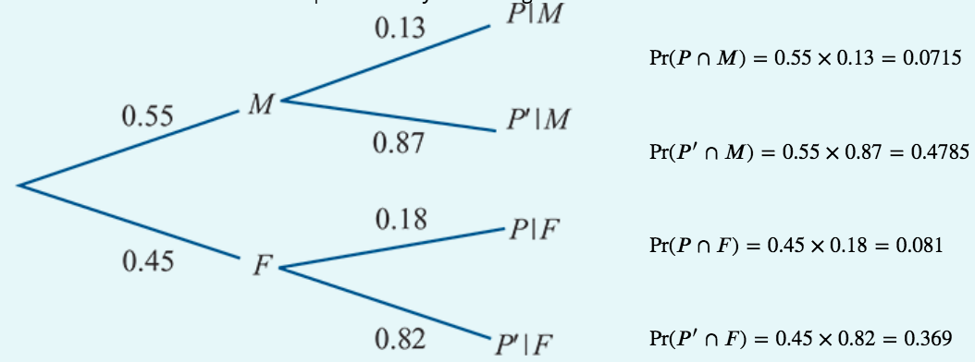
The law of total probability--Example
Construct a tree diagram of previous example and use it to determine:
1. the probability that a student selected is female and does not prefer mathematics
2. the overall percentage of students who prefer mathematics.
1. Pr(𝐹∩𝑃′)=Pr(𝐹)×Pr(𝑃′|𝐹)=0.45×0.82=0.369
2. 𝑃=(𝑃∩𝐹)∪(𝑃∩𝑀)
Since 𝑃∩𝐹 and 𝑃∩𝑀 are mutually exclusive,
Pr(𝑃)=Pr(𝑃∩𝐹)+Pr(𝑃∩𝑀)=0.081+0.0715=0.1525
Thus 15.25% of all students prefer mathematics.

Slide 11
The law of total probability
The law of total probability states that, in the case of two events 𝐴 and 𝐵,
Pr(𝐴)=Pr(𝐴|𝐵)Pr(𝐵)+Pr(𝐴|𝐵′)Pr(𝐵′)

Slide 12
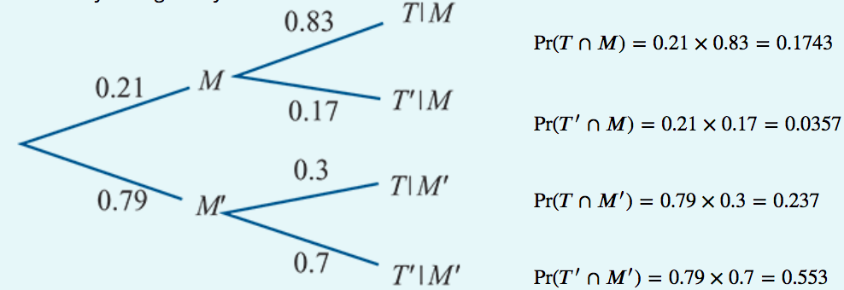
Example
In a certain town, the probability that it rains on any Monday is 0.21. If it rains on Monday, then the probability that it rains on Tuesday is 0.83. If it does not rain on Monday, then the probability of rain on Tuesday is 0.3. For a given week, find the probability that it rains:
1. on both Monday and Tuesday
2. on Tuesday.
Let 𝑀 represent the event ‘rain on Monday’
and 𝑇 represent the event ‘rain on Tuesday’.
1. The probability that it rains on both Monday and Tuesday
is given by
Pr(𝑇∩𝑀)=0.21×0.83=0.1743
2. The probability that it rains on Tuesday is given by
Pr(𝑇)=Pr(𝑇∩𝑀)+Pr(𝑇∩𝑀′)=0.1743+0.237=0.4113

Slide 13
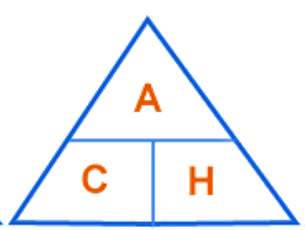
Section summary
The probability of an event 𝐴 occurring when it is known that some event 𝐵 has already occurred is called conditional probability and is written Pr(𝐴|𝐵).
In general, the conditional probability of an event 𝐴, given that event 𝐵 has already occurred, is given by
Pr(𝐴|𝐵)=$\frac{\text{Pr}\text{(}\text{A}\text{∩}\text{B}\text{)}}{\text{Pr}\text{(}\text{B}\text{)}}$ if Pr(𝐵)≠0
This formula may be rearranged to give the multiplication rule of probability:
Pr(𝐴∩𝐵)=Pr(𝐴|𝐵)×Pr(𝐵)
The law of total probability states that, in the case of two events 𝐴 and 𝐵,
Pr(𝐴)=Pr(𝐴|𝐵)Pr(𝐵)+Pr(𝐴|𝐵′)Pr(𝐵′)
$$\text{Pr}\text{(}\text{A}\text{∩}\text{B}\text{)}$$
$$\text{Pr}\text{(}\text{A}\text{|}\text{B}\text{)}$$
Pr(𝐵)
$$\text{Pr}\text{(}\text{A}\text{∩}\text{B}\text{)}$$
$$\text{Pr}\text{(}\text{B}\text{|}\text{A}\text{)}$$
Pr(A)

