Slide 1
Linear Equations
Chapter 1

Slide 2
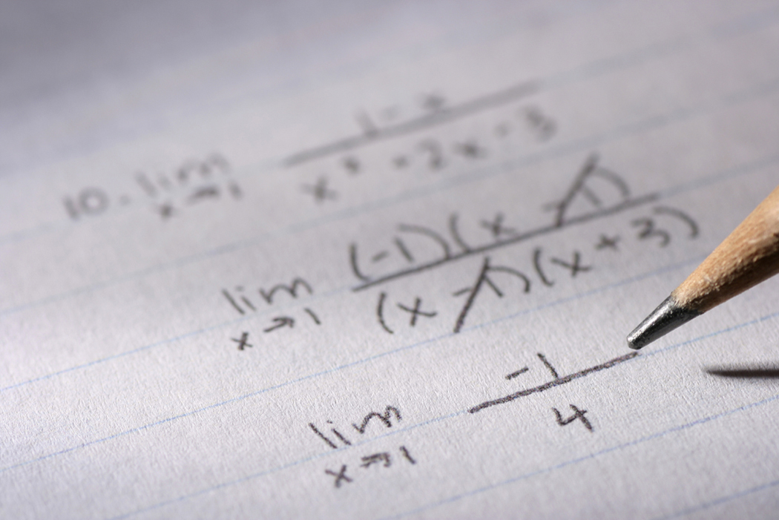
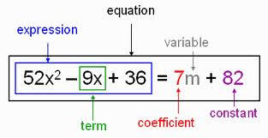
Coefficient: slope
Constant: y-intercept
Variable 1
Variable 2
y=mx+b
Linear Equation: slope y-intercept form
https://www.youtube.com/watch?v=BouqkWYlfzg
How to say maths signs in English?

Slide 3
Review one step equations.
3 + a = - 2
- 3 - 3
a = - 5

Slide 4
Solve:
n
3
+ 8
=
2
- 8 -8
n
3
(3) (3)
= -6
n = -18

Slide 6
1
5x
+
y
20
… (1)
Number
the Equations
=
2x
+
y
11
… (2)
=
Subtract (to get rid of a letter)
3x
=
9
x
=
3
Divide
(to find x)
2 x 3
+
y
11
=
6
+
y
11
=
Substitute
in (2)
(to find y)
y
5
=

Slide 7
7
Number
the Equations
2x
+
3y
=
13
… (1)
4x
-
y
=
5
… (2)
Scale up one of the equations
2x
+
3y
=
13
… (1)
12x
-
3y
=
15
… 3 x (2)
Add
(to get rid of a letter)
14x
=
28
x
=
2
Divide
(to find x)
4 x 2
-
y
=
5
8
-
y
=
5
Substitute
in (2)
(to find y)
y
=
3

