Slide 1
??
Sam's Mother has four children:
April, May, June, and ...
What is the name of the fourth child?
Six wolves catch six lambs in six minutes.
How many wolves will be needed to catch sixty lambs in sixty minutes?

Slide 2
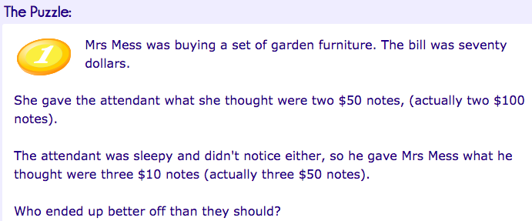
Whosoever shall solve this puzzle shall Rule The Universe!

Slide 3
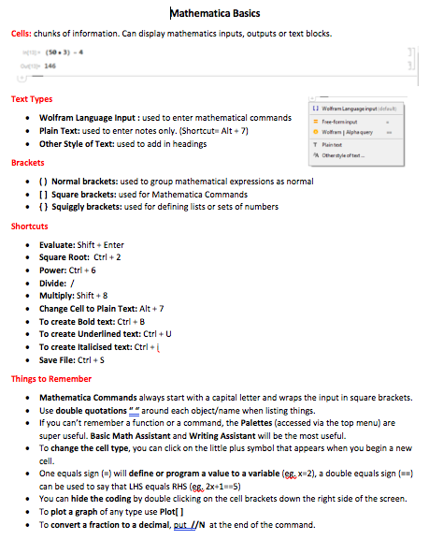
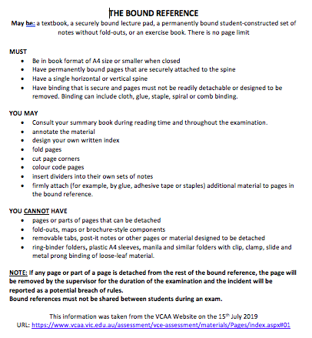
Summary Book Requirement
Index page.
Mathematica Basics page.
The Bound Reference page.

Slide 4
Kahoot
https://play.kahoot.it/v2/?quizId=9194c2c7-83bf-46bc-8dae-611d9f67b285

Slide 5
A frequency table contains 4 columns.
# of Cats in Homes
 |  | Frequency
# of Cats | Tally | Number | %
0 | IIII | 4 | 28.57
1 | IIII I | 6 | 42.86
2 | III | 3 | 21.43
3 or more | I | 1 | 7.14
Total |  | 14 | 100

Slide 6
Frequency Table
A frequency table is a listing of the values a variable takes in a data set, along with how often (frequently) each value occurs.
Frequency can be recorded as a:
frequency: the number of times a value occurs
percentage frequency: the percentage of times a value occurs, where:

Slide 7
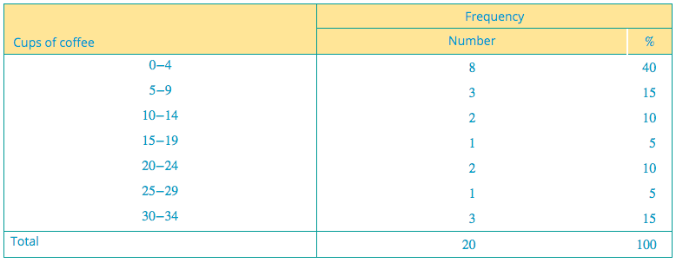
Grouping Data
Sometimes, grouping requirements are given as following. Sometimes you make your own grouping.

Slide 8
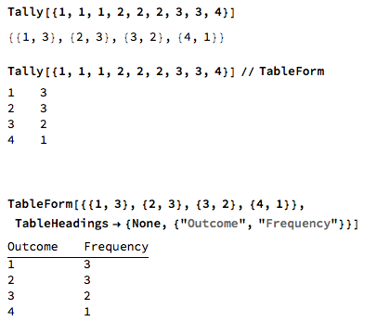
Mathematica

Slide 9
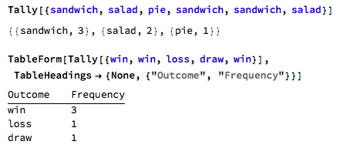
Mathematica

Slide 10
Frequency Table for Categorical Data
These are the favorite colors of fifteen 2nd graders.
Red
Yellow
Green
Red
Blue
Blue
Red
Red
Green
Red
Green
Yellow
Red
Blue
Green
Percentage frequency = $\frac{count}{total}×100\%$
 |  | Frequency
Class | Tally | Number | Percentage %
Red |  | 6 | 40
Yellow |  | 2 | 13.33
Green |  | 4 | 26.67
Blue |  | 3 | 20
Total = 15

Slide 11
Bar Charts
When the data are categorical, the appropriate display is a bar chart.
In a bar chart:
1. frequency or percentage - shown on the vertical axis.
2. the variable - plotted on the horizontal axis
3. the height of the bar (column) gives the frequency (or percentage)
4. the bars are drawn with gaps to indicate that each value is a separate category. There is one bar for each category.

Slide 12
A single bar graph uses the same color or shade of bar to compare amounts, such as number of students per class..
STUDENTS PER CLASS
30
15
Number of Students
0
6
7
8
Grade

Slide 13
Bar Chart
Class | Tally | Frequency | Percentage %
Red |  | 6 | 40
Yellow |  | 2 | 13.33
Green |  | 4 | 26.67
Blue |  | 3 | 20

Slide 14
What about if we deal with Numerical Data (Discrete Data & Continuous data)?

Slide 15
Grouping Data
When the range of the data is large, the data must be grouped into classes
41 104 112 118 87 95
105 57 107 67 78 125
109 99 105 99 101 92

Slide 16
Key Concept
Intervals: It includes all numbers contained between two numbers. For example, 1-5: The interval includes every number greater than 1 and less than 5.
Minimum Value: Smallest data value that included in the data set.
Maximum Value: Largest data value that included in the data set.
41 104 112 118 87 95
105 57 107 67 78 125
109 99 105 99 101 92

Slide 17
Interval & start point given
Use intervals of 10 and starting at 40
 |  | Frequency
Class | Tally | Number | Percentage
41 104 112 118 87 95
105 57 107 67 78 125
109 99 105 99 101 92

Slide 18
Rule #1: Every data value should be in an interval.
Rule #2: The intervals should not overlap.
Rule #3: There should be no gaps between the intervals.
Rules For Grouping Data

Slide 19
Rule #4: 5 to 15 groups preferred.
Rule #5: Easy interval to interpret such as 10 units, 100 units or 1000 units (depending on the data).
Rule #6: Intervals of 0–49, 50–99, 100–149 would be preferred over the intervals 1–50, 51–100, 101–150 etc.
Rules For Grouping Data

Slide 20
Grouping Discrete Data
Minimum Value: 0
Maximum Value: 34
Interval: 5 or 10?
 |  | Frequency
 | Tally | Number | Percentage %
0-4
5-9
10-14
15-19
20-24
25-29
30-34

Slide 21
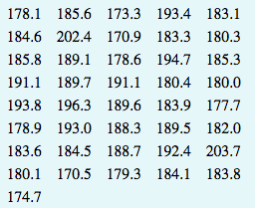
Grouping Continuous Data
Minimum Value: 170.5
Maximum Value: 203.7
Interval: 5 or 10?
 |  | Frequency
 | Tally | Number | Percentage %
170-174.9
175-179.9
180-184.9
185-189.9
190-194.9
195-199.9
200-204.9

Slide 22
Try One On Your Own
After conducting a survey of 30 of your classmates, you are left with the following set of data on how many days off each employee has taken this year:
Construct a Frequency Table. Assume you want to divide the data into 5 different groups.
7, 8, 9, 4, 10, 36, 19, 9, 26, 5, 11, 6, 2, 9, 10, 8, 16, 29, 7, 9, 8, 25, 4, 27, 8, 7, 6, 10, 34, 8

Slide 23
Answer
 |  | Frequency
Groups | Tally | Number | %
2-8 |  | 14 | 46.67
9-15 |  | 8 | 26.67
16-22 |  | 2 | 6.67
23-29 |  | 4 | 13.33
30-36 |  | 2 | 6.67
 | Total: |  | 100.01
30

Slide 24
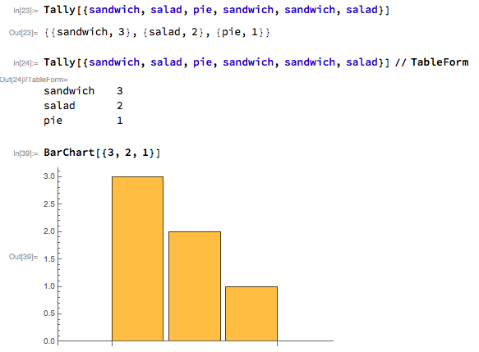
Mathematica

Slide 25
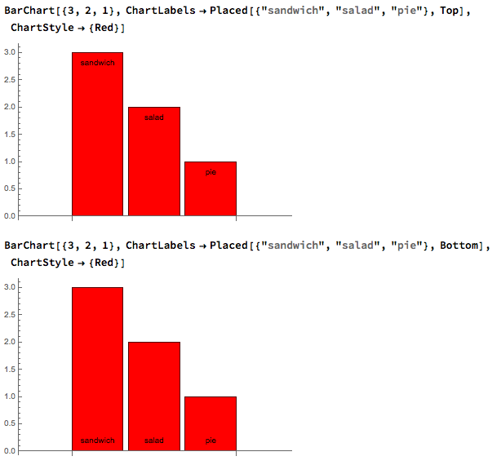
Mathematica

Slide 26
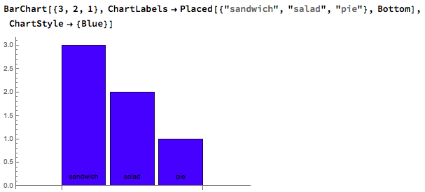
Mathematica

Slide 27
Summary questions?
1. What is frequency table?
2. How do we calculate percentage frequency?
3. When do we use Bar Chart?
4. For Bar Chart, what’s on vertical axis and what’s on horizontal axis?
5. Scratch a Frequency Table and a Bar Chart for Continuous Data.
6. Can you use Wolfram to do Bar Chart and Frequency Table?

