Slide 1
Percentages of data lying within multiple standard deviations of the mean
2G
Notes:
https://create.kahoot.it/details/4704860a-60da-4611-8b28-81ace5ba0c3b
https://create.kahoot.it/details/509f536c-f3f8-4966-b2d7-b6f7263dafd9
https://create.kahoot.it/details/616d8c8b-0f0b-40d1-8f9c-cd1d2d781a48

Slide 2
The normal distribution

Slide 3
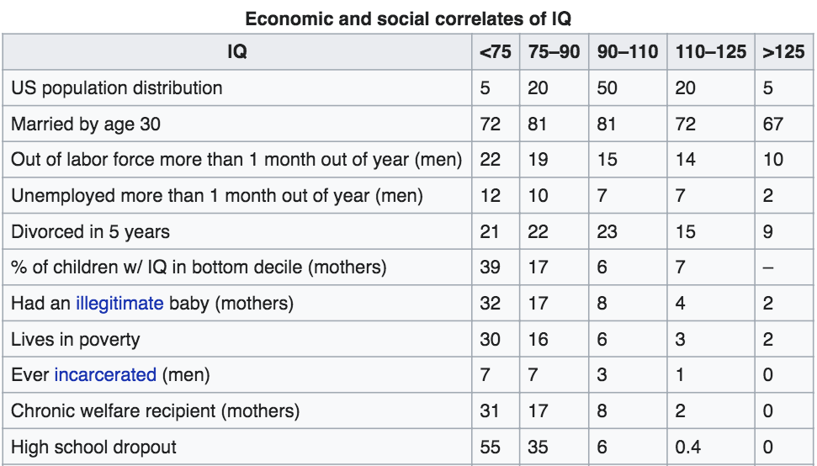

Slide 7
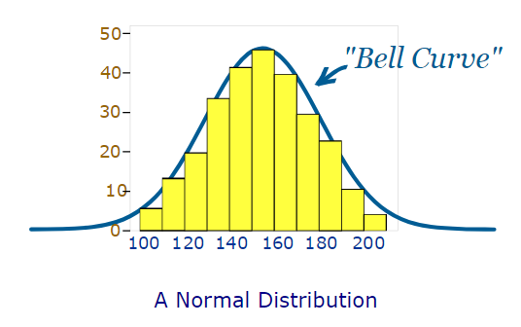
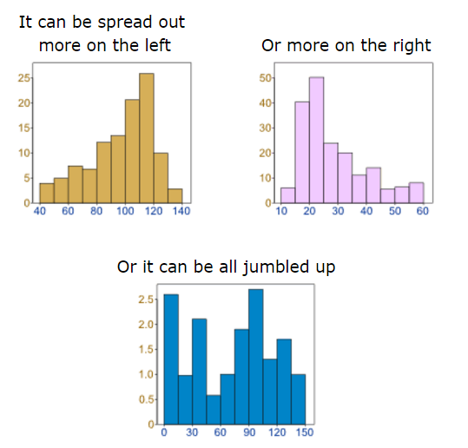
Data can be spread out in different ways.
Many things closely follow a Normal Distribution:
heights of people
size of things produced by machines
errors in measurements
blood pressure
marks on a test
In general, a normal distribution is representative of continuous data (such as measurements) that have some variation but no bias above or below the mean.

Slide 8
mean = median = mode
Symmetry about the centre (mean)
50% of the values are less than the mean and 50% are greater than the mean
All normal distributions have these features. The only differences between one normal distribution and another are:
Where the centre value is (mean)
How spread out the data is (the standard deviation)

Slide 9
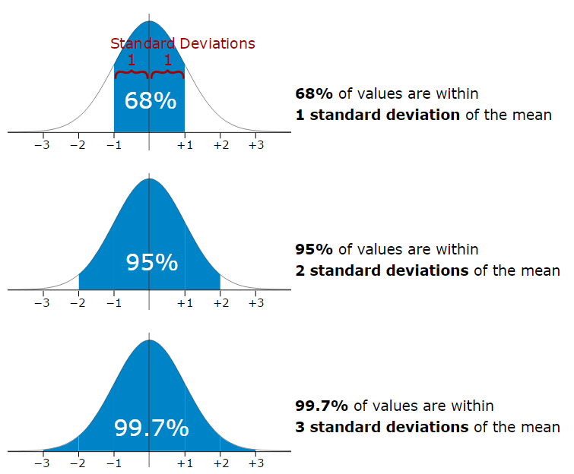
The mean is easy to spot, it is the middle point. But what about the standard deviation?
We have previously looked at how to calculate the standard deviation for a set of data.
The distance of each point from the mean – squared to eliminate and minus signs from points that are below the mean.
We then add up all these distances of all the values in the set of data.
$$s=\sqrt{\frac{Σ{\left(x−\overline{x}\right)}^{2}}{n−1}}$$
The whole thing is then square rooted to counteract the effect of squaring.
Divided by the number of points to find the average.
This gives us an idea of the average distance of each data point from the mean value.
It is good to know the standard deviation, because we can say that any value is:
likely to be within 1 standard deviation
very likely to be within 2 standard deviations
almost certainly within 3 standard deviations
But what does the standard deviation really mean in terms of a normal distribution?

Slide 10
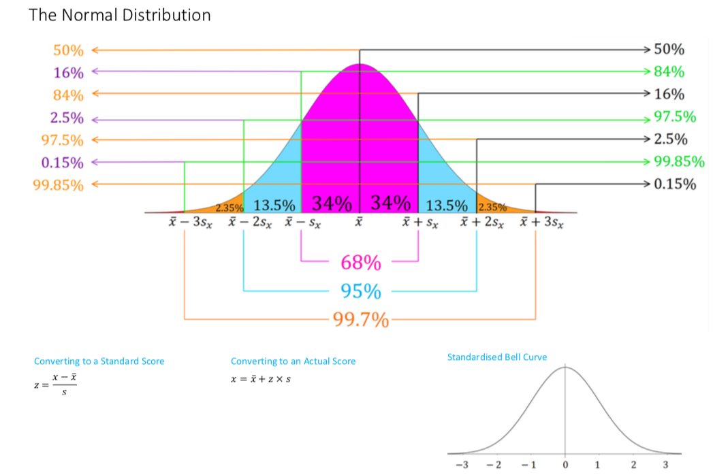

Slide 11
a 95% of pizzas will have delivery times of between 15 and 35 minutes.
b 16% of pizzas will have delivery times of greater than 30 minutes.
c Number =2000
Percentage delivered in less than 10 minutes =0.15%
Number of pizzas delivered in less than 10 minutes=0.15% of 2000=$\frac{0.15}{100}$×2000=3

Slide 12
Normal Distribution
https://www.youtube.com/watch?v=e_h3RBgBx8M&feature=youtu.be

Slide 14
exercises & Summary Book
1. Ex page 2G
2. Summary notes

