Slide 1
2I Comparing the distribution of a numerical variable across groups

Slide 2
Learning Outcome
A brief written report that compares the distribution of the numerical variable across two groups.
Learn to interpret two new graphical displays: the back-to-back stem plot and the parallel boxplot.

Slide 3
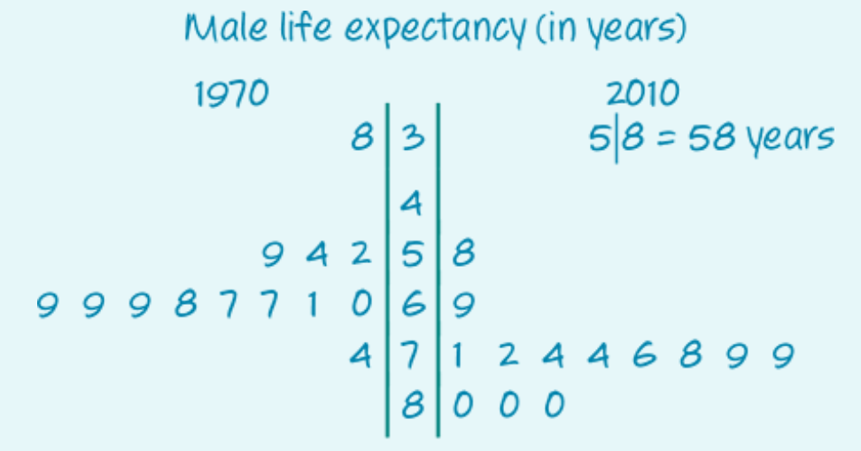
Comparing distributions using back-to-back stem plots (for small data sets)
Life expectancies for males (in years) in several countries in the years 1970 and 2010.
the key features of:
centre (the median)
spread (the IQR)

Slide 4
Comparing distributions using back-to-back stem plots
1. Centre: The medians.
The median life expectancy of males in 2010 (M=76years) was nine years higher than in 1970 (M=67years).
2. Spread: The IQRs.
The spread of life expectancies of males in 1970 (IQR=12.5years) was different to the spread in 2010 (IQR=8).
3. Conclusion:
The median life expectancy has increased, and the variability in life expectancy has decreased. Median life expectancy of males in 2010 (M=76years) was nine years higher than in 1970 (M=67years).
Notes:
Use depression scale as example

Slide 5
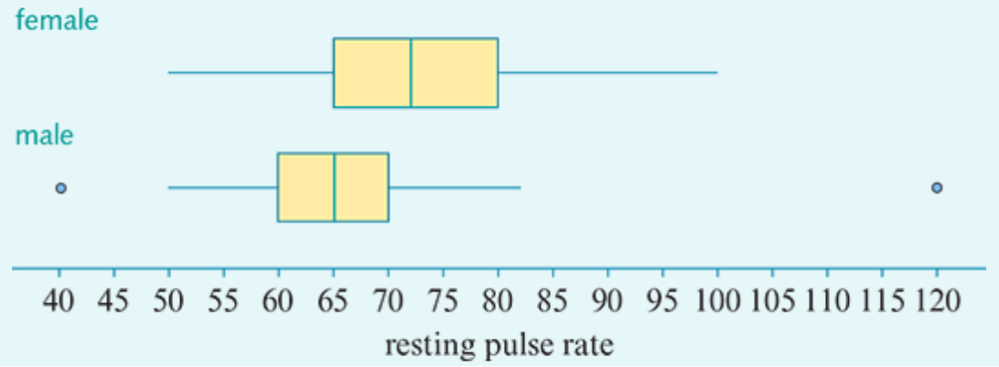
Comparing distributions using parallel boxplots (for big or more than two data sets)
The key features of:
centre (the median)
spread (the IQR)
possible outliers.
The distribution of pulse rates (in beats/minute) for a group of female students and a group of male students.
2

Slide 6
Comparing distributions using parallel boxplots (for big or more than two data sets)
1. Centre: The medians.
The median pulse rate for females (M=72beats/minute) is higher than that for males (M=65beats/minute).
2. Spread: The IQRs.
The spread of pulse rates for females (IQR=15) is higher than for males (IQR=10).
3. Outliers:
There are no female outliers. The males with pulse rates of 40 and 120 were outliers.
4. Conclusion:
The the median pulse rate for females was higher than for males and female pulse rates were generally more variable than male pulse rates.
Notes:
Use depression scale as example

Slide 7
Let’s complete Ex 2I Question 2 & 4 and ask some questions…

