Slide 1
25/01/2023
Percentage increase and decrease
In this topic you will cover:
Increase by a percentage
Decrease by a percentage

Slide 3
Example
Sally deposits £600 into an account with an increase of 5% per annum.
Find how much money she has in the account after one year.
Increase = 5% of £600
100% + 5% = ?
£600 +5% = ?
5% = 5/100 (Multiplier)
5/100 of £600
= £30
New balance = £600 + £30
= £630
Is there a quicker way?

Slide 4
Percent Increase
The increase growth factor is
$1+\frac{r}{100}$
Percentage of increase

Slide 5
Example
Sally deposits £600 into an account with an increase of 5% per annum.
Find how much money she has in the account after one year.
Growth factor=$1+\frac{r}{100}$ = $1+\frac{5}{100}$ =1+0.05=1.05
New balance = £600 $×1.05$
= £630
A quicker way!

Slide 6
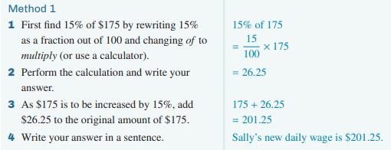
Method 1

Slide 7
Method 2
Growth factor =1+ $\frac{15}{100}$ = $\frac{100}{100}$+ $\frac{15}{100}= \frac{115}{100}=1.15$

Slide 8
Phrase % Multiplier/Growth factor
5 % increase
1.005
10 % increase
1
15 % increase
1.15
½ % increase
1.1
No change
1.05

Slide 9
Example
A car depreciates at rate of 30%. Initially it cost £25,000.
How much will it be worth after a year?
Decrease: 100 - 30 = 70%
70% of £25,000
10%= £2500
70% = £17,500
Is there a quicker way?

Slide 10
Percent Decrease
The decrease decay factor is
$1−\frac{r}{100}$
Percentage of decrease

Slide 11
Example
A car depreciates at rate of 30%. Initially it cost £25,000.
How much will it be worth after a year?
Decay factor= $1−\frac{r}{100}=1−\frac{30}{100}$=0.70
25 000 $×$0.70 = £17,500
A quicker way!

Slide 12
Phrase % Multiplier/Decay factor
0.5
1 % decrease
0.965
0.85
3.5 % decrease
1
15 % decrease
50 % decrease
0.99
No change

Slide 13
Method 1

Slide 14
Method 2
Decay factor =1– $\frac{15}{100}$ = $\frac{100}{100}$– $\frac{15}{100}= \frac{85}{100}=0.85$

Slide 15
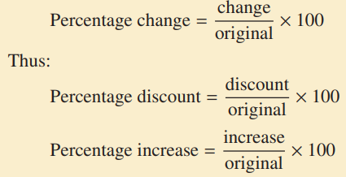
Percentage Change

Slide 16
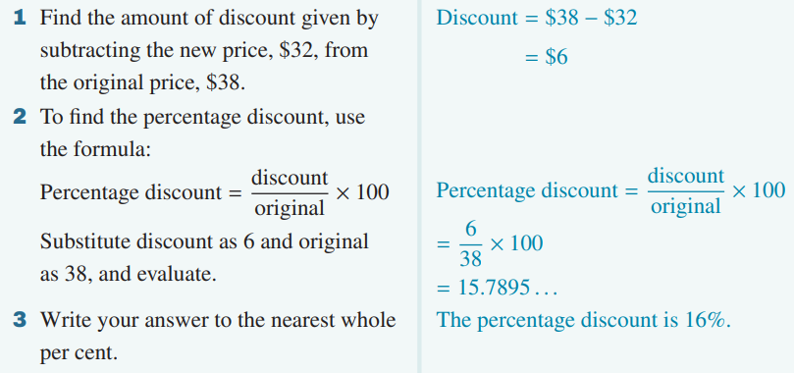
Example

