Slide 1
5J Piecewise linear graphs

Slide 2
Learning intentions
To be able to construct and analyse piecewise linear graphs.
To be able to construct and analyse step graphs

Slide 3
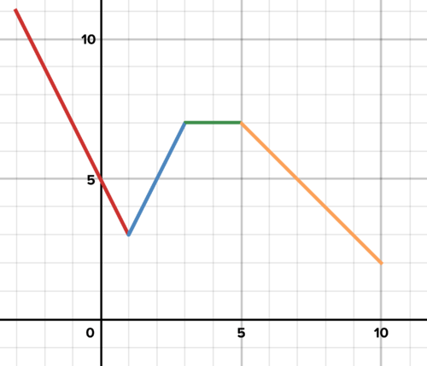
Piecewise linear graphs
Sometimes a situation requires two linear graphs to obtain a suitable model. The graphs we use to model such situations are called piecewise linear graphs

Slide 4
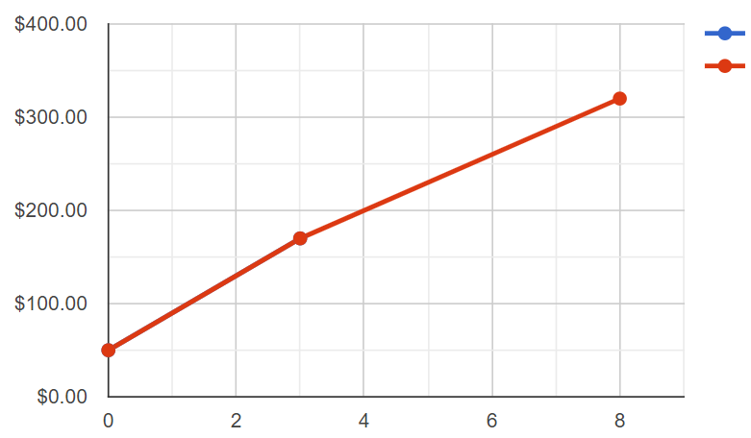
Constructing a piecewise linear graph model
①
②
50+40×2.5=$150 80+30×3=$170 80+30×6=$260
50+40×0=$50 (0,50)
C
C=50+40x
(8,320)
C=80+30x
50+40×2.5=$150 (2.5,150)
80+30×3=$170 (3,170)
(3,170)
80+30×8=$320 (8,320)
(2.5,150)
(0,50)
x

Slide 5
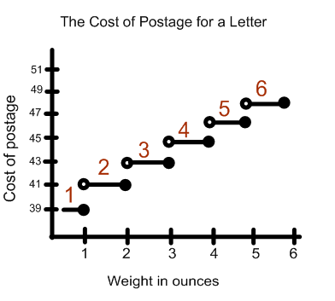
Step graphs
A step graph is a type of piecewise graph that uses line segments where each line segment is horizontal.

Slide 6
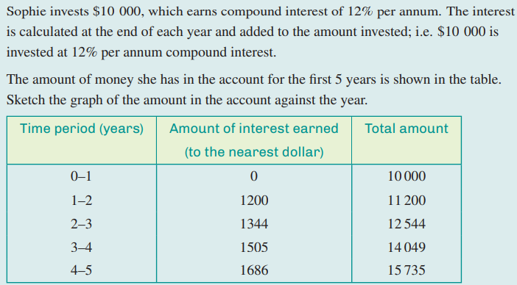
Step graphs

Slide 7
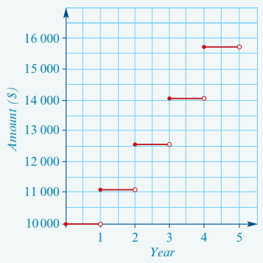
Step graphs

