Slide 1
Coordinate geometry and linear relations
Revision

Slide 3
Distance Formula
Used to find the distance between two points

Slide 4
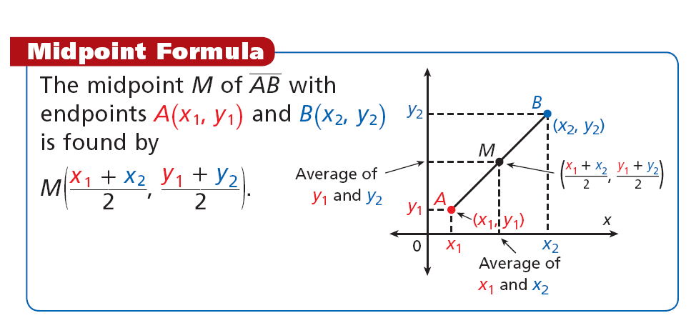
Midpoint Formula
Used to find the center of a line segment

Slide 6
Calculating Gradient/slope

Slide 7
Trigonometry
HYPOTENUSE
OPPOSITE
Located opposite the included angle
Greek letter ‘Pheta’ – represents the angle
Ѳ
ADJACENT
Located between the right angle and the included angle

Slide 8
Trig Ratios
Sine Ratio:
SinѲ =
Cosine Ratio:
CosѲ =
Tangent Ratio:
TanѲ =
Opposite
Hypotenuse
Adjacent
Hypotenuse
Opposite
Adjacent
Hypotenuse
Hypotenuse
Adjacent
Opposite
Adjacent
Opposite
SOH
CAH
TOA

Slide 9
Tangent (tan)
We use cosine when we have the Opposite and Adjacent lengths.
10cm
The rule we use is:
50˚
Opposite
Adjacent
Tanϴ=
6.4cm (1dp)

Slide 10
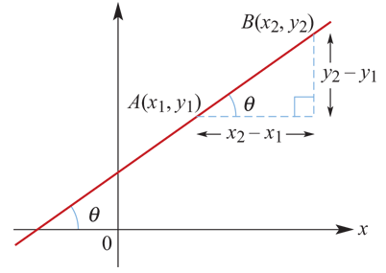
The tangent of the angle of slope Positive gradient

Slide 11
The tangent of the angle of slope Negative gradient

Slide 12
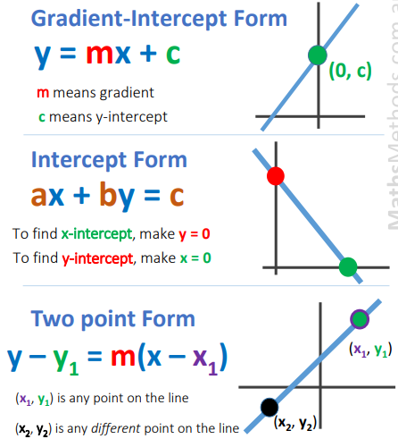
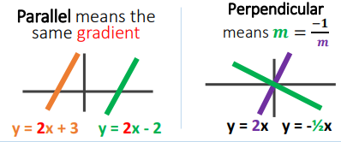
m
(0, a)
=ab
(b,0)
m

Slide 13
The equation of a straight line Five ways of determining the equation:
gradient and y-axis intercept
gradient and a point
two points
two intercepts
Vertical and horizontal lines

Slide 14
Writing Equations – Type #1
Write an equation in slope-intercept form of the line that has a slope of 2 and a y-intercept of 6.
To write an equation, you need two things:
slope (m) =
y – intercept (c) =
We have both!! Plug them into slope-intercept form
y = mx + c
y = 2x + 6
2
6

Slide 15
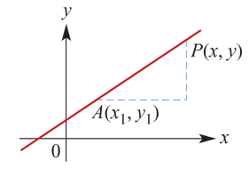
Writing Equations – Type #2

Slide 16
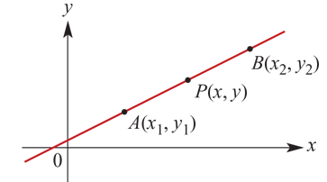
Writing Equations – Type #3

Slide 17
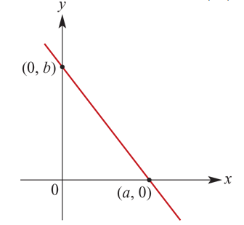
Writing Equations – Type #4

Slide 18
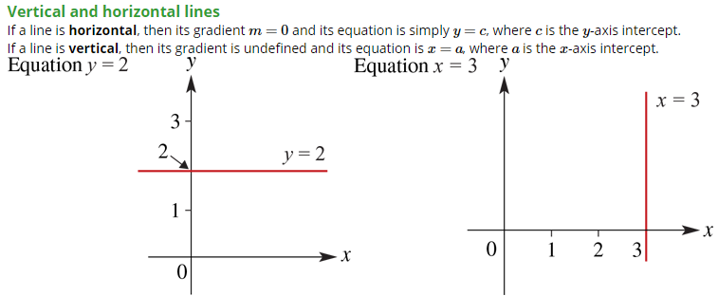
Writing Equations – Type #5

Slide 19
The geometry of simultaneous equations
There are three possible outcomes when considering a system of two simultaneous linear equations in two unknowns:
There is a unique solution. (Lines intersect at a point.)
There are infinitely many solutions. (Lines coincide.)
There is no solution. (Lines are parallel.)

Slide 21
