Slide 1

A-gallery-of-graphs
4
Notes:
https://create.kahoot.it/details/6fee896b-6a05-494e-af07-5f6cbcf1f4c4
https://create.kahoot.it/details/49477f89-7e27-47e4-953d-575b54805de4
https://create.kahoot.it/details/1124bfb7-9076-4d90-aa68-11a28df8f111

Slide 2
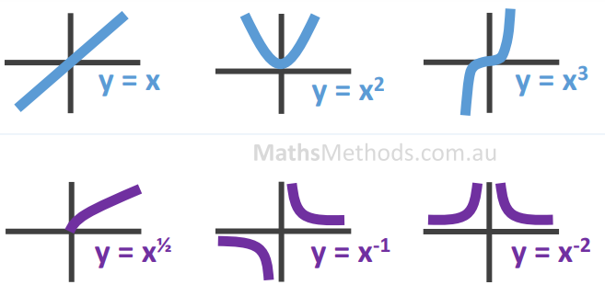
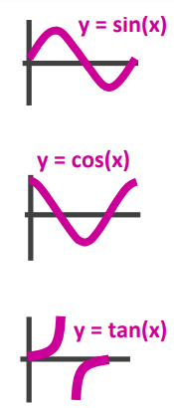
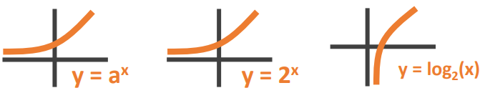
$$y=\sqrt{x} y=\frac{1}{x} y=\frac{1}{x^{2}}$$

Slide 3

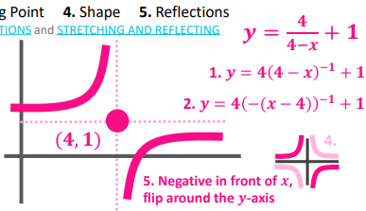
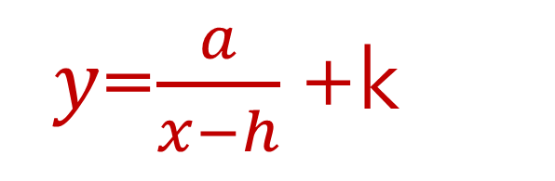
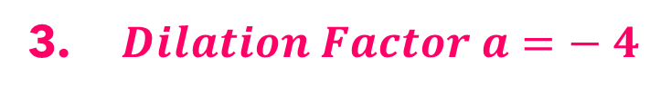
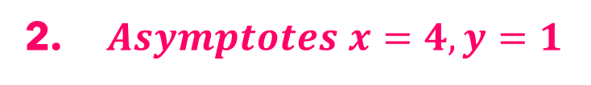

Hyperbola
𝑦=$\frac{a}{x−h}$+k
1. $y=\frac{4}{−\left(x−4\right)}+1$
2. $Asymptotes x=4, y=1$
3. $Dilation Factor a=− 4$

Slide 4
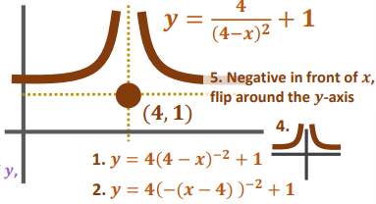
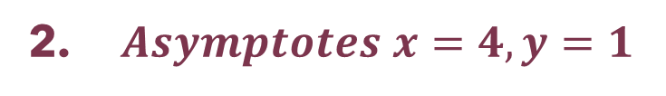


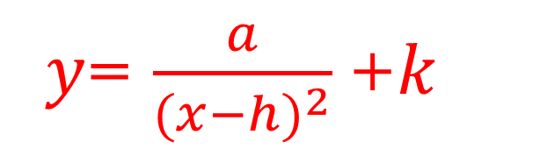
Truncus
𝑦= $\frac{a}{{(x−h)}^{2}}$+𝑘
1. $y=\frac{4}{{\left(x−4\right)}^{2}}+1$
2. $Asymptotes x=4, y=1$
3. $Dilation Factor a= 4$

Slide 5
Parabolas y= a(x - h)² + k
Comparing y = a(x - h)² + k with y = x ²:
(3, 2)
(-2, 1)
y= (x +2)² + 1
y= x²
y= —(x—3)² + 2
Vertex is (—2, 1)
Axis of symmetry is x = — 2
Minimum value of y = 1
Vertex is (3, 2)
Axis of symmetry is x = 3
Maximum value of y = 2
3.1.13

Slide 6
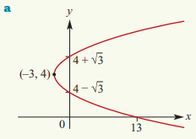
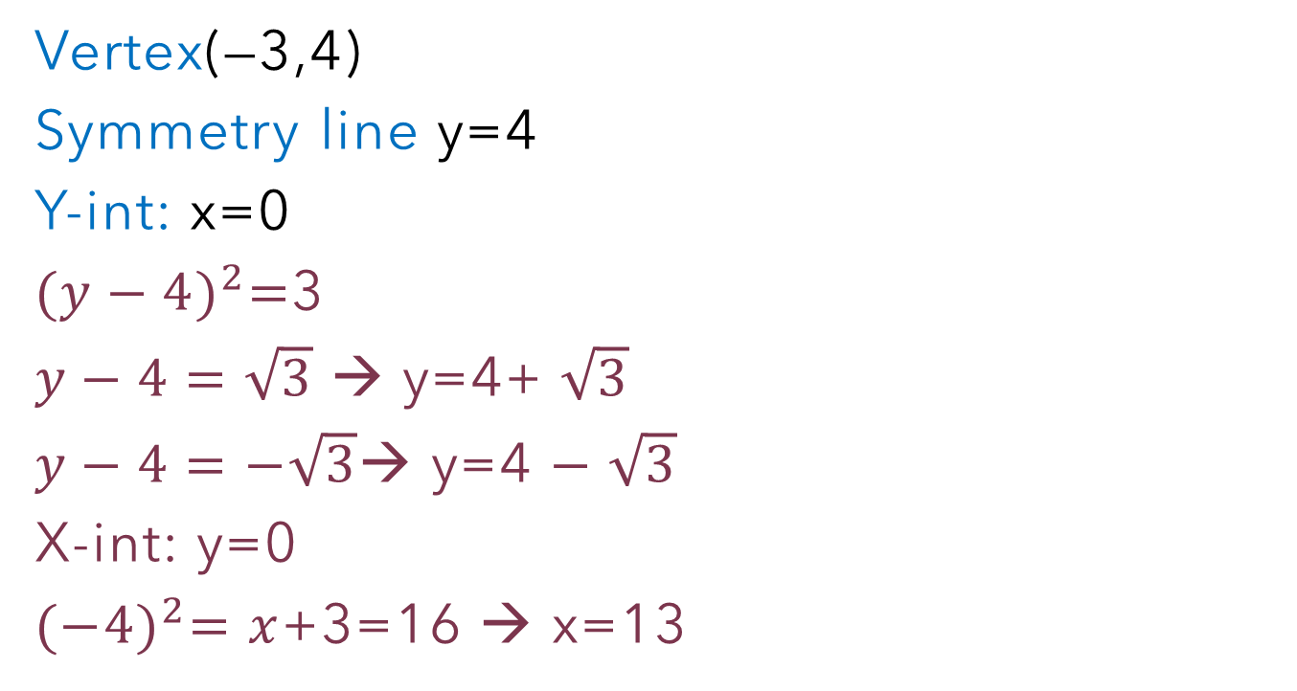

Sketch ${(y−4)}^{2}=x$+3
Sideway Parabolas
(y - k)² = a² (x - h)
Vertex(—3,4)
Symmetry line y=4
Y-int: x=0
${(y−4)}^{2}=$3
$y−4=\sqrt{3}$ → y=4+ $\sqrt{3}$
$y−4=−\sqrt{3}$→ y=4 $− \sqrt{3}$
X-int: y=0
${(−4)}^{2}=x$+3=16 → x=13

Slide 7
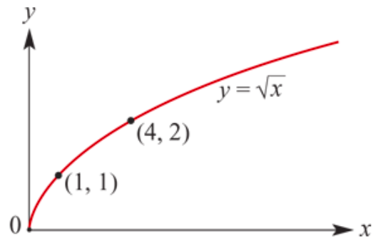
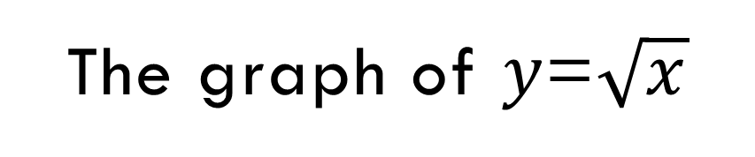
The graph of 𝑦=$\sqrt{x}$
Half Sideway Parabolas
Coordinates of points on the graph of 𝑦=$\sqrt{x}$include (0,0), (1,1), (4,2) and (9,3).
Starting point is (0,0)
All graphs of the form
𝑦=$\text{a}\sqrt{x−h}$+𝑘
will have the same basic shape as the graph of 𝑦=$\sqrt{x}$.
Starting point is (h,k)

Slide 8
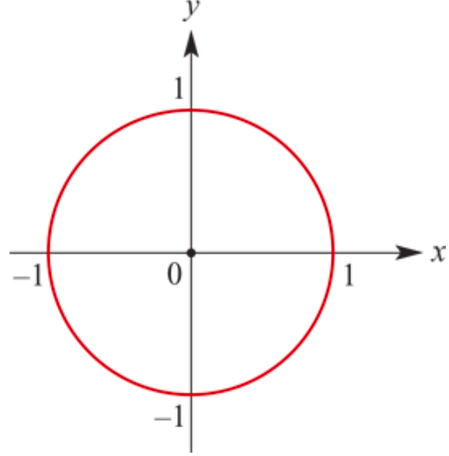

Equation of a Circle: ‘centre--radius’ form
Is 𝑥² + 𝑦² =𝑟²
Where
  The circle has centre (0,0)
  It’s radius is 𝑟

Slide 9
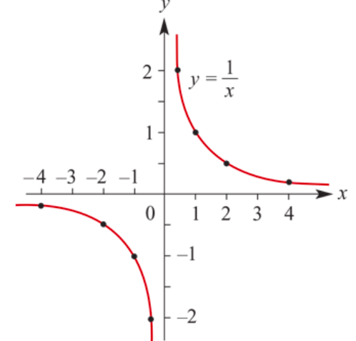
Asymptotes
There are two lines associated with this graph that help to describe its shape.
Horizontal asymptote
Vertical asymptote

Slide 10
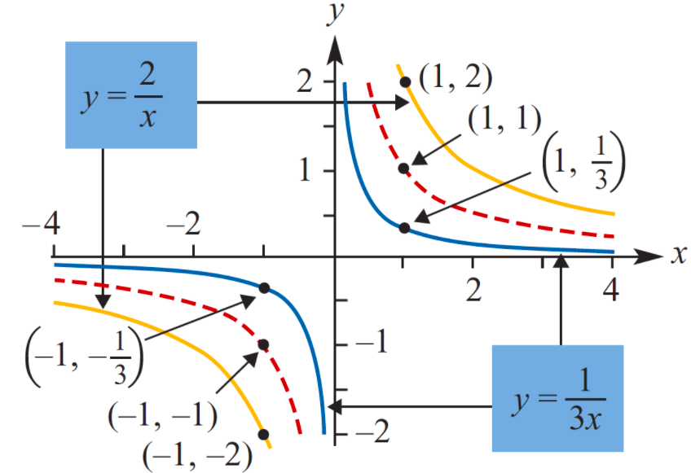
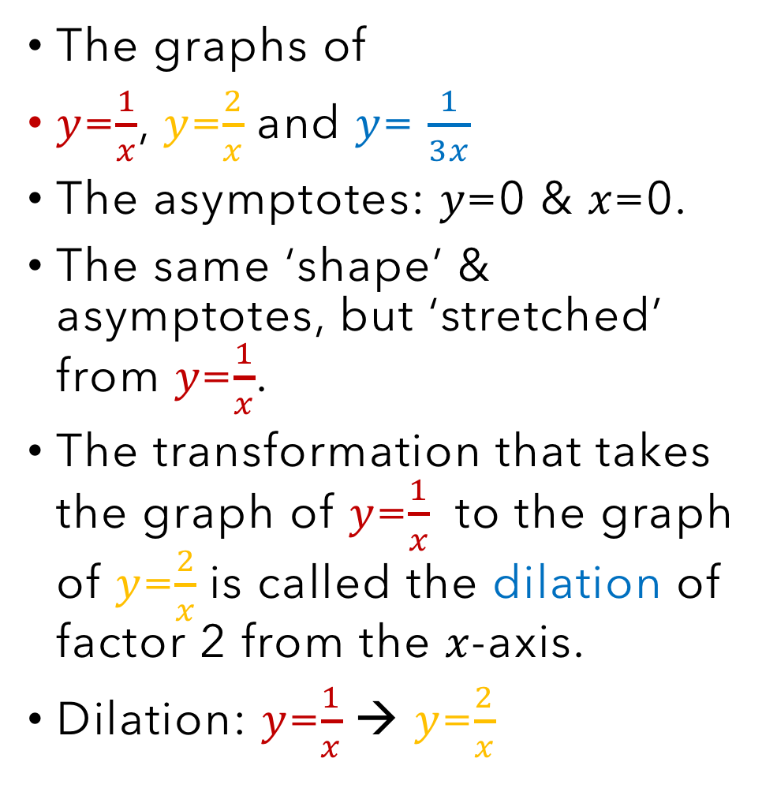
Dilations from an axis
The graphs of
𝑦=$\frac{1}{x}$, 𝑦=$\frac{2}{x}$and 𝑦= $\frac{1}{3x}$
The asymptotes: 𝑦=0 & 𝑥=0.
The same ‘shape’ & asymptotes, but ‘stretched’ from 𝑦=$\frac{1}{x}$.
The transformation that takes the graph of 𝑦=$\frac{1}{x}$ to the graph of 𝑦=$\frac{2}{x}$is called the dilation of factor 2 from the 𝑥-axis.
Dilation: 𝑦=$\frac{1}{x}$→ 𝑦=$\frac{2}{x}$

Slide 11

Sketching rectangular hyperbolas
Using dilations, reflections and translations, we are now able to sketch the graphs of all rectangular hyperbolas of the form 𝑦=$\frac{a}{x−h}$+k.

Slide 12
What can you spot? Conic Graphs
Circle
Obtained when the plane is parallel to the base of the cones.
Ellipse
The plane is less steep than the surface of the cone.
Parabola
Plane is parallel to the surface of the cone.
Hyperbola
The plane is steeper than the surface of the cone, so intersects both cones.

