Slide 1
Using an explicit rule for linear growth or decay
7C

Slide 2
Rules for linear growth and decay
While we can generate as many terms as we like in a sequence using a recurrence relation for linear growth and decay, it is possible to derive a rule for calculating any term in the sequence directly.
For instance, if you invest $2000 in a simple interest investment paying 5% interest per annum, your investment will increase by the same amount, $100, each year.
$V_{0}$=2000, $V_{n+1}$= $V_{n}$+100
The Rule: $V_{n}$=2000+𝑛×100
$V_{20}$=2000+20×100=$4000

Slide 3
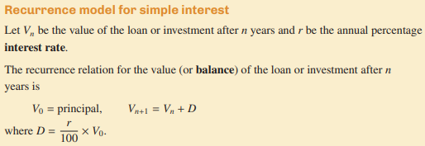
Recurrence Relation for linear growth and decay

Slide 4
Rules for linear growth and decay

Slide 5
Using a rule to determine the value of a simple interest investment 1
The following recurrence relation can be used to model a simple interest investment:
$V_{0}$=3000, $V_{n+1}$= $V_{n}$+260
where $V_{n}$ is the value of the investment after 𝑛 years.
1. What is the principal of the investment? How much interest is added to the investment each year?
2. Write down the rule for the value of the investment after 𝑛 years.
3. Use a rule to find the value of the investment after 15 years.
4. Use a rule to find when the value of the investment first exceeds $10000.
1. Principal: $3000. Amount of interest =$260
2. $V_{n}$=3000+𝑛×260=3000+260𝑛
3. $V_{15}$=3000+260×15=$6900
4. 10000=3000+260n
so 7000=260nor n=7000/260=26.92… years.
The value of the investment will first exceed $10000 after 27 years.

Slide 6
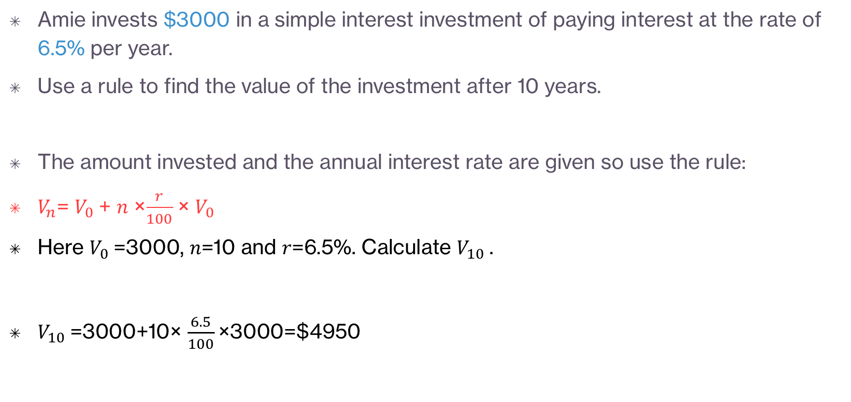
Using a rule to determine the value of a simple interest investment 2
Amie invests $3000 in a simple interest investment of paying interest at the rate of 6.5% per year.
Use a rule to find the value of the investment after 10 years.
The amount invested and the annual interest rate are given so use the rule:
$V_{n}$= $V_{0}$+ 𝑛 ×$\frac{r}{100}$ × $V_{0}$
Here $V_{0}$=3000, 𝑛=10 and 𝑟=6.5%. Calculate $V_{10}$.
$V_{10}$=3000+10× $\frac{6.5}{100}$×3000=$4950

Slide 7
Using a rule for the flat rate of depreciation of an asset
The following recurrence relation can be used to model the flat rate of depreciation of a set of office furniture: $V_{0}$=12000, $V_{n+1}$= $V_{n}$−1200 where $V_{n}$ is the value of the furniture after 𝑛 years.
1. What is the initial value of the furniture? By how much does the furniture decrease in value each year?
2. Write down the rule for the value of the investment after 𝑛 years.
3. Use a rule to find the value of the investment after 6 years.
4. How long does it take for the furniture’s value to decrease to zero?
5. A photocopier in the office costs $6000 when new. Its value depreciates at the flat rate of 17.5%. What is its value after 4 years?
1. Initial value: $12000 Depreciation =$1200
2. $V_{n}$=12000−𝑛×1200=12000−1200𝑛
3. $V_{6}$=12000−1200×6=$4800
4. 0=12000−𝑛×1200 so 𝑛×1200=12000 or 𝑛=10 years
5. $V_{n}$= $V_{0}$−𝑛×$\frac{r}{100}$× $V_{0}$ Here $V_{0}$=6000, 𝑛=4 and 𝑟=17.5%. Calculate $V_{4}$.
$V_{4}$=6000−4× $\frac{17.5}{100}$×6000=$1800

Slide 8
Using a rule to determine the value of an asset with unit-cost depreciation
A hairdryer in a salon was purchased for $850. The value of the hairdryer depreciates by 25 cents for every hour it is in use.
Let $V_{n}$ be the value of the hairdryer after 𝑛 hours of use.
1. Write down a rule to find the value of the hairdryer after 𝑛 hours of use.
2. What is the value of the hairdryer after 50 hours of use?
3. On average, the salon will use the hairdryer for 17 hours each week. How many weeks will it take the value of the hairdryer to halve?
1. $V_{0}$=850 and 𝐷=0.25 $V_{n}$=850−0.25𝑛
2. 𝑛=50 $V_{50}$=850−0.25×50 $V_{50}$=837.50
3. $V_{n}$= $\frac{850}{2}$ = 425 425=850−0.25𝑛
0.25𝑛=850−425=425 𝑛 =1700
Number of weeks = $\frac{1700}{17}$ = 100

