Slide 1
Modelling growth and decay using recursion
Revision
Notes:
https://create.kahoot.it/details/8141be6f-d207-48c0-9173-f15c9ac4c6d8
https://create.kahoot.it/details/ec98ff28-9ba8-475a-b850-0d3d101a24a4
https://create.kahoot.it/details/2172f773-7e4c-4427-a1fc-656e0d47c32d
https://create.kahoot.it/details/a780716d-96ff-46ad-9877-7c46e6904213
https://create.kahoot.it/details/103d3ec5-2e65-442c-a73d-b75da2423a58

Slide 2
Arithmetic vs. Geometric Sequences
Arithmetic Sequences
Increases by the common difference d
Addition or Subtraction
d = $t_{n}$ – $t_{n−1}$
Geometric Sequences
Increases by the common ratio r
Multiplication or Division
r = $\frac{t_{n}}{t_{n−1}}$
Common difference d
=any term $−$ the previous term
=$t_{2}−$ $t_{1}$= $t_{3} − t_{2}$= $t_{4} − t_{3}$
=…

Slide 3
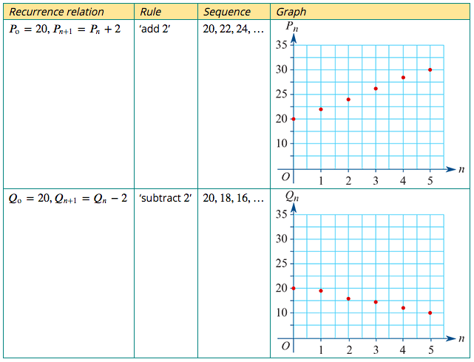
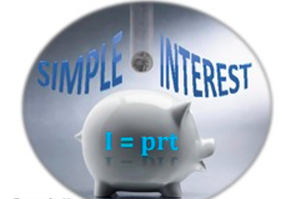
A recurrence model for linear growth and decay
The recurrence relations: $P_{0}$=20, $P_{n+1}$= $P_{n}$+ 2 $Q_{0}$=20, $Q_{n+1}$= $Q_{n}−$ 2
linear growth
Model and investigate simple interest loans and investments, as well as flat rate depreciation and unit cost depreciation of assets
linear decay

Slide 4
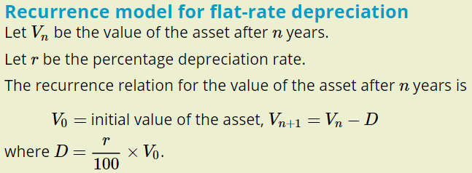
A recurrence model for linear growth and decay

Slide 5
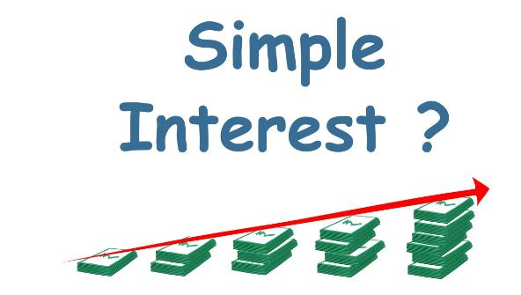
Rules for linear growth and decay
Flat rate/unit-cost depreciation

Slide 6
A recurrence model for reducing balance depreciation
Let $V_{n}$ be the value of the asset after 𝑛 years.
Let 𝑟 be the annual percentage depreciation.
The recurrence model for the value of the investment after 𝑛 years is:
$V_{0}$ = initial value, $V_{n+1}$ =𝑅 $V_{n}$ where 𝑅=1$−\frac{r}{100}$
Compound Interest
Reducing Balance Depreciation

Slide 7
A recurrence model for geometric growth and decay

Slide 8
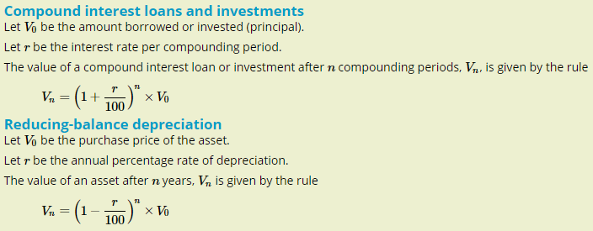
A rules for the nth term in a sequence representing geometric growth or decay

Slide 9
Nominal interest rate
Compound interest rates are usually quoted as annual rates, or interest rate per annum. This rate is called the nominal interest rate for the investment or loan.
The time period after which compound interest is calculated and paid is called the compounding period.

Slide 10
Converting nominal interest rates to compounding interest rates
An investment account will pay interest at the rate of 3.6% per annum. Convert this interest rate to
1. a monthly rate
2. a fortnightly rate
3. a quarterly rate.
1. Monthly interest rate= $\frac{3.6}{12}$=0.3%
2. Fortnightly interest rate= $\frac{3.6}{26}$=0.138% to 3 d.p.
3. Quarterly interest rate= $\frac{3.6}{4}$=0.9%

Slide 11
Effective interest rates

Slide 12
Effective interest rates
The effective interest rate of a loan or investment is the interest earned after one year expressed as a percentage of the amount borrowed or invested.
Let:
𝑟 be the nominal interest rate per annum
$r_{effective}$ be the effective annual interest rate
𝑛 be the number of times the interest compounds each year.
The effective annual interest rate is given by: $r_{effective}$ =(${\text{(1+}\frac{\text{r}\text{/}\text{n}}{100}\text{)}}^{n}$−1)×100%
Investment will need higher effective rate to gain more interests.
Loan will need lower effective rate to pay less interests.

Slide 13
Key vocabularies
A sequence is a list of numbers or symbols written in succession, for example: 5, 15, 25, …
Each number or symbol that makes up a sequence is called a term.
Recurrence relation: A relation that enables the value of the next term in a sequence to be obtained by one or more current terms. Examples include ‘to find the next term, add two to the current term’ and ‘to find the next term, multiply the current term by three and subtract five’.
Modelling is the use of a mathematical rule or formula to represent or model real-life situations. Recurrence relations can be used to model situations involving the growth (increase) or decay (decrease) in values of a quantity.
Percentage growth and decay
If a quantity grows by 𝑟% each year, then 𝑅=1+$\frac{r}{100}$.
If a quantity decays by 𝑟% each year, then 𝑅=1− $\frac{r}{100}$.
The principal is the initial amount that is invested or borrowed.
The balance is the value of a loan or investment at any time during the loan or investment period.
The fee that is added to a loan or the payment for investing money is called the interest.

Slide 14
Linear growth and decay
Simple interest
Simple interest is a fixed amount of interest that is paid at regular time intervals. Simple interest is an example of linear growth.
Depreciation
Depreciation is the amount by which the value of an item decreases after a period of time.
Scrap value
Scrap value is the value of an item at which it is ‘written off’ or is considered no longer useful or usable.
Flat-rate depreciation
Flat-rate depreciation is a constant amount that is subtracted from the value of an item at regular time intervals. It is an example of linear decay.
Unit-cost depreciation
Unit-cost depreciation is depreciation that is calculated based on units of use rather than time. Unit-cost depreciation is an example of linear decay.

Slide 15
Geometric growth and decay
Compounding period: Interest rates are usually quoted as annual rates (per annum). Interest is sometimes calculated more regularly than once a year, for example each quarter, month, fortnight, week or day. The time period for the calculation of interest is called the compounding period.
Compound interest: When interest is added to a loan or investment and then contributes to earning more interest, the interest is said to compound. Compound interest is an example of geometric growth.
Reducing-balance depreciation: When the value of an item decreases as a percentage of its value after each time period, it is said to be depreciating using a reducing-balance method. Reducing-balance depreciation is an example of geometric decay.
Nominal interest rate: A nominal interest rate is an annual interest rate for a loan or investment.
Effective interest rate: The effective interest rate is the interest earned or charged by an investment or loan, written as a percentage of the original amount invested or borrowed. Effective interest rates allow loans or investments with different compounding periods to be compared. Effective interest rates can be calculated using the rule $r_{effective}$ =(${\text{(1+}\frac{\text{r}\text{/}\text{n}}{100}\text{)}}^{n}$−1)×100%
where 𝑟 is the nominal interest rate and 𝑛 is the number of compounding periods in 1 year.

Slide 16
Skill check
understand the concept of a first-order linear recurrence relation and its use in generating the terms in a sequence
use a given first-order recurrence relation to generate the terms in a sequence
understand the concepts of simple and compound interest
use a recurrence relation to model compound interest investments and loans, and the flat-rate, unit-cost and reducing-balance methods for depreciating of assets
understand the concepts nominal and effective interest rates as they apply to compound interest investments and loans
use a rule for the future value of a compound interest investment or loan, or a depreciating asset, to solve practical problems.

