Slide 1
Analysing financial situations using amortisation tables
8D

Slide 2
Learning intentions
To be able to find the final payment in a reducing balance loan and an annuity.
To be able to find the total payment made/received and the total interest paid/earned.
To be able to plot points using an amortisation table for a reducing balance loan, an annuity and a compound interest investment with additional payments.

Slide 3
Finding the final payment in a reducing balance loan and an annuity → reach zero
8932.63=
4294.51+4638.12
5 |  | 371.05 | 4638.12 | 0

Slide 4
Finding the total payment made and total interest paid

Slide 5
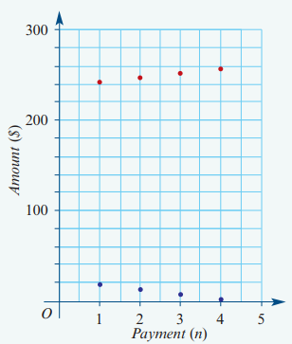
Plotting points from an amortisation table
Principal Reduction
Interest Paid

