Slide 1

Interest-only loans
8H

Slide 2
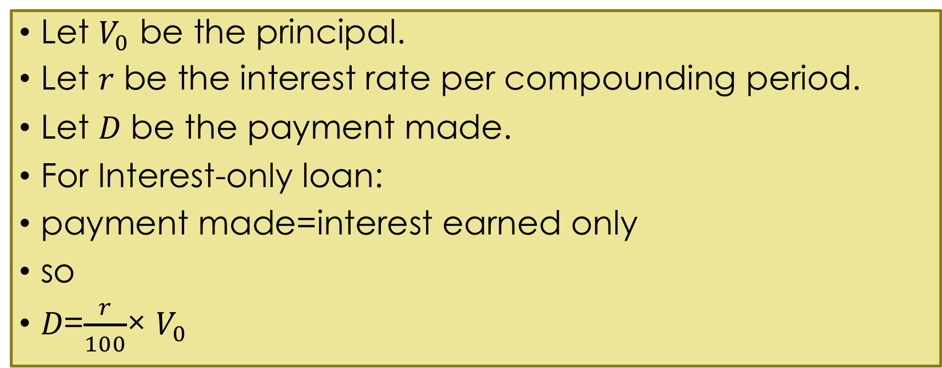
Interest-only loan
Let $V_{0}$ be the principal.
Let 𝑟 be the interest rate per compounding period.
Let 𝐷 be the payment made.
For Interest-only loan:
payment made=interest earned only
so
𝐷=$\frac{r}{100}$× $V_{0}$

Slide 3
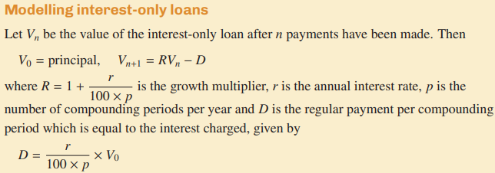

Slide 4
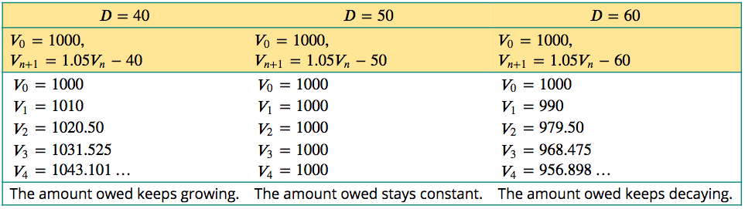
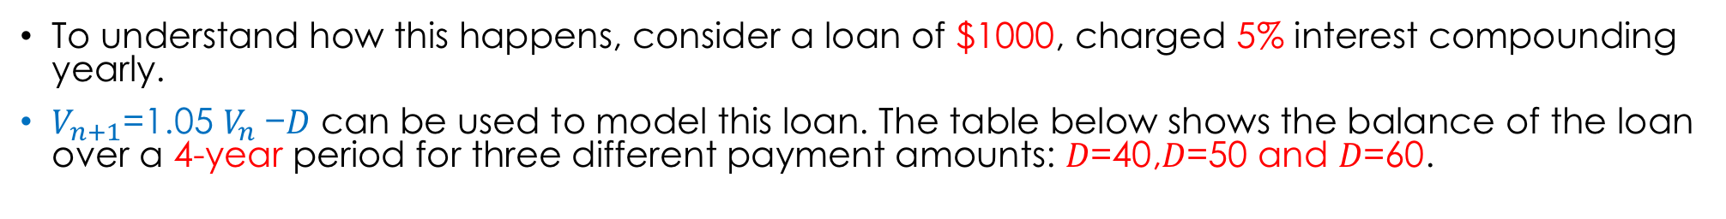
Interest-only loan
To understand how this happens, consider a loan of $1000, charged 5% interest compounding yearly.
$V_{n+1}$=1.05 $V_{n}$−𝐷 can be used to model this loan. The table below shows the balance of the loan over a 4-year period for three different payment amounts: 𝐷=40,𝐷=50 and 𝐷=60.

Slide 5
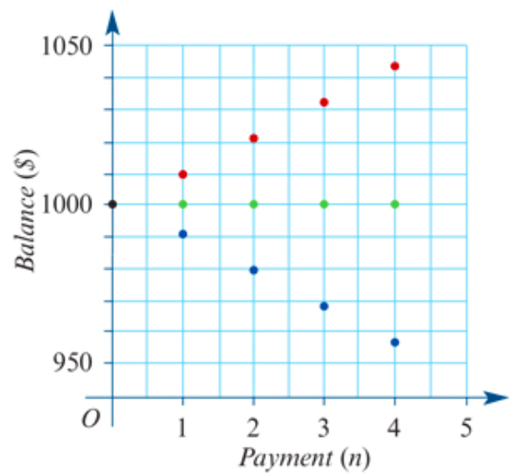

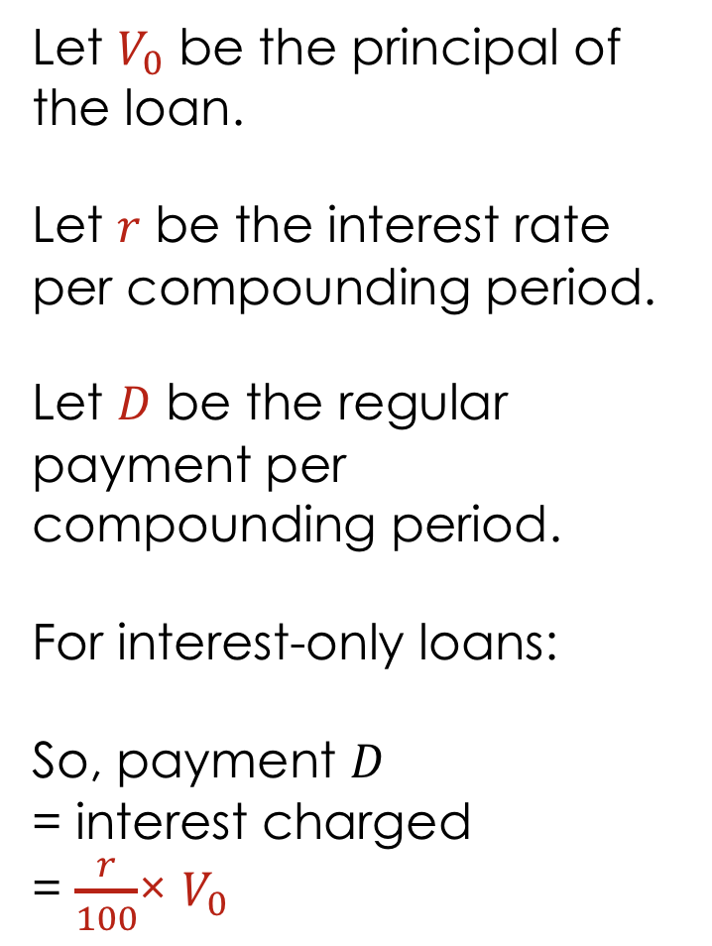


Interest-only loan
Let $V_{0}$ be the principal of the loan.
Let 𝑟 be the interest rate per compounding period.
Let 𝐷 be the regular payment per compounding period.
For interest-only loans:
So, payment 𝐷
= interest charged
= $\frac{r}{100}$× $V_{0}$
$V_{n+1}$=1.05 $V_{n}$−𝐷 𝐷=40
$V_{n+1}$=1.05 $V_{n}$−𝐷 𝐷=50
$V_{n+1}$=1.05 $V_{n}$−𝐷 𝐷=60

Slide 6
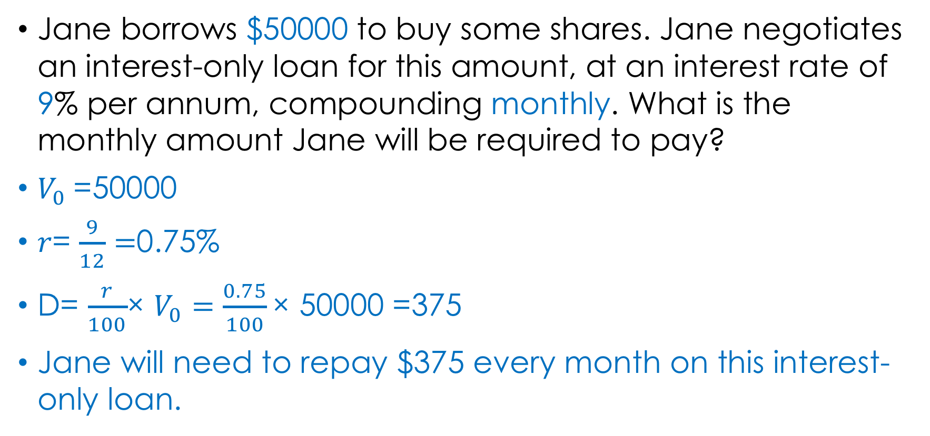
Repaying an interest-only loan
Jane borrows $50000 to buy some shares. Jane negotiates an interest-only loan for this amount, at an interest rate of 9% per annum, compounding monthly. What is the monthly amount Jane will be required to pay?
$V_{0}$=50000
𝑟= $\frac{9}{12}=$0.75%
D= $\frac{r}{100}$× $V_{0}=\frac{0.75}{100}\text{× }\text{50000 }$=375
Jane will need to repay $375 every month on this interest-only loan.

Slide 7
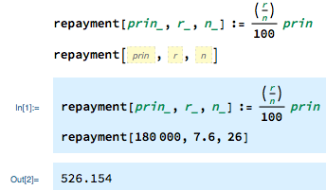
Repaying an interest-only loan using a financial calculator
Stuart borrows $180000 to buy a house. He negotiates an interest-only loan for this amount, at an interest rate of 7.6% per annum, compounding fortnightly. What is the fortnightly payment, correct to the nearest cent?
Stuart will need to repay $526.15 every fortnight.

Slide 8
