Slide 1
Using matrices to represent information
10B

Slide 2
Where to use Matrices?
To store numerical information in a data table.
To carry codes that encrypt credit-card numbers for internet transmission.
To carry all the information needed to solve sets of simultaneous equations.
To represent network diagrams.

Slide 3
Using a matrix to represent data tables
The numerical information in a data table is frequently presented in rows and columns. As such, it is relatively straight forward process to convert this information into matrix form.

Slide 4
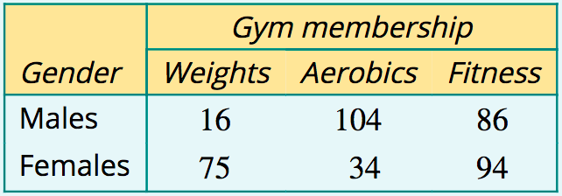
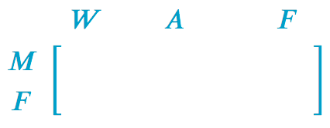
Representing information in a table by a matrix
The table below shows the three types of membership of a local gym and the number of males and females enrolled in each. Construct a matrix to display the numerical information in the table.

Slide 5
Entering a credit card number into a matrix
Convert the 16-digit credit card number: 4454817810293161 into a 2×8 matrix, listing the digits in pairs, one under the other. Ignore the spaces.

Slide 6
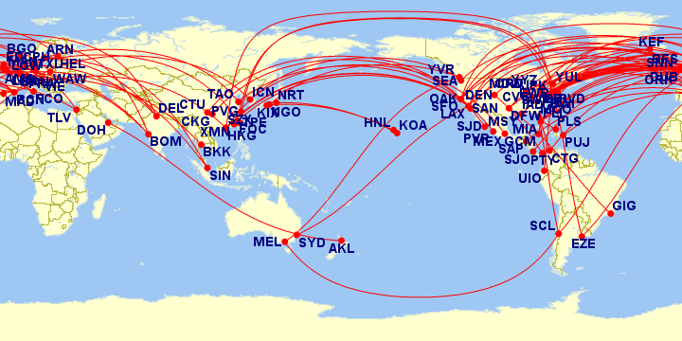
Using matrices to represent network diagrams
Network diagrams consist of a series of numbered or labelled points joined in various ways. They are a powerful way of representing and studying things as different as friendship networks, airline routes, electrical circuits and road links between towns.

Slide 7
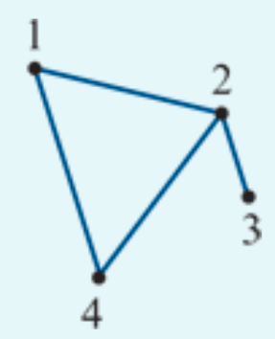
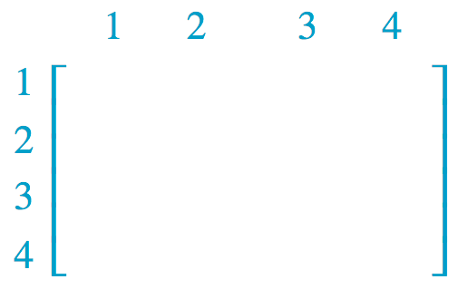
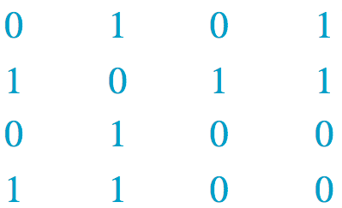
Representing a network diagram by a matrix
Represent the network diagram shown opposite as a 4×4 matrix 𝐴, where:
matrix element =1 if the two points are joined by a line
matrix element =0 if the two points are not connected.

Slide 8
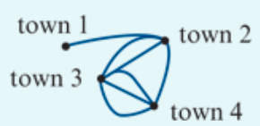
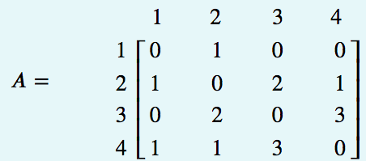
Interpreting a matrix representing a network diagram
The diagram opposite shows the roads connecting four towns: town 1, town 2, town 3, and town 4. This diagram has been represented by a 4×4 matrix, 𝐴. The elements show the number of roads between each pair of towns.
1. In the matrix A, $a_{24}$=1. What does this tell us?
2. In the matrix A, $a_{34}$=3. What does this tell us?
3. In the matrix A, $a_{41}$=0. What does this tell us?
4. What is the sum of the elements in row 3 of matrix A and what does this tell us?
5. What is the sum of all the elements of matrix A and what does this tell us?
1. 1 road between town 2 & 4;
2. 3 road between town 3 & 4;
3. 0 road between town 4 & 1;
4. total 5 roads between town 3 & others;
5. total 14 roads you can travel between towns.

