Slide 1
Chapter 11 Assignment Name

Slide 5


Slide 6
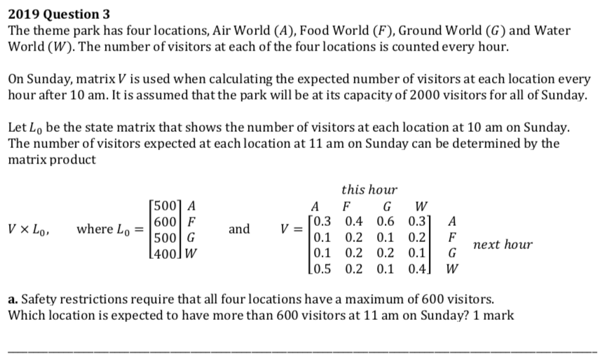

Slide 8


Slide 9
