Slide 1
Transition matrices and their applications
12C

Slide 2
Setting up a transition matrix
A car rental firm has two branches: one in Bendigo and one in Colac. Cars are usually rented and returned in the same town. However, a small percentage of cars rented in Bendigo each week are returned in Colac, and vice versa. The diagram below describes what happens on a weekly basis.

Slide 3
Setting up a transition matrix
What does this diagram tell us?
From week to week:
0.8 (or 80%) of cars rented each week in Bendigo are returned to Bendigo
0.2 (or 20%) of cars rented each week in Bendigo are returned to Colac
0.1 (or 10%) of cars rented each week in Colac are returned to Bendigo
0.9 (or 90%) of cars rented each week in Colac are returned to Colac.

Slide 4
A transition matrix
The percentages (written as proportions) are summarised in the form of the matrix below.
This matrix is an example of a transition matrix (T). It describes the way in which transitions are made between two states:
state 1: the rental car is based in Bendigo.
state 2: the rental car is based in Colac.
Note: In this situation, where the total number of cars remains constant, the columns in a transitional matrix will always add to one (100%). For example, if 80% of cars are returned to Bendigo, then 20% must be returned to Colac.

Slide 5
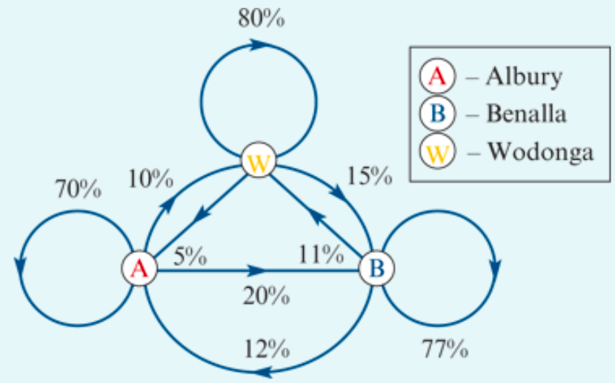
Setting up a transition matrix
The diagram gives the weekly return rates of rental cars at three locations: Albury, Wodonga and Benalla. Construct a transition matrix that describes the week-by-week return rates at each of the three locations. Convert the percentages to proportions.

Slide 6
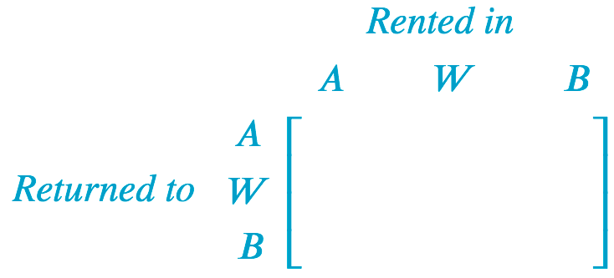
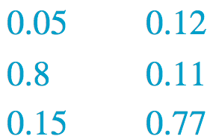
Setting up a transition matrix
Mentally check your answer by summing columns; they should sum to 1.

Slide 7
Setting up a transition matrix
A factory has a large number of machines. Machines can be in one of two states: operating or broken. Broken machines are repaired and come back into operation, and vice versa. On a given day:
85% of machines that are operational stay operating
15% of machines that are operating break down
5% of machines that are broken are repaired and start operating again
95% of machines that are broken stay broken.
Construct a transition matrix to describe this situation. Use the columns to define the situation at the ‘Start’ of the day and the rows to describe the situation at the ‘End’ of the day.

Slide 8
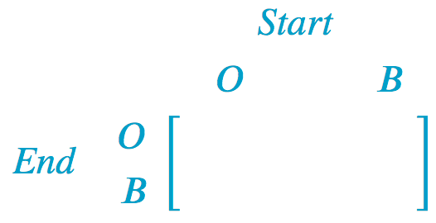
Setting up a transition matrix
85% of machines that are operational stay operating
15% of machines that are operating break down
5% of machines that are broken are repaired and start operating again
95% of machines that are broken stay broken.

Slide 9
Interpreting transition matrices
Using this information alone, a number of predictions can be made.
For example, if 50 cars are rented in Bendigo this week, the transition matrix predicts that:
80% or 40 of these cars will be returned to Bendigo next week (0.80×50=40)
20% or 10 of these cars will be returned to Colac next week (0.20×50=10).
Further, if 40 cars are rented in Colac this week, the transition matrix predicts that:
10% or 4 of these cars will be returned to Bendigo next week (0.10×40=4)
90% or 36 of these cars will be returned to Colac next week (0.90×40=36).

Slide 10
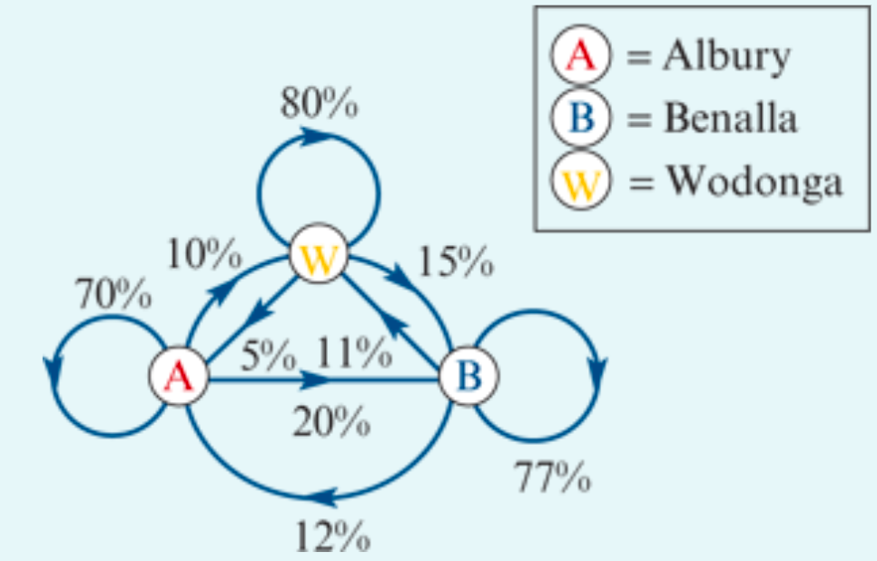
Interpreting a transition matrix
$1.$What percentage of cars rented in Wodonga each week are predicted to be returned to:
Albury?
Benalla?
Wodonga?
2. Two hundred cars were rented in Albury this week. How many of these cars do we expect to be returned to:
Albury?
Benalla?
Wodonga?
3. What percentage of cars rented in Benalla each week are not expected to be returned to Benalla?
4. One hundred and sixty cars were rented in Albury this week. How many of these cars are expected to be returned to either Benalla or Wodonga?
Solution
0.5 or 5%
0.15 or 15%
0.80 or 80%
0.70×200=140 cars
0.20×200=40 cars
0.10×200=20 cars
11+12=23% or 100−77=23%
20% of 160+10% of 160=48cars
Q’s

