Slide 1
Leslie matrices
11E

Slide 2
Leslie matrices
A type of transition matrix, designed specifically to model the change in age distribution over time for an animal population.

Slide 3
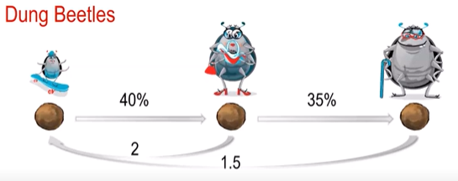
Dung beetles
The typical life span of a dung beetle is 3 years.
Juveniles have a 40% survival rate.
Adults have a 35% survival rate & reproduction factor of 2.
Seniors have a 0% survival rate & reproduction factor of 1.5.

Slide 4
Year 0
$$J_{0}=Initial Juniors$$
$$A_{0}=Initial Adults$$
$$S_{0}=Initial Seniors$$
Year 1
$$J_{1}=0×J_{0}+2{×A_{0}+1.5×S}_{0}$$
$$A_{1}=0.4×J_{0}+0{×A_{0}+0×S}_{0}$$
$$S_{1}=0×J_{0}+0.35{×A_{0}+0×S}_{0}$$

Slide 5
Year 1
$$J_{0}=Current Juniors$$
$$A_{0}=CurrentAdults$$
$$S_{0}=CurrentSeniors$$
Year 2
$$J_{2}=0×J_{1}+2{×A_{1}+1.5×S}_{1}$$
$$A_{2}=0.4×J_{1}+0{×A_{1}+0×S}_{1}$$
$$S_{2}=0×J_{1}+0.35{×A_{1}+0×S}_{1}$$

Slide 6
Leslie matrices→ L
$\left[\begin{matrix}0 & 2 & 1.5 \\ 0.4 & 0 & 0 \\ 0 & 0.35 & 0\end{matrix}\right] \left[\begin{matrix}\begin{aligned}J_{0} \\ A_{0}\end{aligned} \\ S_{0}\end{matrix}\right]$= $\left[\begin{matrix}\begin{aligned}J_{1} \\ A_{1}\end{aligned} \\ S_{1}\end{matrix}\right]$

Slide 7
Leslie matrices→ L
${\left[\begin{matrix}0 & 2 & 1.5 \\ 0.4 & 0 & 0 \\ 0 & 0.35 & 0\end{matrix}\right]}^{n} \left[\begin{matrix}\begin{aligned}J_{0} \\ A_{0}\end{aligned} \\ S_{0}\end{matrix}\right]$= $\left[\begin{matrix}\begin{aligned}J_{n} \\ A_{n}\end{aligned} \\ S_{n}\end{matrix}\right]$

Slide 8
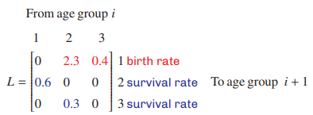
Life cycle transition diagram

Slide 9
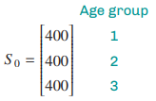
The population state matrix→ column matrix
The initial population state matrix → $S_{0}$

Slide 10
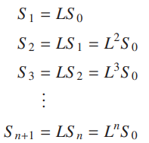
Finding the population matrix $S_{n}$ after n time periods.

Slide 11
Population Change

Slide 12
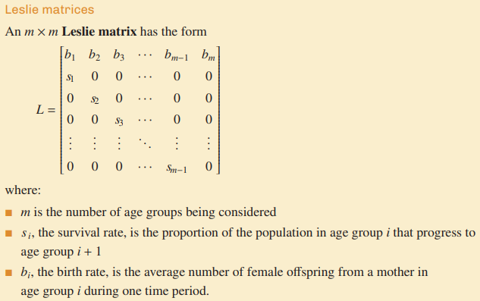
Leslie matrices

Slide 16
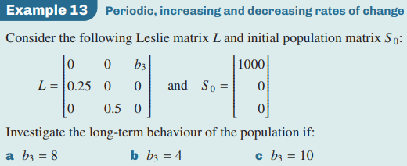

Slide 18
Notes:
https://www.youtube.com/watch?v=iR5E4iKCRe8
https://www.youtube.com/watch?v=Q1zbgd6xpGQ

