Slide 1
Weighted graphs, networks and the shortest path problem
13D
Notes:
Need easy way

Slide 2
Learning Intentions
Weighted Graphs
The shortest paths
Dijkstra’s Algorithm
Finding Hamilton Cycles

Slide 3
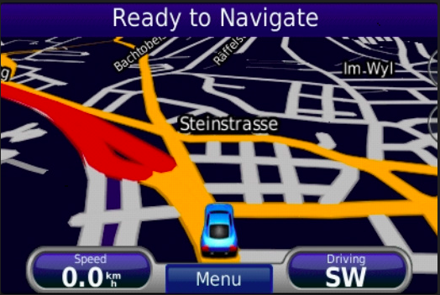
Real life Application
Geographical Maps.
IP routing to find Open shortest Path First.
Telephone network.

Slide 4
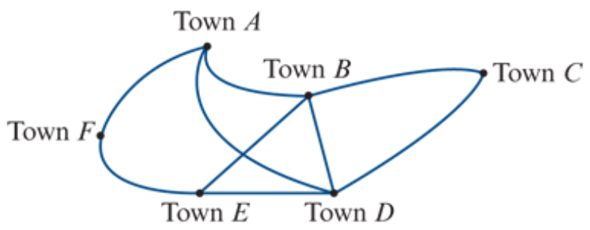
Weighted graphs and networks
A weighted graph is a graph where a number is associated with each edge. These numbers are called weights.
A network is a weighted graph in which the weights are physical quantities, for example, distance, time, cost.

Slide 5
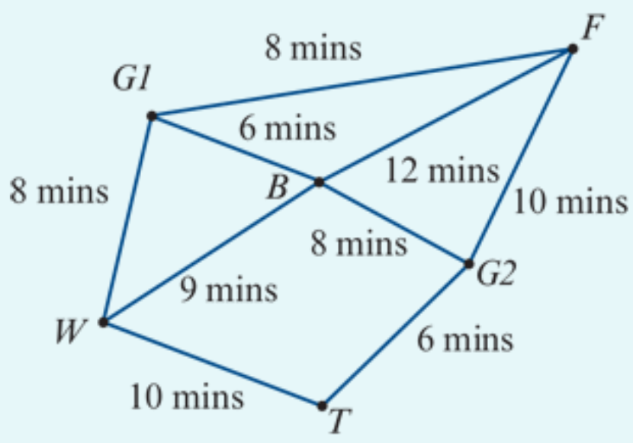
Interpreting a network
The network opposite is used to model the tracks in a forest connecting a suspension bridge (𝐵), a waterfall (𝑊), a very old tree (𝑇) and a fern gully (𝐹).
Walkers can enter or leave the forest through either Gate 1 (𝐺1) or Gate 2 (𝐺2).
The numbers on the edges represent the times (in minutes) taken to walk directly between these places.
a. How long does it take to walk from the bridge directly to the fern gully?
b. How long does it take to walk from the old tree to the fern gully via the waterfall and the bridge?
a. The edge is 𝐵-𝐹. The time taken is 12 minutes.
b. The path is 𝑇-𝑊-𝐵-𝐹. The time taken is 10+9+12=31 minutes.

Slide 6
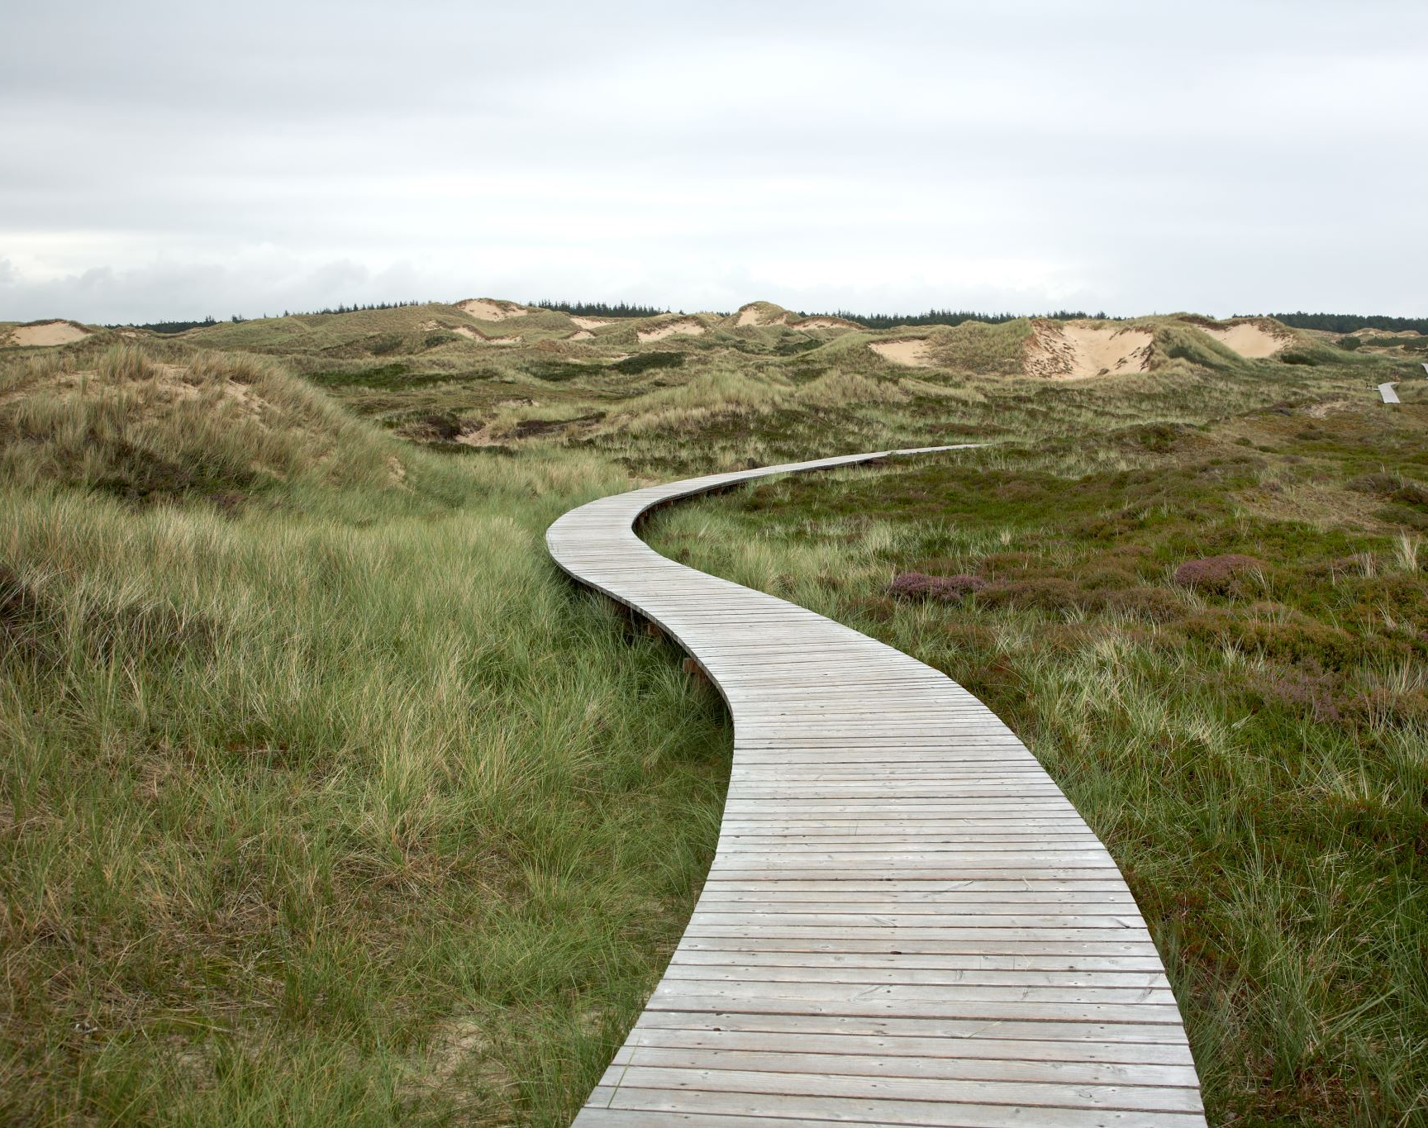
The shortest path problem
Determining the shortest distance or time or the least cost to move around a network is called the shortest path problem.

Slide 7
Finding the shortest path by inspection
Find the shortest route between Town 𝐶 and Town 𝐹 in the previous network opposite.
𝐶-𝐷-𝐸-𝐹: The distance is 6+9+7=22 km. 𝐶-𝐵-𝐸-𝐹: The distance is 5+4+7=16 km. 𝐶-𝐵-𝐴-𝐹: The distance is 5+7+6=18 km.
The shortest path is 𝐶-𝐵-𝐸-𝐹.
Notes:
https://www.youtube.com/watch?v=wtdtkJgcYUM
https://www.youtube.com/watch?v=pVfj6mxhdMw

Slide 8
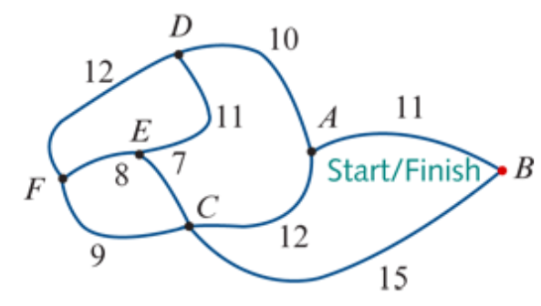
Finding Hamilton Cycle
A
C
B
D
C
A
E
F
E
F
F
B
E
A
D
F
F
D
F
E
C
D
E
A
F
D
C
A
B
D
C
A-D-E-F-C-B-A
A-B-C-F-E-D-A
A-D-F-E-C-B-A
A-B-C-E-F-D-A
B
A
A
A
E
D
D
E
C
A
B
A
F
A
A
E
D
A
B
A
A
A
A

