Slide 1
Dijkstra’s algorithm
13E
Notes:
Need easy way

Slide 2
Learning Intentions
Weighted Graphs
The shortest paths
Dijkstra’s Algorithm
Finding Hamilton Cycles

Slide 3
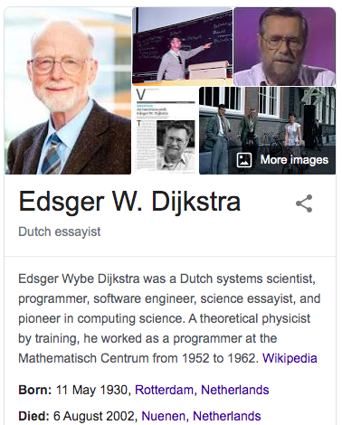
Finding the shortest path by Dijkstra’s Algorithm

Slide 4
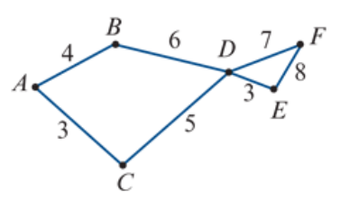
Finding the shortest path by Dijkstra’s Algorithm
Find the shortest path from vertex 𝐴 to vertex 𝐸 in this network. The numbers represent time in hours.
$${10}^{B}$$
$$4^{A}$$
$${15}^{D}$$
$${19}^{E}$$
From Starting vertex.
The shortest edge first.
Write distance from the starting vertex.
Label the last vertex passing by.
Cover all edges from this vertex.
Find the next shortest distance vertex to start over again.
Until all vertices and edges covered.
$$8^{C}$$
0
$${11}^{D}$$
3+5+3=11 Hours
$$3^{A}$$
$${Weights from starting vertex}^{the last passing by vertex}$$

Slide 5
Finding the shortest path by Dijkstra’s Algorithm
Find the shortest path from vertex 𝐴 to vertex 𝐸 in this network. The numbers represent time in hours.
 | B | C | D | E | F
A | 4 | 3
C |  | 3 | 8
B | 4
D |  |  | 8 | 11 | 15
E |  |  |  | 11
 | B | C
A | 4 | 3
C |  | 3
 | B | C | D | E | F
A | 4 | 3
C |  | 3 | 8
B | 4
D |  |  | 8 | 11 | 15
E |  |  |  | 11
F |  |  |  |  | 15
 | B | C | D
A | 4 | 3
C |  | 3 | 8
 | B | C
A | 4 | 3
 | B | C | D
A | 4 | 3
C |  | 3 | 8
B | 4 |  | 10
 | B | C | D | E | F
A | 4 | 3
C |  | 3 | 8
B | 4
D |  |  | 8 | 11 | 15
A
C
D
E
 | B | C | D
A | 4 | 3
C |  | 3 | 8
B | 4
D |  |  | 8
3+5+3=11 Hours

Slide 6
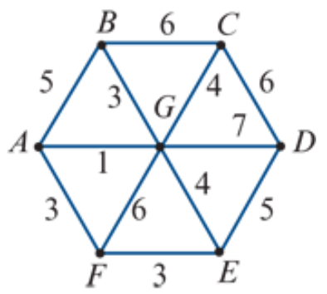
Finding the shortest path by Dijkstra’s Algorithm
Find the shortest path from vertex 𝐵 to vertex 𝐹 in this network. The numbers represent time in minutes.
0
$$6^{B}$$
$$7^{G}$$
From Starting vertex.
The shortest edge first.
Write distance from the starting vertex.
Label the last vertex passing by.
Cover all edges from this vertex.
Find the next shortest distance vertex to start over again.
Until all vertices and edges covered.
$${12}^{E}$$
$$4^{G}$$
$$5^{B}$$
$$3^{B}$$
$${10}^{G}$$
$${12}^{C}$$
3+1+3=7 minutes
$$7^{A}$$
$$9^{G}$$
$${10}^{F}$$
$$7^{G}$$
$${Weights from starting vertex}^{the last passing by vertex}$$

Slide 7
Finding the shortest path by Dijkstra’s Algorithm
Find the shortest path from vertex 𝐵 to vertex 𝐹 in this network. The numbers represent time in minutes.
 | A | G | C | D | E | F
B | 5 | 3 | 6
G | 4 | 3 |  | 10 | 7
A | 4 |  |  |  |  | 7
C |  |  | 6 | 10
F |  |  |  |  |  | 7
E |  |  |  |  | 7
 | A | G | C | D | E | F
B | 5 | 3 | 6
G | 4 | 3 | 7 | 10 | 7 | 9
A | 4 |  |  |  |  | 7
 | A | G | C
B | 5 | 3 | 6
 | A | G | C | D | E | F
B | 5 | 3 | 6
G | 4 | 3 |  | 10 | 7
A | 4 |  |  |  |  | 7
C |  |  | 6 | 10
F |  |  |  |  |  | 7
 | A | G | C
B | 5 | 3 | 6
G |  | 3
 | A | G | C | D | E | F
B | 5 | 3 | 6
G | 4 | 3 | 7 | 10 | 7 | 9
A | 4 |  |  |  |  | 7
C |  |  | 6 | 10
 | A | G | C | D | E | F
B | 5 | 3 | 6
G | 4 | 3 |  | 10 | 7
A | 4 |  |  |  |  | 7
C |  |  | 6 | 10
F |  |  |  |  |  | 7
E |  |  |  |  | 7
D |  |  |  | 10
 | A | G | C | D | E | F
B | 5 | 3 | 6
G | 4 | 3 | 7 | 10 | 7 | 9
3+1+3=7 minutes

