Slide 1
Graphs, networks and trees travelling and connecting problems
14
Notes:
https://quizizz.com/admin/quiz/5d29ab46ef3809001aa5f880/year-12-further-maths-chapter-14-test-1-networks?source=HeroSearchBar&page=FeaturedPage&searchLocale=&fromSearch=true

Slide 4
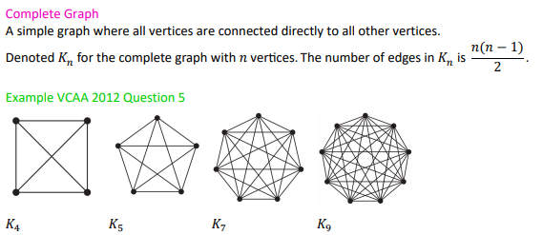
Types of graphs

Slide 5
Types of graphs

Slide 6
Types of graphs

Slide 7
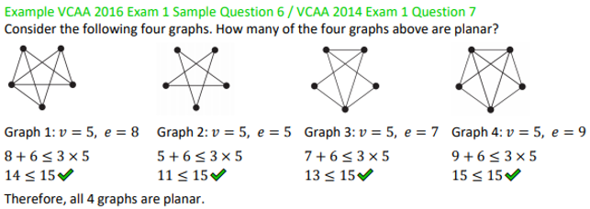
Types of graphs

Slide 8
Travelling in graphs: Trail Circuit Path cycle

Slide 9
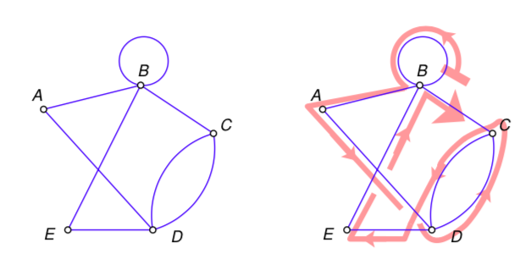
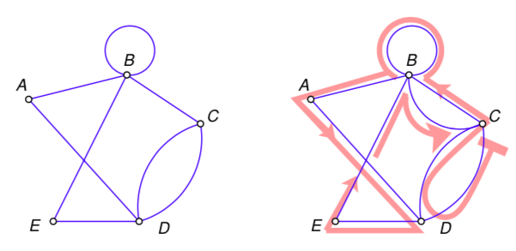
Eulerian trails and circuits
Eulerian trails – Is a trail in which every edge is visited once. Vertices can be repeated.
A Eulerian trail will only exist if:
- The graph is connected
- The graph has exactly two vertices of an odd degree
Eulerian circuit – Is a Eulerian trail (travels every edge once) that begins and ends from the same vertex.
A Eulerian circuit will only exist if:
- The graph is connected
- All the vertices have an even degree

Slide 10
Tree
A connected graph that contains no cycles, multiple edges or loops. A tree may be part of a larger graph.

Slide 11
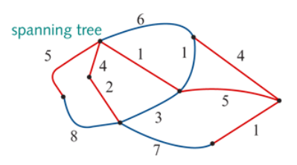
Minimum spanning tree
A minimum spanning tree = the spanning tree of minimum length (may be minimum distance, minimum time, minimum cost, etc.). There may be more than one minimum spanning tree in a weighted graph.
For weighted graphs or networks, it is possible to determine the ‘length’ of each spanning tree by adding up the weights of the edges in the tree.
For the spanning tree shown here:
Length=5+4+2+1+5+4+1=22 units

Slide 12
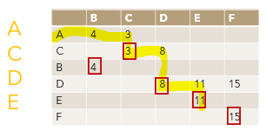
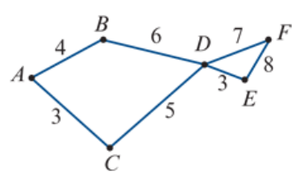
Finding the shortest path by Inspection
Find the shortest path from vertex 𝐴 to vertex 𝐸 in this network. The numbers represent time in hours.
$${10}^{B}$$
$$8^{C}$$
0
$${11}^{D}$$
3+5+3=11 Hours
$$3^{A}$$

Slide 13
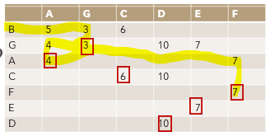
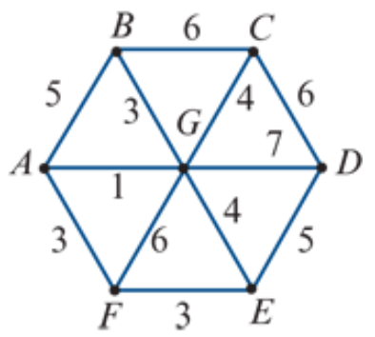
Finding the shortest path by Inspection
Find the shortest path from vertex 𝐵 to vertex 𝐹 in this network. The numbers represent time in minutes.
0
$$4^{G}$$
$$5^{B}$$
$$3^{B}$$
3+1+3=7 minutes
$$7^{A}$$

