Slide 1
Precedence tables and activity networks
15C

Slide 2
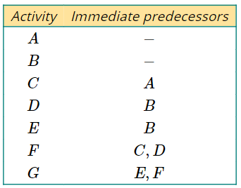
Drawing activity networks from precedence tables
When activity A must be completed before activity B can begin, activity A is called an immediate predecessor of activity B.
A table containing the activities of a project, and their immediate predecessors, is called a precedence table.

Slide 3
Drawing activity networks from precedence tables
An activity network can be drawn from a precedence table. Activity networks have edges representing activities. The vertices are not labelled, other than the start and finish vertices.

Slide 4
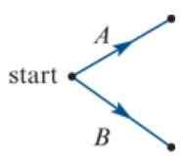
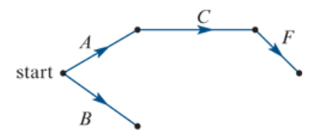
Drawing activity networks from precedence tables
Activities A and B have no immediate predecessors.
These activities can start immediately and can be completed at the same time.

Slide 5
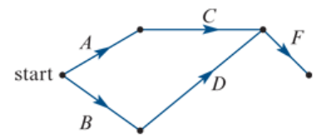
Drawing activity networks from precedence tables
Activities A and B have no immediate predecessors.
These activities can start immediately and can be completed at the same time.

Slide 6
Drawing activity networks from precedence tables
Activity E has immediate predecessor activity B so it will follows immediately after activity B.
Activity G has immediate predecessor activity F and activity E and so it must follow immediately after both of these activities.
Activity G is not an immediate predecessor for any activity and so the project is finished after this activity is complete.

Slide 7
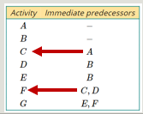
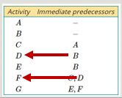
Drawing activity networks from precedence tables

Slide 8
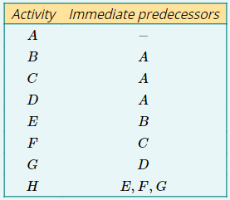
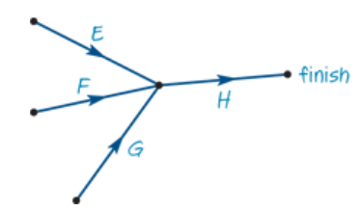
Drawing an activity network from a precedence table.
H is not an immediate predecessor for any other activity so it will lead to the finish of the project.
H has immediate predecessors E, F and G and so these three activities will lead into activity H.

Slide 9
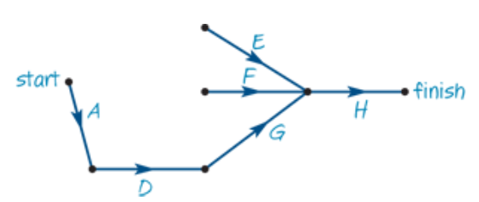
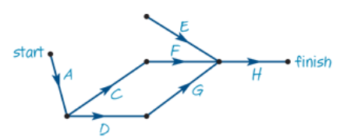
Drawing an activity network from a precedence table.
Activity D is an immediate predecessor of activity G and has immediate predecessor activity A. There will be a path through activity A, activity D and then activity G.
Activity C is an immediate predecessor of activity F and has immediate predecessor activity A. There will be a path through activity A, activity C and then activity F.

Slide 10
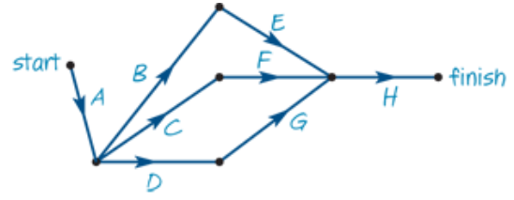
Drawing an activity network from a precedence table.
Activity B is an immediate predecessor of activity E and has immediate predecessor activity A. There will be a path through activity A, activity B and then activity E.
Activity A has no immediate predecessors, so it is the start of the project.

Slide 11
Sketching activity networks
Activities that have no immediate predecessors follow from the start vertex.
Activities that are not immediate predecessors for other activities lead to the finish vertex.
For every other activity, look for:
which activities for which it is an immediate predecessor
which activities it has as immediate predecessors.
Construct the activity network from this information.

Slide 12
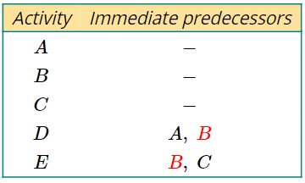
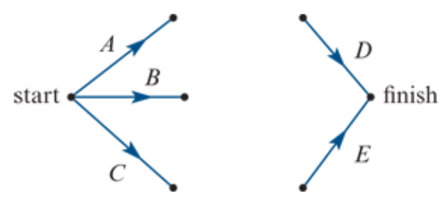
Dummy activities
A dummy activity is required if two activities share some, but not all, of their immediate predecessors.
A dummy activity will be required from the end of each shared immediate predecessor to the start of the activity that has additional immediate predecessors.
Dummy activities are represented in the activity network using dotted lines.

Slide 13
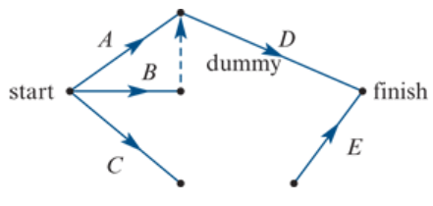
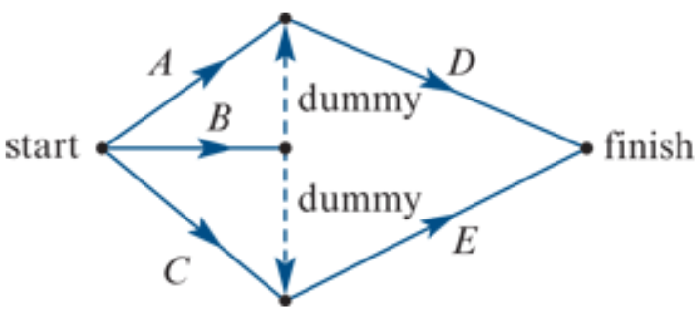
Dummy activities

Slide 14
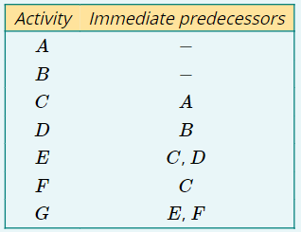
Using a dummy activity in an activity network

Slide 15
Creating a precedence table from an activity network
Activity | Immediate predecessors
A | —
B | A
C | A
D | B
E | C
F | C, D
G | D, C
H | F, E
I | G
J | H, G

