Slide 1
Networks SAC
Revision
Notes:
https://create.kahoot.it/details/b3d27fca-1cf8-4bc9-8d37-a8bbf55ec336
https://create.kahoot.it/details/8d22d12b-3fc9-4902-a0cb-1ed99f497f62
https://create.kahoot.it/details/a987e5d2-8af8-421e-8900-f1af3a57039b
https://create.kahoot.it/details/21b32189-9e7a-4371-b16f-0ba89f71b842
https://create.kahoot.it/details/7ded37a0-6917-4d12-9102-501ab2cc6037

Slide 2
SAC Compulsory booklet questions
Part A
14B Q5, 14C Q3, Q4, 14D Q10, Q11, 14E Q2, 15A Q3, Q5.
Part B
15B Q3, Q5, 15C Q3d, 15D Q6, 15E Q1, Q2, Q3.

Slide 7
Hamiltonian paths and cycles
A Hamiltonian path passes through every vertex in a connected graph. It may or may or may not involve all of the edges in the graph.
A Hamiltonian cycle is a Hamiltonian path that starts and finishes at the same vertex.

Slide 8
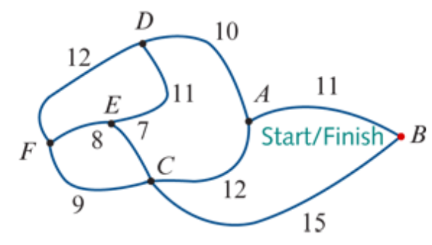
Finding Hamilton Cycle
A
C
B
D
C
A
E
F
E
F
F
B
E
A
D
F
F
D
F
E
C
D
E
A
F
D
C
A
B
D
C
A-D-E-F-C-B-A
A-B-C-F-E-D-A
A-D-F-E-C-B-A
A-B-C-E-F-D-A
B
A
A
A
E
D
D
E
C
A
B
A
F
A
A
E
D
A
B
A
A
A
A

Slide 9
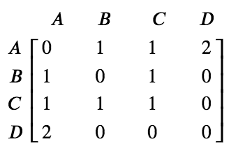
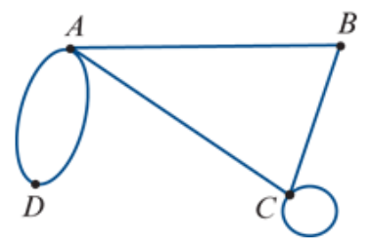
Adjacency matrices
An adjacency matrix is a square matrix that uses a zero or an integer to record the number of edges connecting each pair of vertices in the graph.
0
1
2
$$e_{1}$$
$$e_{2}$$
1

Slide 10
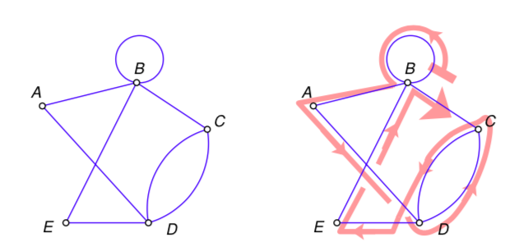
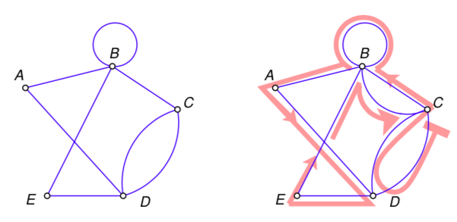
Eulerian trails and circuits
Eulerian trails – Is a trail in which every edge is visited once. Vertices can be repeated.
A Eulerian trail will only exist if:
- The graph is connected
- The graph has exactly two vertices of an odd degree
Eulerian circuit – Is a Eulerian trail (travels every edge once) that begins and ends from the same vertex.
A Eulerian circuit will only exist if:
- The graph is connected
- All the vertices have an even degree

Slide 11
Tree
A connected graph that contains no cycles, multiple edges or loops. A tree may be part of a larger graph.

Slide 12
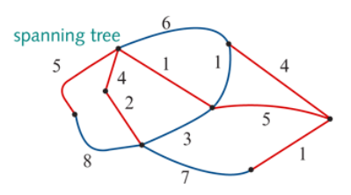
Minimum spanning tree
A minimum spanning tree = the spanning tree of minimum length (may be minimum distance, minimum time, minimum cost, etc.). There may be more than one minimum spanning tree in a weighted graph.
For weighted graphs or networks, it is possible to determine the ‘length’ of each spanning tree by adding up the weights of the edges in the tree.
For the spanning tree shown here:
Length=5+4+2+1+5+4+1=22 units

Slide 13
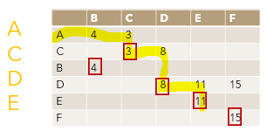
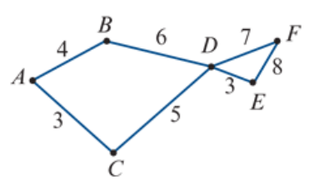
Finding the shortest path by Inspection
Find the shortest path from vertex 𝐴 to vertex 𝐸 in this network. The numbers represent time in hours.
$${10}^{B}$$
$$8^{C}$$
0
$${11}^{D}$$
3+5+3=11 Hours
$$3^{A}$$

Slide 14
Finding the shortest path by Dijkstra’s Algorithm
Find the shortest path from vertex 𝐴 to vertex 𝐸 in this network. The numbers represent time in hours.
 | B | C | D | E | F
A | 4 | 3
C |  | 3 | 8
B | 4
D |  |  | 8 | 11 | 15
E |  |  |  | 11
 | B | C
A | 4 | 3
C |  | 3
 | B | C | D | E | F
A | 4 | 3
C |  | 3 | 8
B | 4
D |  |  | 8 | 11 | 15
E |  |  |  | 11
F |  |  |  |  | 15
 | B | C | D
A | 4 | 3
C |  | 3 | 8
 | B | C
A | 4 | 3
 | B | C | D
A | 4 | 3
C |  | 3 | 8
B | 4 |  | 10
 | B | C | D | E | F
A | 4 | 3
C |  | 3 | 8
B | 4
D |  |  | 8 | 11 | 15
A
C
D
E
 | B | C | D
A | 4 | 3
C |  | 3 | 8
B | 4
D |  |  | 8
3+5+3=11 Hours

Slide 15
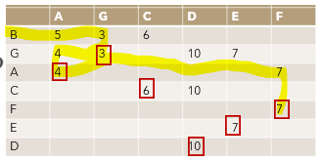
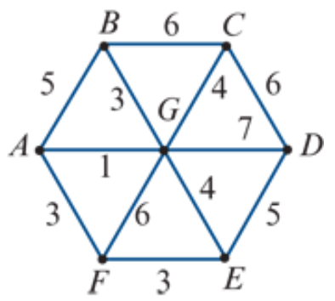
Finding the shortest path by Inspection
Find the shortest path from vertex 𝐵 to vertex 𝐹 in this network. The numbers represent time in minutes.
0
$$4^{G}$$
$$5^{B}$$
$$3^{B}$$
3+1+3=7 minutes
$$7^{A}$$

Slide 16
Finding the shortest path by Dijkstra’s Algorithm
Find the shortest path from vertex 𝐵 to vertex 𝐹 in this network. The numbers represent time in minutes.
 | A | G | C | D | E | F
B | 5 | 3 | 6
G | 4 | 3 |  | 10 | 7
A | 4 |  |  |  |  | 7
C |  |  | 6 | 10
F |  |  |  |  |  | 7
E |  |  |  |  | 7
 | A | G | C | D | E | F
B | 5 | 3 | 6
G | 4 | 3 | 7 | 10 | 7 | 9
A | 4 |  |  |  |  | 7
 | A | G | C
B | 5 | 3 | 6
 | A | G | C | D | E | F
B | 5 | 3 | 6
G | 4 | 3 |  | 10 | 7
A | 4 |  |  |  |  | 7
C |  |  | 6 | 10
F |  |  |  |  |  | 7
 | A | G | C
B | 5 | 3 | 6
G |  | 3
 | A | G | C | D | E | F
B | 5 | 3 | 6
G | 4 | 3 | 7 | 10 | 7 | 9
A | 4 |  |  |  |  | 7
C |  |  | 6 | 10
 | A | G | C | D | E | F
B | 5 | 3 | 6
G | 4 | 3 |  | 10 | 7
A | 4 |  |  |  |  | 7
C |  |  | 6 | 10
F |  |  |  |  |  | 7
E |  |  |  |  | 7
D |  |  |  | 10
 | A | G | C | D | E | F
B | 5 | 3 | 6
G | 4 | 3 | 7 | 10 | 7 | 9
3+1+3=7 minutes

Slide 17
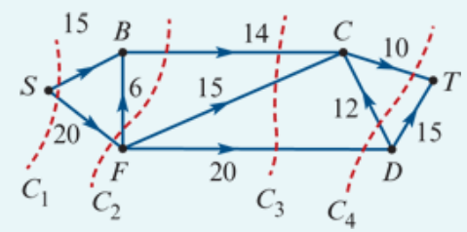
Calculating cut capacity
Calculate the capacity of the four cuts shown in the network on the right. The source is vertex S and the sink is vertex T.
The capacity of $C_{1}$=15+20=35
The capacity of $C_{2}$=14+20=34
The capacity of $C_{3}$=14+15+20=49
The capacity of $C_{4}$=20+10=30

Slide 18
Cut, cut capacity and minimum cut capacity
The minimum cut capacity = the maximum flow

Slide 19
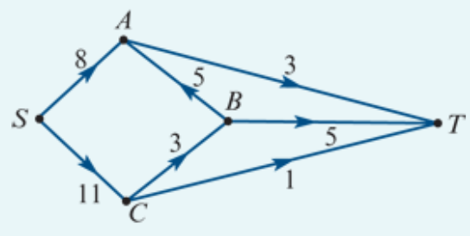
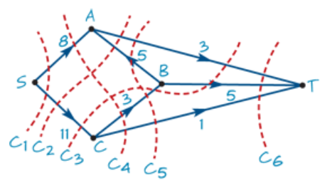
Calculating maximum flow
Determine the maximum flow from S to T for the digraph shown on the right.
The capacity of $C_{1}$=8+11=19
The capacity of $C_{2}$=3+11=14
The capacity of $C_{3}$=3+5+11=19
The capacity of $C_{4}$=8+3+1=12
The capacity of $C_{5}$=3+3+1=7
The capacity of $C_{6}$=3+5+1=9
The minimum cut capacity is 7 so the maximum flow from S to T is 7.

Slide 20
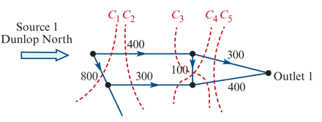
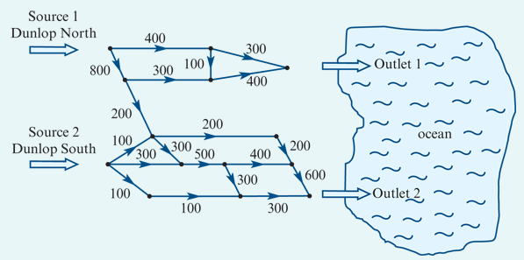
Calculating maximum flow
Storm water enters a network of pipes at either Dunlop North (Source 1) or Dunlop South (Source 2) and flows into the ocean at either Outlet 1 or Outlet 2.
Determine the maximum rate, in kilolitres per minute, at which water can flow from these pipes into the ocean at Outlet 1 and Outlet 2.
The capacity of C1 is: 400+800=1200
The capacity of C2 is: 400+300=700
The capacity of C3 is: 400+400=800
The capacity of C4 is: 300+100+300=700
The capacity of C5 is: 300+400=700
The minimum cut/maximum flow is 700 kilolitres per minute.

Slide 21
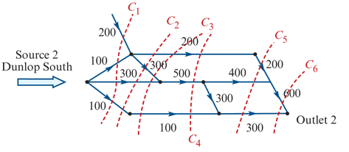
Calculating maximum flow
Storm water enters a network of pipes at either Dunlop North (Source 1) or Dunlop South (Source 2) and flows into the ocean at either Outlet 1 or Outlet 2.
Determine the maximum rate, in kilolitres per minute, at which water can flow from these pipes into the ocean at Outlet 1 and Outlet 2.
The capacity of C1 is: 200+100+300+100=700
The capacity of C2 is: 200+300+300+100=900
The capacity of C3 is: 200+300+300+100=900
The capacity of C4 is: 200+500+100=800
The capacity of C5 is: 200+400+300=900
The capacity of C6 is: 600+300=900
The minimum cut/maximum flow is 700 kilolitres per minute.

Slide 22
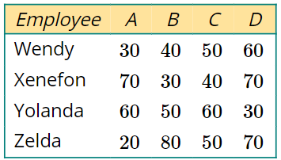
The Hungarian algorithm
The table on the right shows the four employees: Wendy, Xenefon, Yolanda and Zelda. The machines in a factory are represented by the letters A, B, C and D.
The numbers in the table are the times, in minutes, it takes each employee to finish the task on each machine.
The table is called a cost matrix. The cost matrix can be used to determine the best way to allocate an employee to a machine so that the overall cost, in terms of the time taken to finish the work, is minimised. The Hungarian algorithm is used to do this.

Slide 23
Performing the Hungarian algorithm Step 1: Subtract the lowest value in each row, from every value in that row.
Employee A B C D
Wendy 30 40 50 60
Xenefon 70 30 40 70
Yolanda 60 50 60 30
Zelda 20 80 50 70
Employee A B C D Wendy 0 10 20 30 Xenefon 40 0 10 40 Yolanda 30 20 30 0 Zelda 0 60 30 50
$−$30
$−$30
$−$30
$−$20

Slide 24
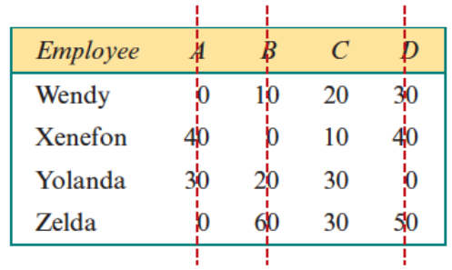
Step 2: If the minimum number of lines required to cover all the zeros in the table is equal to the number of allocations to be made, jump to step 6. Otherwise, continue to step 3.
The zeros can be covered with three lines. This is less than the number of allocations to be made (4).
Continue to step 3.

Slide 25
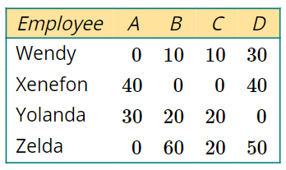
Step 3: If a column does not contain a zero, subtract the lowest value in that column from every value in that column.
Column C does not have a zero.
10 has been subtracted from every value in column C.
–10

Slide 26
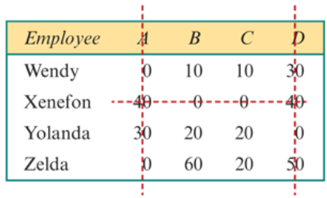
Step 4: If the minimum number of lines required to cover all the zeros in the table is equal to the number of allocations to be made, jump to step 6. Otherwise, continue to step 5a.
The zeros can be covered with three lines. This is less than the number of allocations to be made (4).
Continue to step 5a.

Slide 27
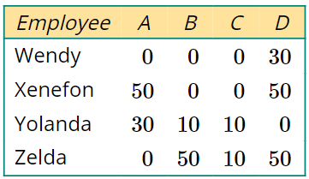
Step 5a: Add the smallest uncovered value to any value that is covered by two lines. Subtract the smallest uncovered value from all the uncovered values.
The smallest uncovered element is 10.
10 has been added to Xenefon–A and Xenefon–D because these values are covered by two lines.
10 has been subtracted from all the uncovered values.

Slide 28
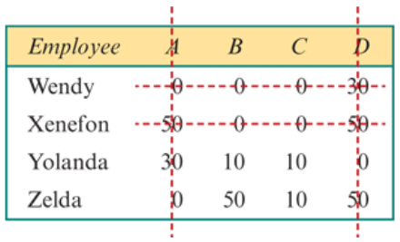
Step 5b: Repeat from step 4.
The zeros can be covered with a minimum of four lines. This is the same as the number or allocations to make.
Continue to step 6.

Slide 29
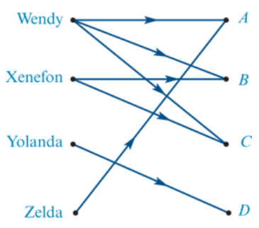
Step 6: Draw a directed bipartite graph with an edge for every zero value in the table.
In the bipartite graph:
Wendy will be connected to A, B and C
Xenefon will be connected to B and C
Yolanda will be connected to D
Zelda will be connected to A.

Slide 30
Step 7: Make the allocation and calculate minimum cost
Zelda must operate machine A (20 minutes).
Yolanda must operate machine D (30 minutes).
Wendy can operate either machine B (40 minutes) or C (50 minutes).
Xenefon can operate either machine B (30 minutes) or C (40 minutes).
The minimum time taken to finish the work=20+30+50+30=130 minutes.

Slide 31
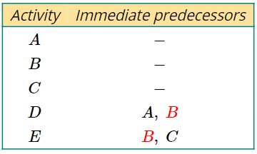
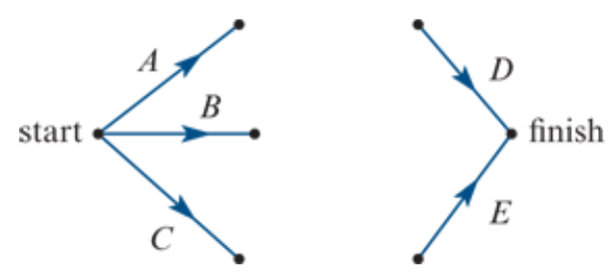
Dummy activities
A dummy activity is required if two activities share some, but not all, of their immediate predecessors.
A dummy activity will be required from the end of each shared immediate predecessor to the start of the activity that has additional immediate predecessors.
Dummy activities are represented in the activity network using dotted lines.

Slide 32
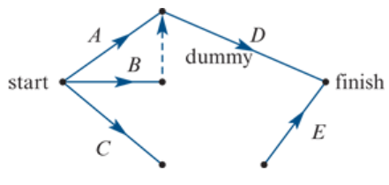
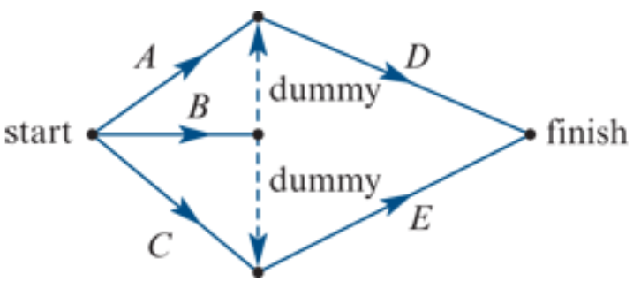
Dummy activities

Slide 33
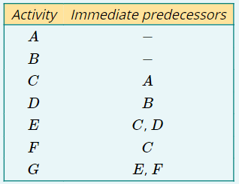
Using a dummy activity in an activity network

Slide 34
Creating a precedence table from an activity network
Activity | Immediate predecessors
A | —
B | A
C | A
D | B
E | C
F | C, D
G | D, C
H | F, E
I | G
J | H, G

Slide 35
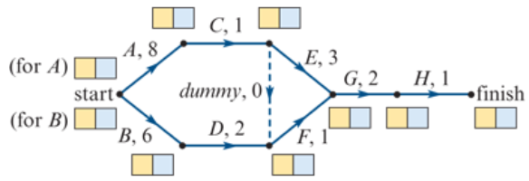
Forward scanning
Forward scanning will be demonstrated using the activity network below. The durations of each are in days.
1. Draw a box, split into two cells, next to each vertex of the activity network, as shown in the diagram. If more than one activity begins at a vertex, draw a box for each of these activities.

Slide 36
Forward scanning
2. Activities that begin at the start of the project have an EST of zero (0). Write this in the left box, shown shaded yellow in the diagram.

Slide 37
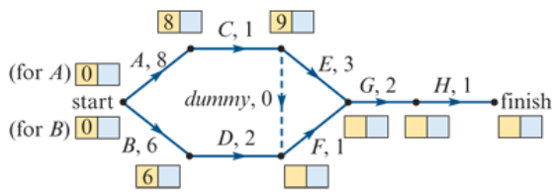
Forward scanning
3. Calculate the EST of each activity of the project by adding the EST of the immediate predecessor to the duration of the immediate predecessor.
EST of C= EST of A+ duration of A (EST of C=0+8=8)
EST of D= EST of B+ duration of B (EST of D=0+6=6)
EST of E= EST of C+ duration of C (EST of C=8+1=9)

Slide 38
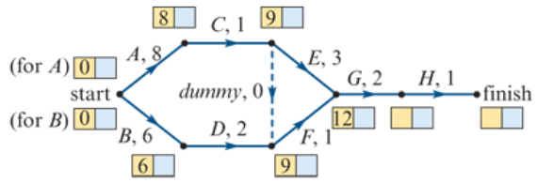
Forward scanning
4. If an activity has more than one predecessor, calculate the EST using each of the predecessors and choose the largest value.
EST of F=6+2=8 or EST of F=9+0=9. Use 9.
EST of G=9+1=10 or EST of G=9+3=12. Use 12.

Slide 39
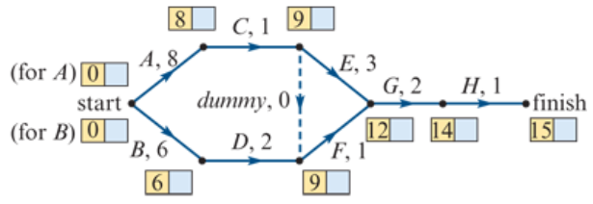
Forward scanning
5. The EST value at the finish of the project is the minimum time it takes to complete the project.
Note: The minimum time to complete this project is 15 days.

Slide 40
Backward scanning
Backward scanning will be demonstrated using the activity network with completed forward scanning from above.
1. Copy the minimum time to complete the project into the right cell shown shaded blue in the diagram.

Slide 41
Backward scanning
2. Calculate the LST for each activity by subtracting the duration of the activity from the LST of the following activity.
LST of H= LST of finish – duration of H (LST of H=15−1=14).
LST of G= LST of H – duration of G (LST of G=14−2=12).
LST of F= LST of G – duration of F (LST of F=12−1=11).
LST of E= LST of G – duration of E (LST of E=12−3=9).

Slide 42
Backward scanning
3. If more than one activity have the same predecessor, calculate the LST using each of the activities that follow and choose the smallest value.
Note: LST of E=12−3=9 (from duration of E) or LST of E=11−0=11 (from duration of dummy). Use 9.
The completed activity network with all EST and LST is shown below.

Slide 43
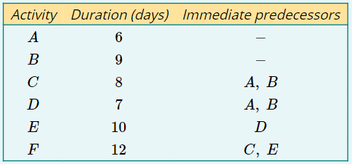
Finding the critical path
A project has six activities as shown in the precedence table opposite.
Draw an activity network for this project.
Complete the critical path analysis to calculate the EST and LST for each activity.
Write down the critical path of this project.
What is the minimum time required to complete the project?

Slide 44
Finding the critical path
The critical path of this project is B→D→E→F.
The minimum completion time of this project is 38 days.

Slide 45
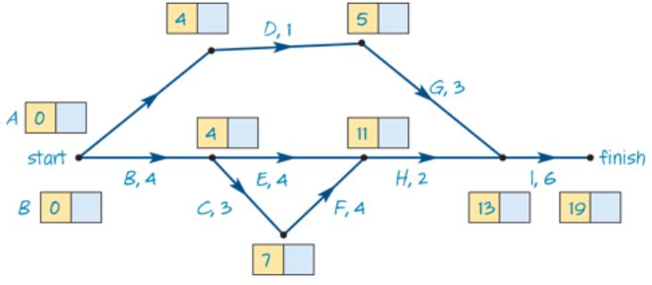
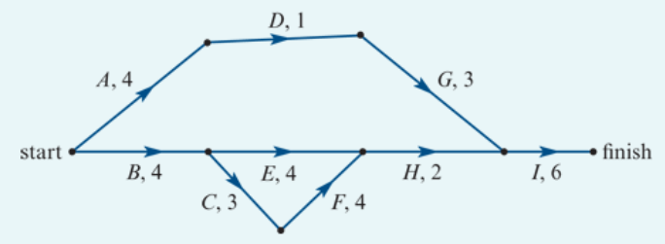
Crashing
1. Determine the minimum time, in weeks, to complete this project.
The minimum completion time of this project is 19 weeks.

Slide 46
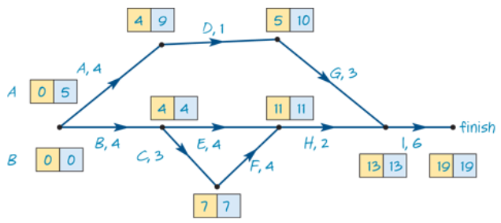
Crashing
2. Determine the slack time, in weeks, for activity D.
EST=4 and LST=9, Float=LST−EST=9−4=5 weeks

Slide 47
Crashing
3. Write down the critical path of this project.
The critical path of this project is B→C→F→H→I.

Slide 48
Crashing
4. The builders of the community centre are able to speed up the project.
Some of the activities can be reduced in time at an additional cost.
The activities that can be reduced in time are A, C, E, F and G.
Which of these activities, if reduced in time individually, would not result in an earlier completion of the project?
Activities A, E and G are not on
the critical path. These activities
would not result in an earlier
completion of the project.

Slide 49
Crashing
5. The owner of the estate is prepared to pay the additional cost to achieve early completion.
The cost of reducing the time of each activity is $5000 per week.
The maximum reduction in time for each one of the five activities, A, C, E, F and G is 2 weeks.
Determine the minimum time, in weeks, for the project to be completed now that certain activities can be reduced in time.
Activities C and F are on the
critical path. Reduce these by
2 weeks each to reduce the
path B→C→F→H→I by 4 weeks,
from 19 down to 15 weeks.

Slide 50
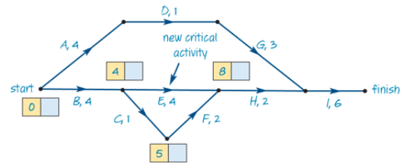
Crashing
5. The owner of the estate is prepared to pay the additional cost to achieve early completion.
The cost of reducing the time of each activity is $5000 per week.
The maximum reduction in time for each one of the five activities, A, C, E, F and G is 2 weeks.
Determine the minimum time, in weeks, for the project to be completed now that certain activities can be reduced in time.
This has resulted in a new
critical path.
E can be reduced by 1 week to
ensure overall minimum
completion time of 15 weeks.
3

Slide 51
Crashing
6. Determine the minimum additional cost of completing the project in this reduced time.
The cost of reducing the time of each activity is $5000 per week.
C and F have been reduced by
2 weeks. E has been reduced by
1 week. There is 5 weeks
reduction at $5000 per week.
Minimum cost is $25000.
3

