Slide 1
Quadratics
Methods Chapter3
Notes:
Nearpod Activity

Slide 3
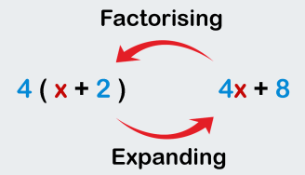

Slide 4
Multiplying/Expanding Binomials
Multiply. (x+3)(x+2)
 | x | +3
x | $$x^{2}$$ | +3x
+2 | +2x | +6
5
3
2
6
(x+3)(x+2)= x²+ 5x + 6

Slide 5
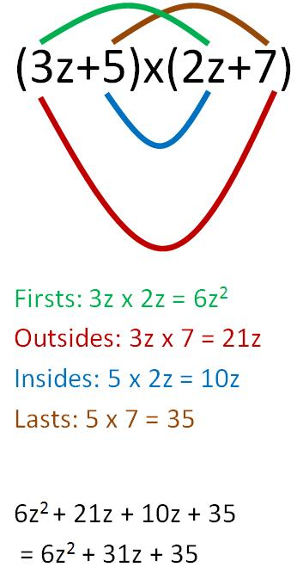
Multiplying Binomials (FOIL)
Multiply. (3z+5)(2z+7)
= 6z²+ 31z + 35

Slide 6
Factoring Trinomials
2
– 4
6
Factor. x² + 2x - 24
-24
This time, the constant is negative!
Step 1: List all pairs of numbers that multiply to equal the constant, -24. (To get -24, one number must be positive and one negative.)
-24 = 1 • -24, -1 • 24
= 2 • -12, -2 • 12
= 3 • -8, -3 • 8
= 4 • -6, - 4 • 6
Step 2: Which pair adds up to 2?
Step 3: Write the binomial factors.
x² + 2x - 24 = ( x - 4)( x + 6)

Slide 7
Factoring Trinomials
2x² + x - 21
1) Multiply 2 • (-21) = - 42; list factors of - 42.
1 • -42, -1 • 42
2 • -21, -2 • 21
3 • -14, -3 • 14
6 • -7, -6 • 7
1
2) Which pair adds to 1 ?
-6
7
-42
3) Write the temporary factors.
( x - 6)( x + 7)
2
2
4) Put “2” underneath.
3
( x - 6)( x + 7)
5) Reduce (if possible).
2
2
6) Move denominator(s)in front of “x”.
( x - 3)( 2x + 7)
2x² + x - 21 = (x - 3)(2x + 7)

Slide 8
Factoring Trinomials
3x² - 21x - 54
1) Multiply 3 • -54 = -162; list factors of -162.
-21
-2 • 81
-3 • 54
-6 • 27
-9 • 18
2 • -81
3 • -54
6 • -27
9 • -18
-27
6
2) Which pair adds to -21 ?
-162
3) Write the temporary factors.
( x - 27)( x + 6)
3
3
4) Put “3” underneath.
9
2
-7
( x - 27)( x + 6)
5) Reduce to no denominator.
3
3
-9
2
6) Full reduction but Because of coefficient 3, Add 3 to front.
3(x - 9)( x + 2)
-18
3(x² - 7x – 18)
3x² - 21x - 54= 3(x - 9)(x + 2)
Notes:
Can get 3 out first

Slide 9
Null Factor Theorem

Slide 10
X-intercept
X-intercept
Vertex
Notes:
NOTE: That this graph has a minimum point, but no maximum point as the graph does to positive infinity. It is this vertex that the lesson is focused on.

Slide 11
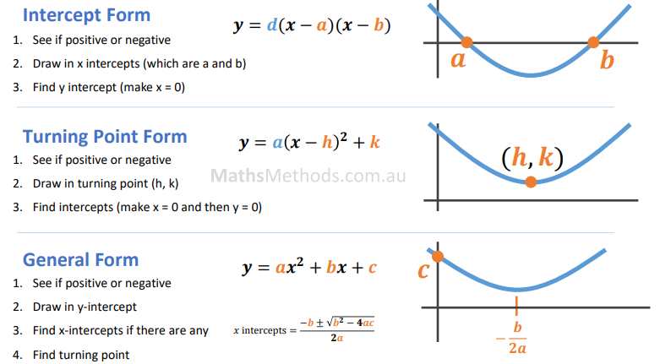
Symmetry line: x=h
Symmetry line: x=$−\frac{b}{2a}$
discriminant: Δ= $b^{2}−4ac$

Slide 13
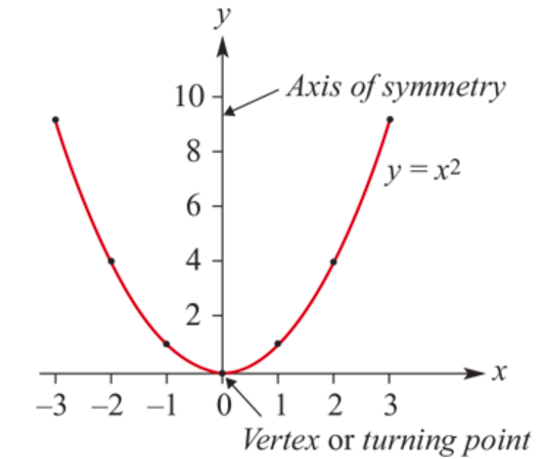
The parabola 𝑦=$x^{2}$
A quadratic polynomial function is defined by the general rule 𝑦=𝑎$x^{2}$+𝑏𝑥+𝑐
where 𝑎, 𝑏 and 𝑐 are constants and 𝑎≠0. This is called polynomial form.
The simplest quadratic function is 𝑦= $x^{2}$. If a table of values is constructed for 𝑦= $x^{2}$for −3≤𝑥≤3, these points can be plotted and then connected to produce a continuous curve.
(—3,9)
(3,9)
(—2,4)
(2,4)
(—1,1)
(1,1)
(0,0)

Slide 14
The Vertex/turning point Form of the Quadratic Function
Horizontal
Shift
Vertical
Shift
Dilation
Factor
y= a(x - h)² + k
Indicates direction
of opening
Coordinates of
the vertex are (h, k)
If a > 0, the graph opens
up and there is a
minimum value of y.
If a < 0, the graph opens
down and there is a
maximum value of y.
Axis of Symmetry
is x =h
3.1.12

Slide 15
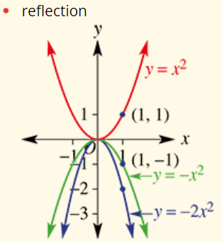
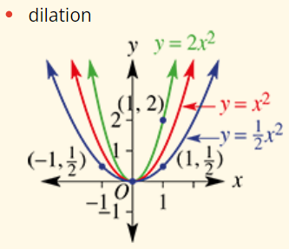
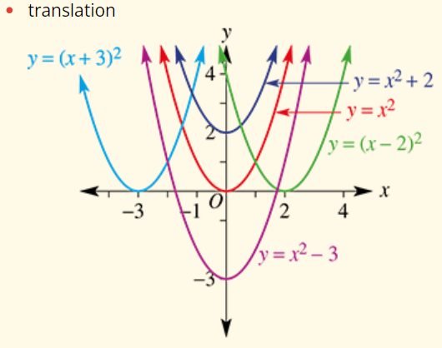

Slide 16
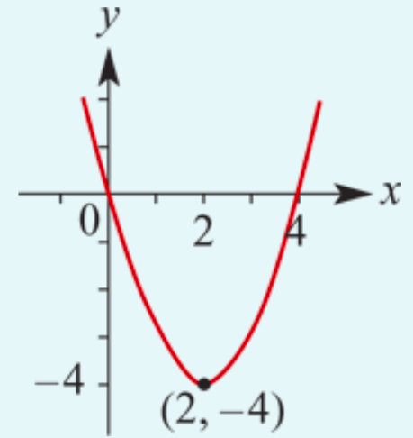
Find the 𝑥- and 𝑦-axis intercepts and the turning point, and hence sketch the graph of 𝑦=$x^{2}$−4𝑥.
Step 1 𝑐=0. Therefore the 𝑦-axis intercept is 0.
Step 2 Let 𝑦=0. Then
0=$x^{2}$−4𝑥= 𝑥(𝑥−4)
∴𝑥=0 or 𝑥=4
The 𝑥-axis intercepts are 0 and 4.
Step 3 The axis of symmetry is the line with equation 𝑥=$\frac{0+4}{2}$, that is, 𝑥=2.
Step 4 When 𝑥=2, 𝑦= $2^{2}$−4×2=−4. The turning point has coordinates (2,−4).

Slide 17
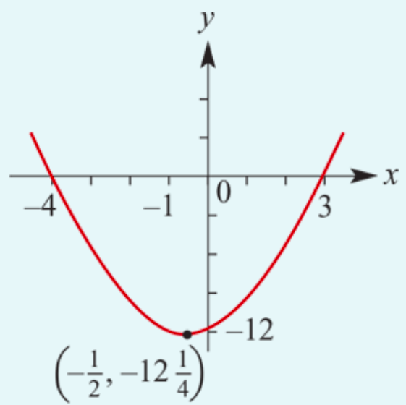
Find the 𝑥- and 𝑦-axis intercepts and the turning point, and hence sketch the graph of 𝑦=$x^{2}$+𝑥−12.
Step 1 𝑐= −12. Therefore the 𝑦-axis intercept is −12.
Step 2 Let 𝑦=0. Then
0= $x^{2}$+𝑥−12 = (𝑥+4)(𝑥−3)
∴𝑥=3 or 𝑥=−4
The 𝑥-axis intercepts are 3 and −4.
Step 3 The axis of symmetry is the line with equation 𝑥=$\frac{3−4}{2}$, that is, 𝑥= −$\frac{1}{2}$.
Step 4 When 𝑥= −$\frac{1}{2}$, 𝑦= ${(\text{−}\frac{1}{2})}^{2}$+(−$\frac{1}{2}$)−12 =−12$\frac{1}{4}$. The turning point has coordinates (−$\frac{1}{2}$, −12$\frac{1}{4}$).

