Slide 1
Unitary Proportion
Notes:
https://www.transum.org/software/SW/Starter_of_the_day/Students/Unitary_Method.asp
https://www.blendspace.com/lessons/GhPTIjVt4V0bqg/proportion-unitary-method

Slide 2
Ratios can be used to calculate unit prices, i.e. the price of one item. This method is known as the unitary method and can be used to solve a range of ratio problems.

Slide 3
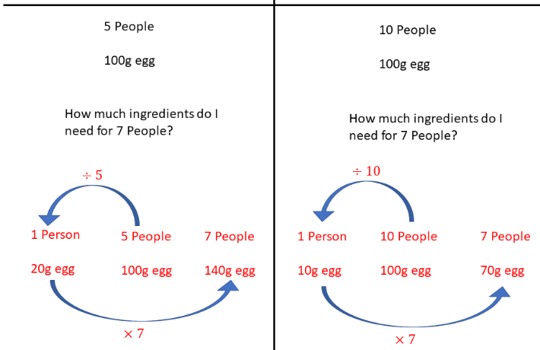
Unitary Proportion

Slide 4
Find out how long it would take to run 1 mile
5 miles takes 45 minutes
1 mile takes
÷ 5
9 minutes
Now what?
1 mile takes 9 minutes
So 18 times will take 18 times as long
9 x 18 = 162 minutes

Slide 5
Your turn to have a go
5 packs of sweets cost £5.25.
How much would it cost to buy 7 packs of sweets?
£7.35

Slide 6
10 pieces of wood when laid end to end measure 55 m. How far would 18 pieces stretch?
99m

Slide 7
Inverse Proportion

Slide 8
15 masons can build the wall in 20 days. How many masons will build the wall in 12 days?
Think!
Will you need more masons or less masons?
So if there was only 1 mason working how long would he take?
15 x 20 =300 days!
I have 12 days so 300 ÷ 12 = 25 masons needed.

Slide 9
76 persons can complete the job in 42 days. In how many days will 56 persons do the same job?
Will the job take more time or less time with fewer people?
So how long in days will the whole job take?
76 x 42 =3192 days
I have 56 people to put on this job so
3192 ÷ 56 = 57 days to complete.

Slide 10
Your turn to have a go
10 builders can build a house in 20 days. How many builders will you need build the house in 10 days?
20 builders

Slide 11
15 people can complete a job in 42 days. In how many days will 9 people do the same job?
70 days

Slide 12
If 9 m of cloth cost £22.50 what would 15m cost?

Slide 13
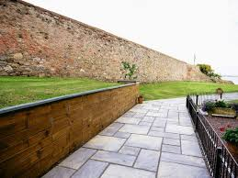
If 6 men build a wall in 10 hours how long would it have taken 1 man to build it?

Slide 14
If 12 books cost £15 what
would 15 books cost?

Slide 15
If 18 rose bushes cost £9.90 what would 24 rose bushes cost?

