Slide 1
Chapter 1 Percentages
Notes:
https://www.mathgames.com/skill/7.31-solving-proportions
https://quizizz.com/admin/quiz/5817addeefa277402cee5a37/solving-proportions
https://create.kahoot.it/details/439b683f-c311-42c7-a7bd-7e7f00de082a
https://quizizz.com/admin/quiz/58e3bbb1578787c01e4c9aa2?source=quiz_share
https://quizizz.com/admin/presentation/602f140eb92419001e655fde?source=lesson_share

Slide 2
1. What is equivalent to:
1
1
2
2
1.2
50%
20%

Slide 3
3. What is equivalent to:
0.2
0.2
2
2
2%
10
100

Slide 5
Percent Increase
The increase growth factor is
$1+\frac{r}{100}$
Percentage of increase

Slide 6
Phrase % Multiplier/Growth factor
5 % increase
1.005
10 % increase
1
15 % increase
1.15
½ % increase
1.1
No change
1.05

Slide 7
Percent Decrease
The decrease decay factor is
$1−\frac{r}{100}$
Percentage of decrease

Slide 8
Example
A car depreciates at rate of 30%. Initially it cost £25,000.
How much will it be worth after a year?
Decay factor= $1−\frac{r}{100}=1−\frac{30}{100}$=0.70
25 000 $×$0.70 = £17,500
A quicker way!

Slide 9
Example
Sally deposits £600 into an account with an increase of 5% per annum.
Find how much money she has in the account after one year.
Growth factor=$1+\frac{r}{100}$ = $1+\frac{5}{100}$ =1+0.05=1.05
New balance = £600 $×1.05$
= £630
A quicker way!

Slide 10
Phrase % Multiplier/Decay factor
0.5
1 % decrease
0.965
0.85
3.5 % decrease
1
15 % decrease
50 % decrease
0.99
No change

Slide 11
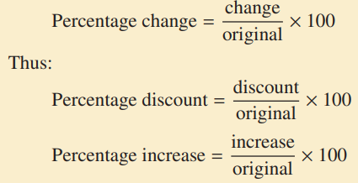
Percentage Change

Slide 12
Overview
Rate = 10% charged on the supply of most goods and services consumed in Australia

Slide 13
A RATIO is a quotient
that compare 2 quantities.
3
4
3 : 4
3 to 4
These are all the same.

Slide 14
How to simplify ratios?
Now I tell you I have 12 cats and 6 dogs. Can you simplify the ratio of cats and dogs to 2 to 1?
=
=
Divide both numerator and denominator by their Greatest Common Factor 6.

Slide 15
How to simplify ratios?
A person’s arm is 80cm, he is 2m tall.
Find the ratio of the length of his arm to his total height
To compare them, we need to convert both numbers into the same unit …either cm or m.
Let’s try cm first!
Once we have the same units, we can simplify them.

Slide 16
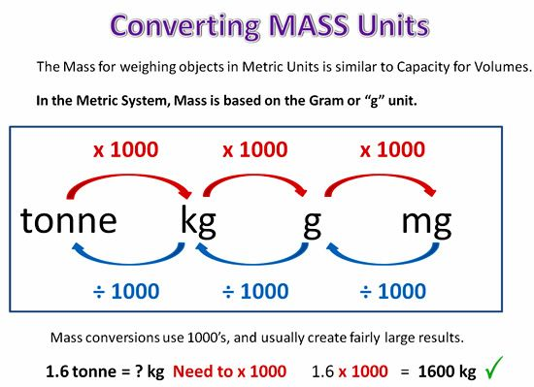
How to simplify ratios?
If the numerator and denominator do not have the same units it may be easier to convert to the smaller unit so we don’t have to work with decimals…
3cm/12m = 3cm/1200cm = 1/400
2kg/15g = 2000g/15g = 400/3
2g/8g = 1/4
Of course, if they are already in the same units, we don’t have to worry about converting. Good deal☺

Slide 17
A Proportion is an equation of two equal ratios.

Slide 18
all
reduce
to 1/2
3 4 5
6 8 10
=
=
Proportion is true if fractions are equal when in lowest terms.

Slide 19
the Extremes.
the Means.

Slide 20
The product of the means equals the product of the extremes.
Cross products are equal.
2 • 12 = 3 • 8
24 = 24

Slide 21
To Solve Proportions
Find n
9 n =
(3) (6)
9 n = 18
n = 2

Slide 22
How to divide quantity as a ratio
How can you check your answer?
1) Share £24 into the ratio 1 : 5
We add the parts of the ratio
1 + 5 = 6
To find each part, we divide £24 by 6
24 ÷ 6 = £4
This means one part is equivalent to £4
Since one gets 1 part = 1 x £4 = £4
Since the other gets 5 parts = 5 x £4 = £20

Slide 23
Ratios can be used to calculate unit prices, i.e. the price of one item. This method is known as the unitary method and can be used to solve a range of ratio problems.

Slide 24
Find out how long it would take to run 1 mile
5 miles takes 45 minutes
1 mile takes
÷ 5
9 minutes
Now what?
1 mile takes 9 minutes
So 18 times will take 18 times as long
9 x 18 = 162 minutes

