Slide 1
Functions
5C

Slide 3
functions
A function is a relation such that for each x-value there is only one corresponding y-value. This means that, if (a,b) and (a,c) are ordered pairs of a function, then b=c. In other words, a function cannot contain two different ordered pairs with the same first coordinate.

Slide 4
Examples
Which of the following sets of ordered pairs defines a function?
a. {(−3,−4),(−1,−1),(−6,7),(1,5)}
{(−3,−4),(−1,−1),(−6,7),(1,5)} is a function, because for each x-value there is only one y-value.
b. {(−4,1),(−4,−1),(−6,7),(−6,8)}
{(−4,1),(−4,−1),(−6,7),(−6,8)} is not a function, because there is an x-value with two different y-values. The relation contains two ordered pairs, (−4,1) and (−4,−1), with the same first coordinate.

Slide 5
Vertical-line test
One way to identify whether a relation is a function is to draw a graph of the relation and then apply the following test.
If a vertical line can be drawn anywhere on the graph and it only ever intersects the graph a maximum of once, then the relation is a function.

Slide 6
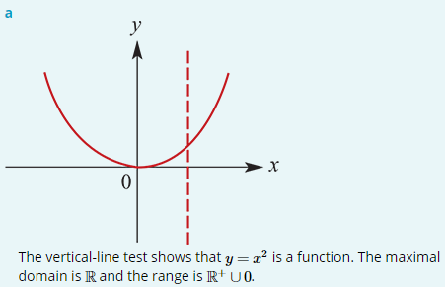
Examples
a. Is y= $x^{2}$ a function? State the maximal domain and range of y= $x^{2}$.
For each x-value there is only one y-value.
The ordered pairs of the relation are all of the form ($a$, $a^{2}$).

Slide 7
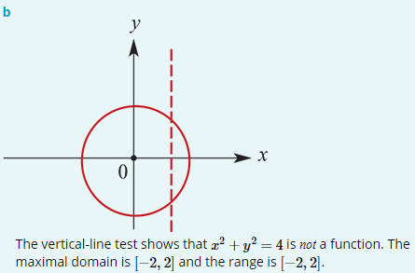
Examples
b. Is $x^{2}$+ $y^{2}$=4 a function? State the maximal domain and range of $x^{2}$+ $y^{2}$=4.
Note that ($\sqrt{2}$, $\sqrt{2}$) and ($\sqrt{2}$,− $\sqrt{2}$) are ordered pairs of the relation.
There is an x-value with more than one y-value.

Slide 8
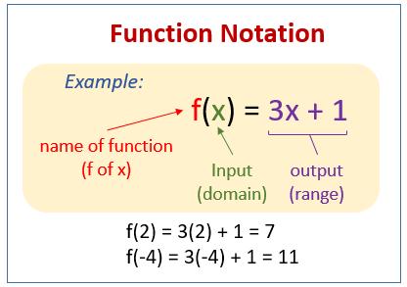
Function notation
Functions are usually denoted with lowercase letters such as f, g, h.
If f is a function, then for each x in the domain of f there is a unique element y in the range such that (x,y)∈f. The element y is called ‘the image of x under f’ or ‘the value of f at x’, and the element x is called ‘a pre-image of y’.
Since the y-value obtained is a function of the x-value, we use the notation f(x), read as ‘f of x’, in place of y.
For example, instead of y=2x+1 we can write f(x)=2x+1. Then f(2) means the y-value obtained when x=2.
e.g. f(2) =2(2)+1=5
f(−4) =2(−4)+1=−7
f(a) =2a+1

Slide 9
Function notation
By incorporating this notation, we have an alternative way of writing functions:
For the function {(x, y):y= $x^{2}$} with domain R, we write f: R → R, f(x)= $x^{2}$.
For the function {(x, y):y=2x−1, x∈[0,4]}, we write f:[0,4]→ R, f(x)=2x−1.
For the function {(x, y):y= $\frac{1}{x}$ } with domain R ∖0, we write f: R ∖0→ R, f(x)= $\frac{1}{x}$.

Slide 10
Function notation
If the domain is R, we often just write the rule. For example: f(x)= $x^{2}$.
Note that in using the notation f: X→Y, the set X is the domain but Y is not necessarily the range. It is a set that contains the range and is called the codomain. With this notation for functions, we write the domain of f as dom f and the range of f as ran f.
A function f:R→R, f(x)=a is called a constant function. For such a function f, we have dom f= R and ran f=a. For example, let f(x)=7. Then dom f= R and ran f=7.
A function f: R → R, f(x)=mx+c is called a linear function. For example, let f(x)=3x+1. Then dom f= R and ran f= R. Note that if the domain of a linear function is R and m≠0, then the range is R.

Slide 11
examples
Rewrite each of the following using the f:X→Y notation:
1. {(x,y):y=−3x+2}
2. {(x,y):y=−2x+5, x≥0}
3. y=5$x^{2}$+6, −1≤x≤2
4. y= $\frac{1}{{(x−2)}^{2}}$, x≠2
f : R → R, f(x)=−3x+2
f : ${\text{R}}^{+}$∪ 0→ R, f(x)=−2x+5 or f:[0,∞)→ R, f(x)=−2x+5
f :[−1,2]→ R, f(x)=5$x^{2}$+6
f : R ∖2→ R, f(x)= $\frac{1}{{(x−2)}^{2}}$

Slide 12
examples
If f(x)=2$x^{2}$+ $x$, find:
1. f(3)
2. f(−2)
3. f(x−1)
4. f($\frac{1}{a}$), a≠0
f(3)=2${(3)}^{2}$+3=21
f(−2)=2${(−2)}^{2}$−2=6
f(x−1)=2(${x−1)}^{2}$+ $x$−1=2($x^{2}$−2$x$+1)+ $x$−1=2 $x^{2}$−3$x$+1
f($\frac{1}{a}$)=2${(\frac{1}{a})}^{2}$+ $\frac{1}{a}$= $\frac{2}{a^{2}}$+ $\frac{1}{a}$= $\frac{2+a}{a^{2}}$

Slide 13
Examples
Consider the function defined by f(x)=2x−4 for all x∈R.
1. Find the value of f(2) and f(t).
2. Find the value of x for which f(x)=6.
3. Find the value of x for which f(x)=0.
4. For what values of t is f(t)=t?
5. For what values of x is f(x)≥x?
6. For what values of x is f(x)≤3x?
1. f(2)=2(2)−4=0 f(t)= 2t−4
2. f(x) =6 → 2x−4 =6 → 2x =10 ∴ x =5
3. f(x) =0 → 2x−4 =0 → 2x =4 ∴ x =2
4. f(t) =t → 2t−4 =t → t−4 =0 ∴ t =4
5. f(x) ≥x → 2x−4 ≥x → x−4 ≥0 ∴ x ≥4
6. f(x) ≤3x → 2x−4 ≤3x →−4 ≤x ∴ x ≥−4

Slide 14
Restriction of a function
Consider the following functions:
The different letters, f, g and h, used to name the functions emphasise the fact that there are three different functions, even though they all have the same rule. They are different because they are defined for different domains. We say that g and h are restrictions of f, since their domains are subsets of the domain of f.

Slide 15
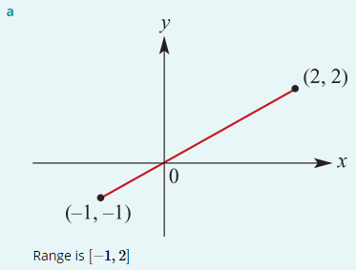
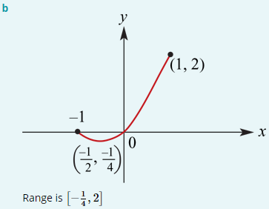
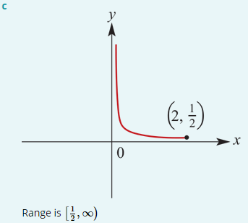
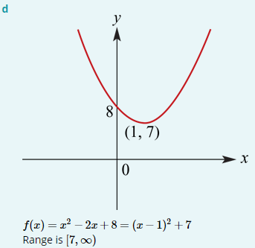
Examples
Sketch the graph of each of the following functions and state its range:
a. f :[−1,2]→ R, f(x)=x b. f :[−1,1]→ R, f(x)= $x^{2}$+ $x$
c. f :(0,2]→ R, f(x)=$\frac{1}{x}$ d. f : R → R, f(x)=$x^{2}$−2$x$+8

Slide 16
Section summary
A function is a relation such that for each x-value there is only one corresponding y-value.
Vertical-line test: If a vertical line can be drawn anywhere on the graph and it only ever intersects the graph a maximum of once, then the relation is a function.
Functions are usually denoted with lowercase letters such as f,g,h.
For an ordered pair (x,y) of a function f, we say that y is the image of x under f or that y is the value of f at x, and we say that x is a pre-image of y.
Since the y-value obtained is a function of the x-value, we use the notation f(x), read as ‘f of x’, in place of y.
Notation for defining functions: For example, we write f:[0,4]→R, f(x)=2x−1 to define a function f with domain [0,4] and rule f(x)=2x−1.
A restriction of a function has the same rule but a ‘smaller’ domain.

