Slide 1
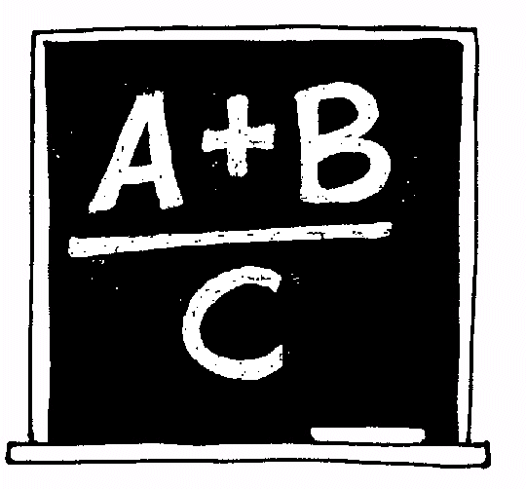
3B Writing recurrence relations in symbolic form

Slide 2
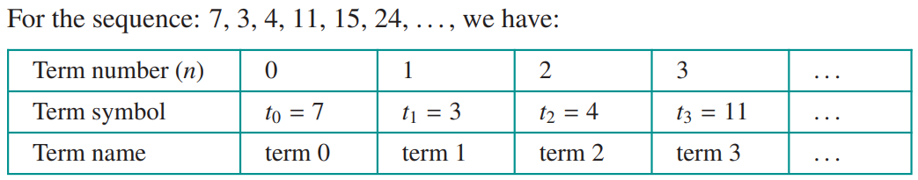
Numbering and naming the terms in a sequence

Slide 3
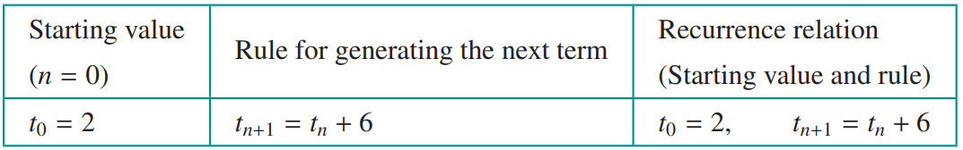
Recurrence relations
A recurrence relation is a mathematical rule that is used to generate a sequence. It has two parts:
a rule, that can be used to generate successive terms in the sequence.
a starting point: the value of the term at the start of the sequence
Note that t can be replaced by any letter of the alphabet, and that each application of the rule is called an iteration.

Slide 4
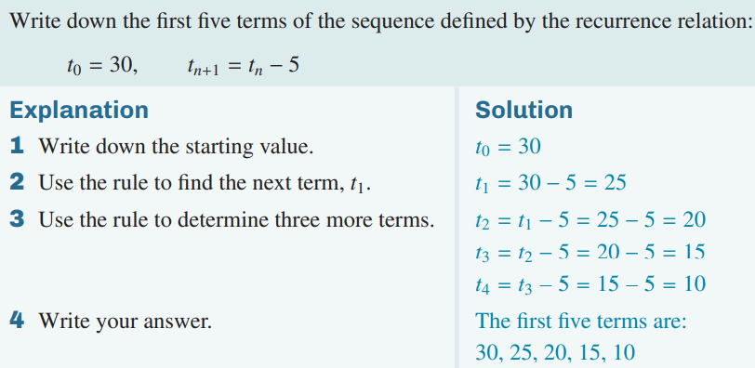
Generating a sequence from a recurrence relation

