Slide 1
Finance applications using arithmetic sequences and recurrence relations
3E

Slide 2
Learning intentions
To be able to use a recurrence relation to model simple interest.
To be able to use a recurrence relation to model flat rate depreciation.
To be able to use a recurrence relation to model unit cost depreciation.
To be able to use a rule to determine the nth term for linear growth or decay.

Slide 3
Using recurrence relations to model simple interest

Slide 4
Simple interest
Simple interest is an example of linear growth, where a fixed amount of interest is earned each period and found by multiplying the interest rate, r, by the initial amount, $v_{0}$. That is,
D = $\frac{r}{100}$ × $v_{0}$

Slide 5
Finding the amount of simple interest each year

Slide 6
Using recurrence relations to model flat rate depreciation
Linear decay can be represented as a recurrence relation. For example, a car that is purchased for $80 000 will be worth far less in a few years’ time. One way that depreciation is calculated is based on the age of the asset. This is called flat rate or fixed rate depreciation.
The value of an asset, $v_{n}$, in period n, reduces in value by a fixed amount, D, each period. The fixed amount may be given or it may be calculated based on a percentage rate, r, of the original value, $v_{0}$.
Thus, D = $\frac{r}{100}$ × $v_{0}$

Slide 7
Using a recurrence relation to model linear decay: flat rate depreciation

Slide 8
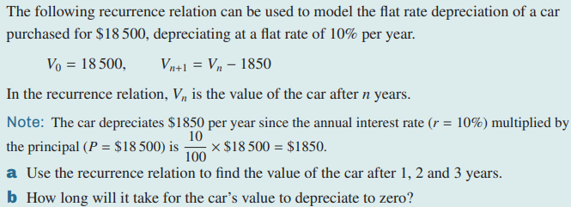
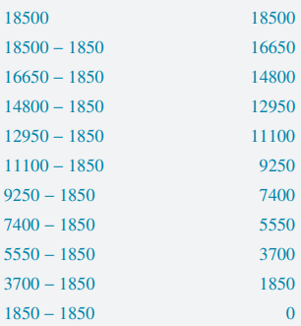
Using a recurrence relation to model linear decay: flat rate depreciation

Slide 9
Using recurrence relations to model unit cost depreciation
A second way that depreciation can be calculated is based on how often the asset is used, rather than based on its age. In the instance of a car, the value of the car may depreciate based on the number of kilometres that the car has travelled. This is called unit cost depreciation.

Slide 10
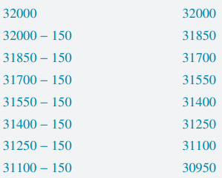
Using a recurrence relation to model linear decay: unit cost depreciation

Slide 11
Linear growth and decay
Linear growth and decay can be modelled by $v_{0}$ = initial or starting value, $v_{n+1}$ = $v_{n}$ + D, where $v_{n}$ is the value after n years and D is the amount that is added each time period. Thus,
$v_{n}$ = $v_{0}$ + n × D.
For linear growth, D > 0.
For linear decay, D < 0.

Slide 12
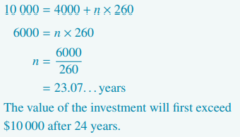
Using a rule for determining the $n^{th}$ term for linear growth or decay

