Slide 1
GeometRic sequences
Lesson 5

Slide 2
Geometric Sequences
Know the definition of A Geometric Sequence & Common Ratio
Finding the Common Ratio R, Identifying a geometric sequence
How to use Recursion to generate the terms of a geometric sequence with Mathematica

Slide 3
Geometric Sequences
R=3
R=$\frac{1}{2}$
In geometric sequences, you multiply by a common Ratio, R, each time.
R=$Common Ratio$

Slide 4
Arithmetic vs. Geometric Sequences
Arithmetic Sequences
Increases by the common difference d
Addition or Subtraction
d = $t_{n}$ – $t_{n−1}$
Geometric Sequences
Increases by the common Ratio R
Multiplication or Division
R = $\frac{t_{n}}{t_{n−1}}$
Common difference d
=any term $−$ the previous term
=$t_{2}−$ $t_{1}$= $t_{3} − t_{2}$= $t_{4} − t_{3}$
=…

Slide 5
Finding the common Ratio R
Find the common Ratio in each of the following geometric sequences.
A. 3,12,48,192,… B. 16,8,4,2,…
Common Ratio, R = $\frac{t_{2}}{t_{1}}$ = $\frac{12}{3}$= 4
Common Ratio, R = $\frac{t_{2}}{t_{1}}$ = $\frac{8}{16}$= $\frac{1}{2}$
The common Ratio R = 4
The common Ratio R = $\frac{1}{2}$

Slide 6
Identifying a geometric sequence
Which of the following is a geometric sequence?
A. 2,10,50,250,… B. 3,6,18,36,…
$$×5$$
$$×5$$
$$×5$$
$$×5$$
$$×2$$
$$×3$$
$$×2$$
$$×?$$
2
10
50
250
3
6
18
36
Common Ratio, R = $\frac{t_{n}}{t_{n−1}}$ = $\frac{10}{2} \text{=} \frac{50}{10}$= $\frac{250}{50}$= 5
Ratio, $\frac{t_{2}}{t_{1}}$ = $\frac{6}{3}$= 2, $\frac{t_{3}}{t_{2}}$ = $\frac{18}{6}$= 3, $\frac{t_{4}}{t_{3}}$ = $\frac{36}{18}$= 2,
The common Ratio R = 5
The sequence is geometric.
The Ratios are not the same.
The sequence is not geometric.

Slide 7
Recurrence Relations for Geometric Sequence
Recurrence Relations describe the Relationship between consecutive terms in a sequence.
Example: A sequence is defined by the $n^{th}$ term:
$$t_{1}=a$$
$t_{n+1}=t_{n}$× R
a= the first term
R= common Ratio
Recurrence Relations Rule
For Geometric Sequences

Slide 8
How to use Recursion to generate the terms of a geometric sequence with Mathematica
Generate the first six terms of the geometric sequence: 1,3,9,27,…

Slide 9
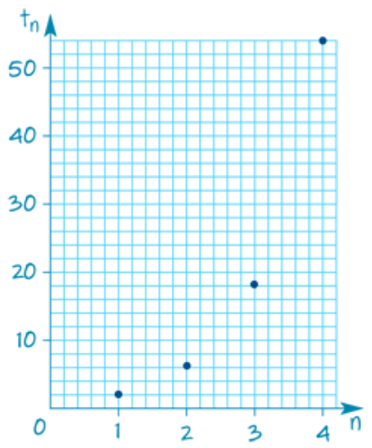
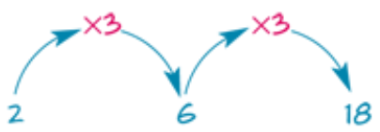
Graphing an increasing geometric sequence (R>1)
Consider the geometric sequence: 2,6,18,…
A. Find the next term. B. Show the positions and values of the first four terms in a table.
C. Use the table to plot the graph. D. Describe the graph.
Common Ratio, R = $\frac{t_{2}}{t_{1}}$ = $\frac{6}{2}$= 3
The next term $t_{4}=18 ×3=$54.
The values lie along a curve and they are increasing.

Slide 10
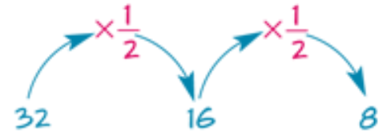
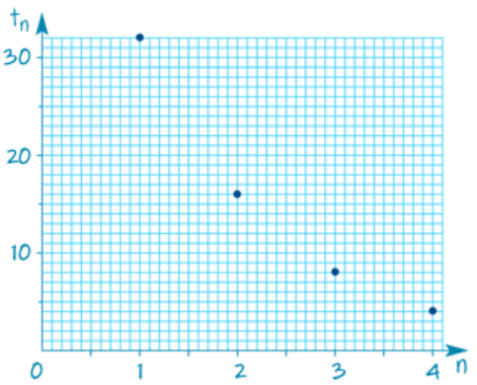
Graphing a decreasing geometric sequence (0 < R <1)
Consider the geometric sequence: 32,16,8,…
A. Find the next term. B. Show the positions and values of the first four terms in a table.
C. Use the table to plot the graph. D. Describe the graph.
The graph is a curve with values decreasing and approaching zero.
Common Ratio, R = $\frac{t_{2}}{t_{1}}$ = $\frac{16}{32}$= $\frac{1}{2}$
The next term $t_{4}=8 ×\frac{1}{2}=$4.

Slide 11
Graphs of geometric sequences (for R positive)
Graphs of geometric sequences for R>0 are:
increasing when 𝑟 is greater than 1, R>1
decreasing towards zero when R is less than 1,0<R<1
R = 3
R = $\frac{1}{2}$

Slide 12
Questions & Summary Book
2. What is Geometric Sequences what is the Rule for its Recurrence Relation?
1. Ex Booklet 3F
6. Summary notes for Homework.
3. Difference between Arithmetic and Geometric Sequences.
4. Finding Common Ratio R.
5. Graphing a geometric sequence.

