Slide 1
Using a recurrence relation to generate and analyse a geometric sequence
3G

Slide 2
Recurrence Relations
What is a Recurrence Relation for A Geometric Sequence?
Using Recurrence Relations to generate A Geometric Sequence.
Using Recurrence Relations to analyse A Geometric Sequence.

Slide 3
A sequence in which a constant (R) can be Multiplied to each term to get the next term is called an
Geometric Sequence.
The constant (R) is called the
Definition
Common Ratio.
To find the common ratio (R), dividing any pair of successive terms.
t₁
t₂
t₃
t₄
t₅
Common Ratio
R = 3
2 6 18 54 162
$×$3
$×$3
$×$3
$×$3
Notes:
Constant = fixed amount

Slide 4
R
R

Slide 5
Recurrence Relations-Geometric Sequences
Recurrence Relations describe the relationship between consecutive terms in a sequence
Example: A sequence is defined by the $n^{th}$ term:
$$t_{0}=a$$
$$t_{n+1}={\text{R}t}_{n}$$
𝒂= the first term
R= common ratio
Recurrence Relations Rule
t is used here to represent a term
n is the term number

Slide 6
Recurrence Relations
$t_{1}$ ${ t}_{2}$ $t_{3}$
2 6 18...
Consider the geometric sequence: 2,6,18,…
$t_{1}=2,$ $t_{n+1}=3t_{n}$
the first term is 2, and each subsequent term =the current term $×$ 3
$$t_{1}=2$$
x3
x3
$$t_{2}=3×t_{1}$$
$=3×2$
$=6$
$$t_{3}=3×t_{2}$$
$=3×6$ $=18$
$$t_{4}=3×t_{3}$$
$=3×18$
$=54$
$$t_{5}=3×t_{4}$$
$=3×54$
$=162$

Slide 7
Finding the $n^{th}$ term in a Geometric sequence
The $n^{th}$ term of a geometric sequence is given by:
Rule
t_{n} = a$×R^{n}$
The last # in the sequence/or the # you are looking for
The position the term is in
First term
The common ratio

Slide 8
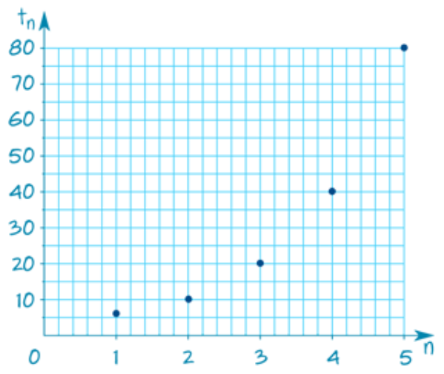
Using a recurrence relation to generate a geometric sequence
Generate and graph the first five terms of the sequence defined by the recurrence relation:$t_{1}$=5, ${ t}_{n+1}$=2 $t_{n}$
Use a rule to calculate the value of the ${10}^{th}$ term in the sequence.
$$t_{1}=a$$
$$t_{n+1}={Rt}_{n}$$
Recurrence Relations Rule
Example 1
$∵t_{1}=5$, $t_{n+1}={2t}_{n}$
$∴$ The first five terms are
$t_{1}$=5
$t_{2}$= ${2t}_{1}$= $2×$5=10
$t_{3}$= ${2t}_{2}$=$2×10$=20
$t_{4}$= ${2t}_{3}$=$2×$20=40
$t_{5}$= ${2t}_{4}$=$2×40$=80
To graph the terms, plot $t_{n}$against 𝑛.

Slide 9
Using a recurrence relation to generate a geometric sequence
Generate and graph the first five terms of the sequence defined by the recurrence relation:$t_{0}$=5, ${ t}_{n+1}$=2 $t_{n}$
Use a rule to calculate the value of the ${10}^{th}$ term in the sequence.
The $n^{th}$ term of geometric sequence is given by:
t_{n} = a $×$ ${\text{R}}^{\text{n}}$
Rule
$$t_{10}$$
5
10
2
t₁₀ = 5 $× {\text{2}}^{\text{10} }$
t₁₀ = 5 $× {\text{2}}^{10}$
Example 1
t₁₀ = 5120

Slide 10
Using a recurrence relation to generate a geometric sequence
Generate and graph the first five terms of the sequence defined by the recurrence relation:$t_{1}$=5, ${ t}_{n+1}$=2 $t_{n}$
Use a rule to calculate the value of the ${10}^{th}$ term in the sequence.
Example 1

Slide 11
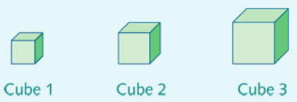
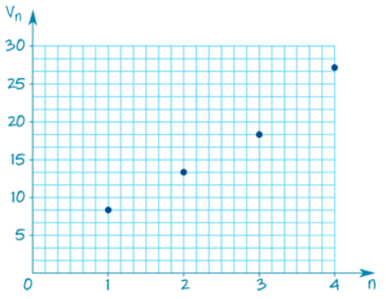
Application of geometric sequences using a recurrence relation and the rule for the $n^{th}$ term
Let $v_{n}$ be the volume (in ${cm}^{3}$) of the $n^{th}$cube in this sequence of cubes.
A recurrence relation that can be used to generate the volumes of this sequence of cubes is:
$v_{1}$=8 ${cm}^{3}$, ${ v}_{n+1}$=1.5 $v_{n}$
1. Use the recurrence relation to generate the volumes of the first four cubes in this sequence and use these volumes to construct a table showing the cube number (𝑛) and its volume (𝑉𝑛).
2. Use the table to plot the volume of the cube against cube number and comment on the form of the graph.
3. Use the rule for the $n^{th}$ term for this sequence to predict the volume of the ${10}^{th}$ cube in this sequence.
Example 2
$v_{n+1}$=1.5× $v_{n}$
$v_{1}$ =8
$v_{2}$ =1.5× $v_{1}$ =1.5×8=12
$v_{3}$ =1.5× $v_{2}$ =1.5×12=18
$v_{4}$ =1.5× $v_{3}$ =1.5×18=278
The plot is non-linear and curves upwards.
Notes:
The Snake shapes below are made using blocks, each with a side length of 1 unit.
The perimeter of each Snake shape can be found by counting the sides of the blocks around the outside of the shape. The perimeter of each new snake built is 6 units longer than the previous snake.
Let 𝑃𝑛 be the perimeter of the Snake shape 𝑛.

Slide 12
Using a recurrence relation to generate a geometric sequence
A recurrence relation that can be used to generate the volumes of this sequence of cubes is:
$v_{1}$=8 ${cm}^{3}$, ${ v}_{n+1}$=1.5 $v_{n}$
3. Use the rule for the $n^{th}$ term for this sequence to predict the volume of the ${10}^{th}$ cube in this sequence.
The $n^{th}$ term of geometric sequence is given by:
t_{n} = a $×$ ${\text{R}}^{\text{n}}$
Rule
$$v_{10}$$
8
10
1.5
v₁₀ = 8 $× {\text{1.5}}^{\text{10} }$
v₁₀ = 8 $× {\text{1.5}}^{10}$
Example 2
v₁₀ = 462 ${cm}^{3}$

Slide 13
Application of geometric sequences using a recurrence relation and the rule for the $n^{th}$ term
Let $v_{n}$ be the volume (in ${cm}^{3}$) of the $n^{th}$cube in this sequence of cubes.
A recurrence relation that can be used to generate the volumes of this sequence of cubes is:
$v_{1}$=8 ${cm}^{3}$, ${ v}_{n+1}$=1.5 $v_{n}$
1. Use the recurrence relation to generate the volumes of the first four cubes in this sequence and use these volumes to construct a table showing the cube number (𝑛) and its volume (𝑉𝑛).
2. Use the table to plot the volume of the cube against cube number and comment on the form of the graph.
3. Use the rule for the $n^{th}$ term for this sequence to predict the volume of the ${10}^{th}$ cube in this sequence.
Example 2
Notes:
The Snake shapes below are made using blocks, each with a side length of 1 unit.
The perimeter of each Snake shape can be found by counting the sides of the blocks around the outside of the shape. The perimeter of each new snake built is 6 units longer than the previous snake.
Let 𝑃𝑛 be the perimeter of the Snake shape 𝑛.

Slide 14
Questions & Summary Book
2. What is Recurrence Relation and what are equations of its rules?
1. Ex Booklet 3G
3. Summary notes for Homework.

