Slide 1
3H Finance applications using geometric sequences and recurrence relations

Slide 2
Learning intentions
To be able to use a recurrence relation to model compound interest for investments or loans.
To be able to write a recurrence relation to model a loan that compounds with a different compounding period.
To be able to use a recurrence relation to model reducing-balance depreciation.

Slide 3
Geometric growth and decay
Geometric growth = Compound interest
Geometric decay = reducing-balance depreciation

Slide 4
The recurrence relation for compounding interest investments and loans that compound yearly
Let $v_{n}$ be the value of the investment after n years.
Let r be the percentage interest per compound period.
The recurrence model for the value of the investment after n compounding periods is:
$v_{0}$ = principal, $v_{n+1}$ = R × $v_{n}$
where: R = 1 + $\frac{r}{100}$
Compound interest rate
Growth Factor

Slide 5
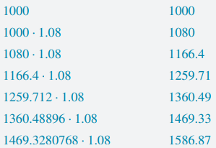
Using a recurrence relation to model geometric growth: a compound interest investment

Slide 6
Using a recurrence relation to model geometric growth: a compound interest investment
Interest rate:
$r_{yearly}=4.2$ $r_{quarterly}$= $\frac{4.2}{4}=1.05$ $r_{monthly}$= $\frac{4.2}{12}=0.35$
Growth factor:
$R_{yearly}=1+\frac{4.2}{100}=1.042 R_{quarterly}$= $1+\frac{1.05}{100}=1.0105 R_{monthly}$=$1+\frac{0.35}{100}=1.0035$
Recurrence relation:
$v_{0}$ = principal, $v_{n+1}$ = R × $v_{n}$
$v_{0}$ = 6000, $v_{n+1}$ = 1.042 × $v_{n}$ $v_{0}$ = 6000, $v_{n+1}$ = 1.0035× $v_{n}$
$v_{0}$ = 6000, $v_{n+1}$ = 1.0105× $v_{n}$

Slide 7
The recurrence relation for reducing-balance depreciation
Decay Factor
Depreciation rate
Minus for Depreciation

Slide 8
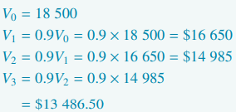
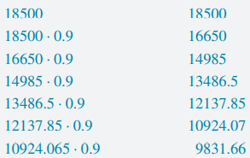
Using a recurrence relation to model geometric decay: reducing-balance depreciation

