Slide 1
Finding term n in a sequence modelling geometric growth and decay
3I

Slide 2
Using recurrence relations to model growth and decay
Linear growth and decay
Arithmetic Sequence
e.g. Simple Interests
Flat-rate or straight-line depreciation
Geometric growth and decay
Geometric Sequence
e.g. Compound Interests
Reducing balance depreciation

Slide 3
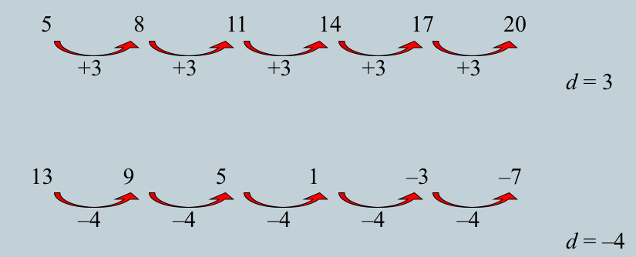
Linear growth and decay
Linear growth and decay →Arithmetic Sequence
(increases or decreases by the same amount at regular intervals.)
e.g. Simple interest
Flat-rate or straight-line depreciation: the depreciation of the value of a new car by a constant amount each year.

Slide 4
Finding the $n^{th}$ term in in a sequence used to model linear growth or decay
The $n^{th}$ term of linear growth is given by:
Growth
V_{n} = $V_{0}$ + n $×$ D
The common difference
The position the term is in
Decay
The $n^{th}$ term of linear decay is given by:
V_{n} = $V_{0}$ $−$ n $×$ D
$V_{n}$ = value of the $n_{th}$term of the sequence
$V_{0}$ = starting or initial value

Slide 5
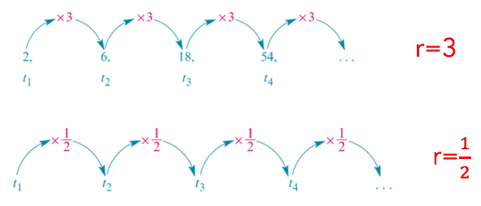
Geometric growth and decay
Geometric growth and decay →Geometric Sequence (increases or decreases by the same percentage at regular intervals.)
e.g. Compound interest
Reducing balance depreciation: a house by a constant percentage of its depreciated value each year.

Slide 6
Finding the $n^{th}$ term in in a sequence used to model geometric growth or decay
Growth
Decay
The $n^{th}$ term of geometric growth or decay is given by:
V_{n} = ${V_{0}R}^{n}$
The common ratio
$V_{n}$ = value of the $n_{th}$term of the sequence
The position the term is in
$V_{0}$ = starting or initial value

Slide 7
Compound interest loans and investment
R = 1 + $\frac{r}{100}$
Compound interest rate
Growth Factor

Slide 8
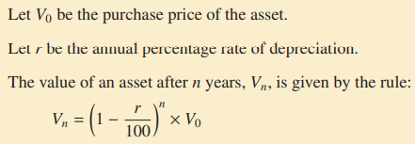
Reducing-balance depreciation
R = 1 – $\frac{r}{100}$
Depreciation rate
Minus for Depreciation
Decay Factor

Slide 9
Using a rule for determining the $n^{th}$ term for geometric growth or decay
V_{n} =R^{n} $V_{0}$
starting or initial value
position number of the term
The $n^{th}$ term
Common ratio
The following recurrence relation can be used to model a compound interest investment of $1000 paying interest at the rate of 10% per year.
$V_{0}$=1000, ${ V}_{n+1}$=1.1 $V_{n}$ Use a rule to find the value of the investment after 15 years correct to the nearest dollar.
V_{n} = R^{n} $V_{0}$
R = 1 + $\frac{r}{100}=\text{1 + }\frac{10}{100}$
=1.1
$a=$ 1000
$$V_{15}$$
R $\text{= }1.1$
n= 15
V₁₅ = 1.1¹⁵ x 1000
= $4177.24… = $4177 (nearest dollar)
Notes:
Write on whiteboard

Slide 10
Using a rule for determining the $n^{th}$ term for geometric growth or decay
V_{n} =R^{n} $V_{0}$
starting or initial value
position number of the term
The $n^{th}$ term
Common ratio
The following recurrence relation can be used to model the reducing balance depreciation of a car purchased for $18500 where the value of the car depreciates in value at the rate of 10% per year.
$V_{0}$=18500, ${ V}_{n+1}$=0.9 $V_{n}$ Use a rule to find the value of the investment after 12 years correct to the nearest dollar.
V_{n} = R^{n} $V_{0}$
R = 1 – $\frac{r}{100}=\text{1–}\frac{10}{100}$
=0.9
$a=$ 18500
$$V_{12}$$
R $\text{= }0.9$
n= 12
V₁₂ = 0.9¹² x 18500
=$5224.90…=$5225(nearest dollar)
Notes:
Write on whiteboard

Slide 11
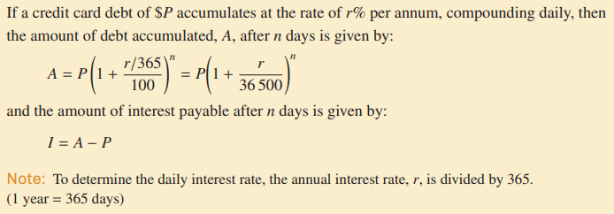
Calculating credit card debt

Slide 12
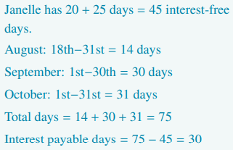
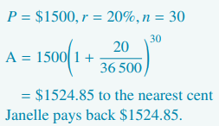
Calculating credit card interest with an interest-free period

Slide 13
Purchase and investment options

Slide 14
Purchase options
R = 1 + $\frac{r}{100}=\text{1 + }\frac{6}{100}$ = 1.06
V_{n} =R^{n} $V_{0}=\text{1.06}\text{2}×2000=\$2247.20$

Slide 15
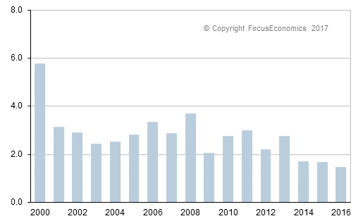
Inflation: Effect on prices and purchasing power
In the early 1970s, inflation rates were very high, up to around 16% and 17%. Between 2009 and 2020, inflation in Australia has been low but continued to fluctuate, ranging from 0.9% and 3.3%.
This has the effect of steadily reducing the purchasing power of your money; that is, what you
can actually buy with your money.

Slide 16
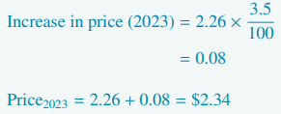
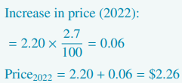
Determining the effect of inflation on prices over a short period of time

Slide 17
Determining the effect of inflation on prices over a long period

Slide 18
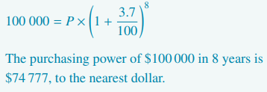
Investigating purchasing power

Slide 19
Questions & Summary Book
2. What is the linear growth and decay?
1. Ex Booklet 3I
5. Summary notes for Homework.
3. What is the geometric growth and decay? Difference between Linear and Geometric?
4. Calculating the $n^{th}$term for growth or decay.
4. Calculating the 𝑛^𝑡ℎterm for growth or decay.

