Slide 1
Number patterns and recursion Revision
Lesson 9

Slide 2
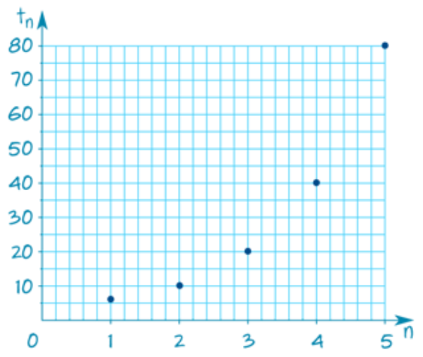
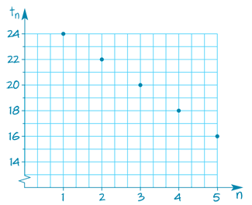
Arithmetic vs. Geometric Sequences
Arithmetic Sequences
Increases by the common difference D
Addition or Subtraction
D = $t_{n}$ – $t_{n−1}$
Geometric Sequences
Increases by the common ratio R
Multiplication or Division
R = $\frac{t_{n}}{t_{n−1}}$
Common difference D
=any term $−$ the previous term
=$t_{2}−$ $t_{1}$= $t_{3} − t_{2}$= $t_{4} − t_{3}$
=…
Curve
increasing when R>1
decreasing towards zero when 0<R<1
Straight Line
increasing when D>0
decreasing towards zero when D<0

Slide 3
Definition of Arithmetic Sequence
A sequence is arithmetic if the differences between consecutive terms are the same.
4, 9, 14, 19, 24, . . .
arithmetic sequence
9 – 4 = 5
14 – 9 = 5
19 – 14 = 5
24 – 19 = 5
The common difference, D, is 5.

Slide 4
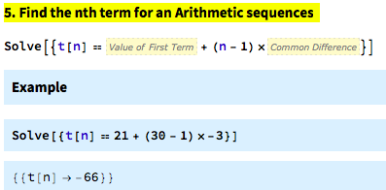
Finding the $n^{th}$ term in an arithmetic sequence
Find $t_{30}$, the 30th term in the arithmetic sequence: 21, 18, 15, 12, …
The $n^{th}$ term of an arithmetic sequence is given by:
t_{n} = a + n *D
Rule
$$t_{30}$$
21
30
-3
t₃₀ = 21 + 30 × (-3)
t₃₀ = 21 -90
t₃₀ = -69

Slide 5
Recurrence Relations for Arithmetic Sequences
Recurrence Relations describe the relationship between consecutive terms in a sequence
Example: A sequence is defined by the $n^{th}$ term:
$$t_{1}=a$$
$t_{n+1}=t_{n}$+ D
a= the first term
d= common difference
Recurrence Relations Rule

Slide 6
Using a recurrence relation to generate an arithmetic sequence
Generate and graph the first five terms of the sequence defined by the recurrence relation: $t_{1}$=24, $t_{n+1}$= $t_{n}$−2
Recurrence Relations Rule
$∵t_{1}=24$, $t_{n+1}=t_{n}−$2
$∴$ The first five terms are
$t_{1}$=24
$t_{2}$= $t_{1}$−2=24−2=22
$t_{3}$= $t_{2}$−2=22−2=20
$t_{4}$= $t_{3}$−2=20−2=18
$t_{5}$= $t_{4}$−2=18−2=16
$$t_{1}=a$$
$t_{n+1}=t_{n}$+ D
To graph the terms, plot $t_{n}$against 𝑛.

Slide 7
Finding the common ratio r
Find the common ratio in each of the following geometric sequences.
A. 3,12,48,192,… B. 16,8,4,2,…
Common ratio, R = $\frac{t_{2}}{t_{1}}$ = $\frac{12}{3}$= 4
Common ratio, R = $\frac{t_{2}}{t_{1}}$ = $\frac{8}{16}$= $\frac{1}{2}$
The common ratio R = 4
The common ratio R = $\frac{1}{2}$

Slide 8
Recurrence Relations for Geometric Sequence
Recurrence Relations describe the relationship between consecutive terms in a sequence.
Example: A sequence is defined by the $n^{th}$ term:
$$t_{1}=a$$
$t_{n+1}=t_{n}$× R
a= the first term
r= common ratio
Recurrence Relations Rule
For Geometric Sequences

Slide 9
Finding the $n^{th}$ term in a geometric sequence
Example: Consider the geometric sequence: 2, 6, 18, 54, 162, 486, …
$t_{n+1}=3t_{n}$, $t_{1}=2$
Given that $a=t_{1}=2$ write down the first six terms of the sequence
$$t_{1}=2$$
$$∴2, 6, 18, 54,162,486…$$
$$t_{2}=t_{1}×3$$
$=2×3$
$=6$
$$t_{3}=t_{2}×3$$
$=6×3$
$=18$
$$t_{4}=t_{3}×3$$
$=18×3$
$=54$
$$t_{5}=t_{4}×3$$
$=54×3$
$=162$
$$t_{6}=t_{5}×3$$
$=162×3$
$=486$

Slide 10
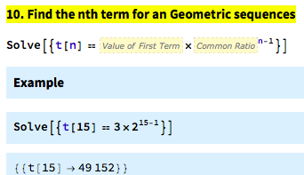
Finding the $n^{th}$ term in a geometric sequence
t_{n} = a x R^{n}
Common ratio
position number of the term
The $n^{th}$ term
The first term ${a= t}_{1}$
Find $t_{15}$, the ${15}^{th}$ term in the geometric sequence: 3, 6, 12, 24, …
t_{n} = a x R^{n}
R = $\frac{t_{2}}{t_{1}}\text{= }\frac{6}{3}\text{= }2$
$$t_{15}$$
$a=$ 3
n= 15
t₁₅ = 3 x 2¹⁵
= 3 x 2¹⁵
= 98304
Notes:
Write on whiteboard

Slide 11
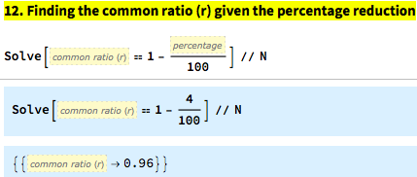
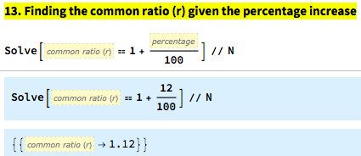
Calculating the common ratio from percentage change
State, correct to two decimal places, the first four terms in each of these geometric sequences for the changes given.
A. Starts at 200 and each new term is 4% less than the previous term.
B. Starts at 500 and each new term is 12% more than the previous term.
$$R=1−\frac{P}{100}$$
$$a=200$$
$$P=4$$
$$R=96\%=0.96$$
$$or$$
$$R=1−\frac{4}{100}=0.96$$
$$R=1+\frac{P}{100}$$
$$a=500$$
$$P=12$$
$$R=112\%=1.12$$
$$or$$
$$R=1+\frac{12}{100}=1.12$$

Slide 12
Using recurrence relations to model growth and decay
Linear growth and decay
Arithmetic Sequence
e.g. Simple Interests
Flat-rate or straight-line depreciation
Geometric growth and decay
Geometric Sequence
e.g. Compound Interests
Reducing balance depreciation

Slide 13
Finding the $n^{th}$ term in in a sequence used to model linear growth or decay
The $n^{th}$ term of linear growth is given by:
Growth
V_{n} = $V_{0}$ + n $×$ D
The common difference
The position the term is in
Decay
The $n^{th}$ term of linear decay is given by:
V_{n} = $V_{0}$ $−$ n $×$ D
$V_{n}$ = value of the $n_{th}$term of the sequence
$V_{0}$ = starting or initial value

Slide 14
Finding the $n^{th}$ term in in a sequence used to model geometric growth or decay
Growth
Decay
The $n^{th}$ term of geometric growth or decay is given by:
V_{n} = $R^{n}$ $V_{0}$
The common ratio
$V_{n}$ = value of the $n_{th}$term of the sequence
The position the term is in
$V_{0}$ = starting or initial value

Slide 15
Using a recurrence relation to model linear growth: simple interest
The following recurrence relation can be used to model a simple interest investment of $2000 paying interest at the rate of 7.5% per annum.
$V_{0}$=2000, $V_{n+1}$= $V_{n}$+150 $V_{n}$ = Value of the investment after 𝑛 years.
1. Use the recurrence relation to find the value of the investment after 1, 2 and 3 years.
2. When will the investment reach $2750 in value?
5 years
$V_{0}$=2000 $V_{1}$=$V_{0}$+150=2000+150=$2150 $V_{2}$= $V_{1}$+150=2150+150=$2300 $V_{3}$= $V_{2}$+150=2300+150=$2450
1 2. 3 4 5. 6. 7. 8. 9. 10

Slide 16
Questions & Summary Book
2. Difference between Arithmetic and Geometric Sequence?
1. Ex Booklet Revision
5. Summary notes for Homework.
3. What is the Recurrence Relations of Arithmetic and Geometric Sequence?
4. Calculating the $n^{th}$term for Arithmetic and Geometric Sequences.
4. Calculating the 𝑛^𝑡ℎterm for Arithmetic and Geometric Sequences.

