Slide 1
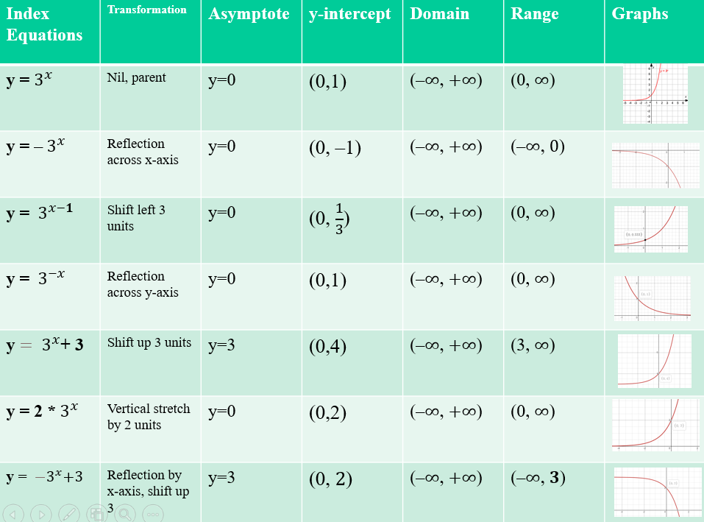
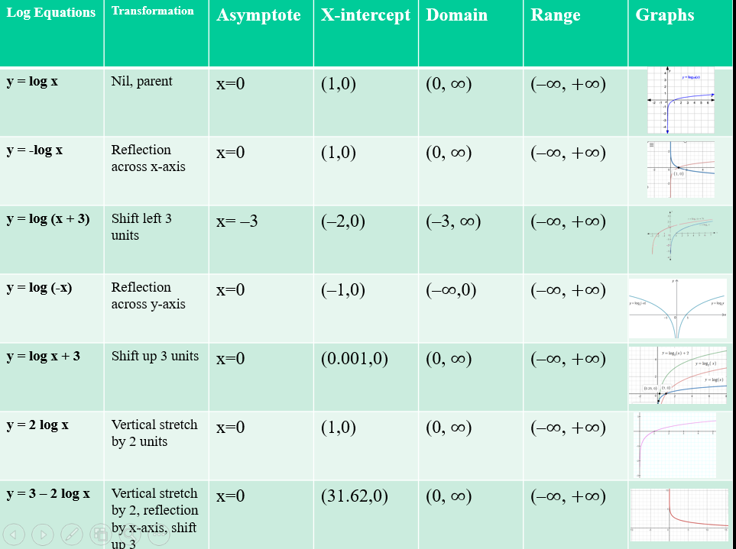

Slide 2
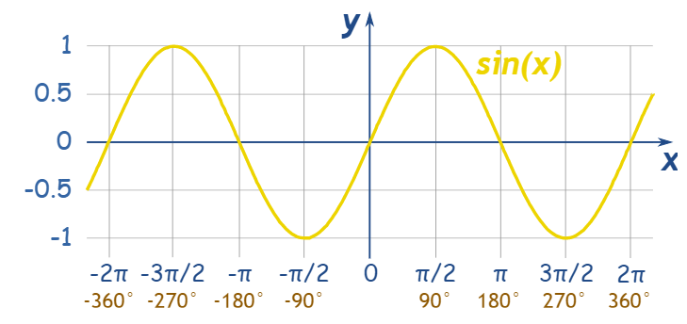
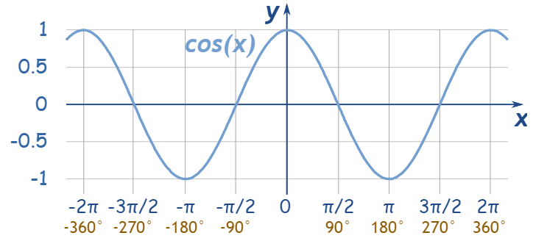
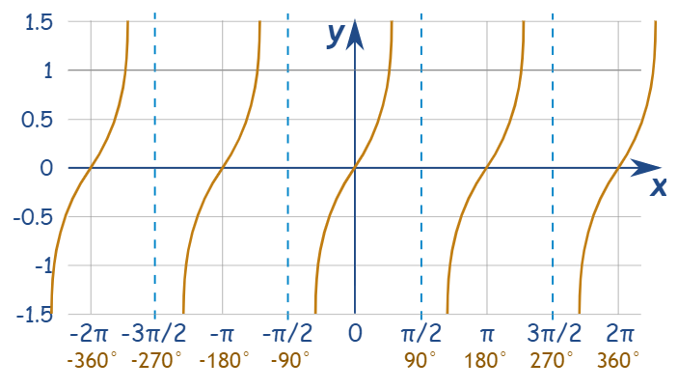
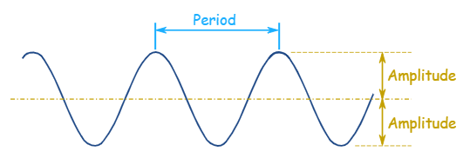
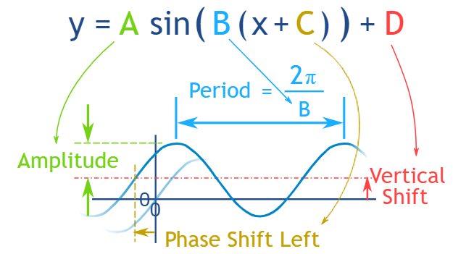
tan(x)

Slide 3
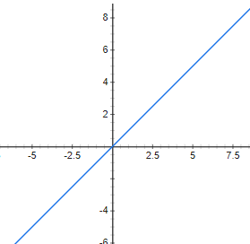
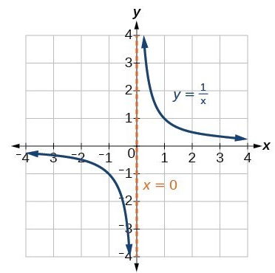
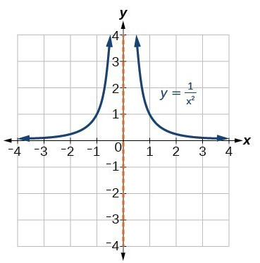
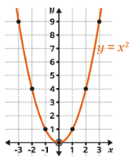
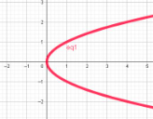
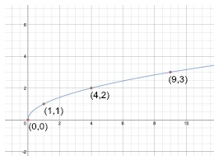
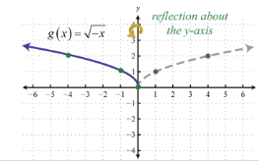
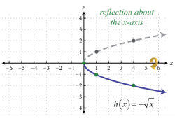
Names | Equations | Parent graphs | Transformation equations
Linear/straight line | y=x |  | y=a+bx
Hyperbola | y=$\frac{1}{x}$ |  | $$y=\frac{a}{x−h}+k$$
Truncus | $$y=\frac{1}{x^{2}}$$ |  | $$y=\frac{a}{{\left(x−h\right)}^{2}}+k$$
Parabola | $$y=x^{2}$$ |  | $$y=a{\left(x−h\right)}^{2}+k$$
Sideway Parabola | $$y^{2}=x$$ |  | $${\left(y−k\right)}^{2}=a^{2}\left(x−h\right)$$
Square root | $$y=\sqrt{x}$$ |  | $$y=a\sqrt{x−h}+k$$
Square root | $$y=\sqrt{−x}$$ |  | $$y=a\sqrt{−(x−h)}+k$$
Square root | $$y=−\sqrt{x}$$ |  | $$y=a\sqrt{x−h}+k$$

Slide 4
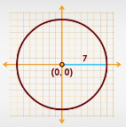
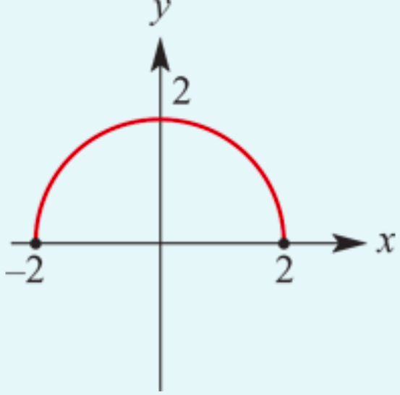
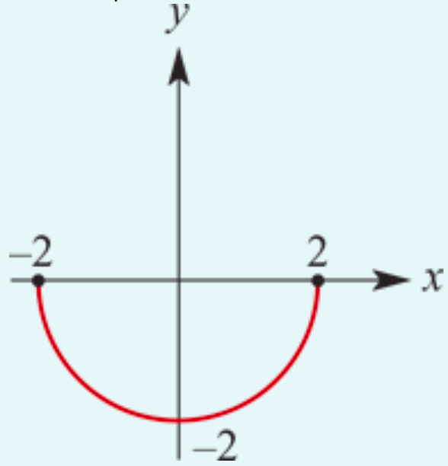
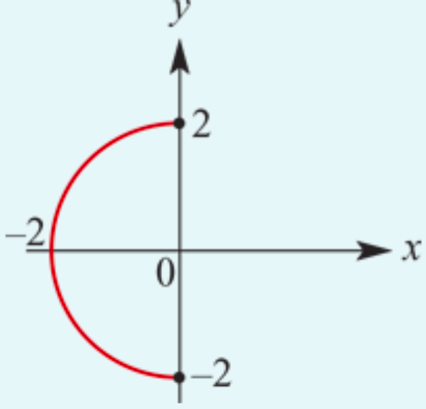
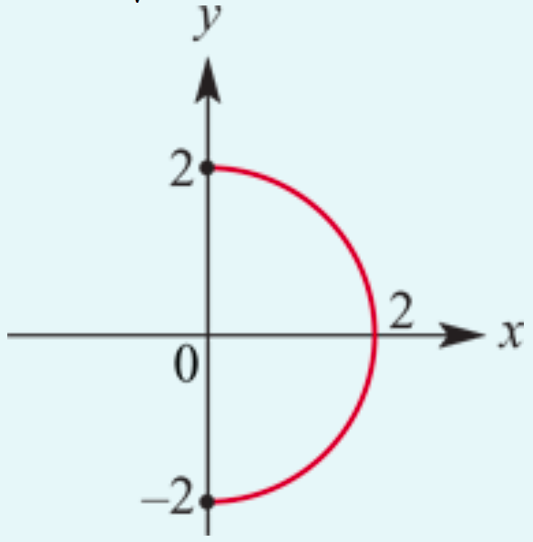
Names | Equations | Parent graphs | Transformation equations
Circle | $$x^{2}+y^{2}=r^{2}$$ |  | (𝑥-ℎ)² +(𝑦− 𝑘)² = 𝑟²
Half circle | 𝑦 =+$\sqrt{r^{2}\text{− }\text{x}\text{2} }$
Half circle | 𝑦=− $\sqrt{r^{2}\text{− }\text{x}\text{2} }$
Half circle | 𝑥=− $\sqrt{r^{2}\text{−}\text{y}\text{2} }$
Half circle | 𝑥=+ $\sqrt{r^{2}\text{−}\text{y}\text{2} }$

