Slide 1
Applying function notation
5F

Slide 2
Functional Notation: Find the following

Slide 3
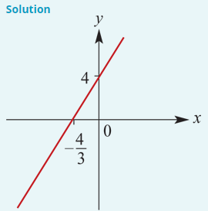
Example 2
If f:R→R, f(x)=ax+b such that f(1)=7 and f(5)=19, find a and b and sketch the graph of y=f(x).
Since f(1)=7 and f(5)=19,
7 =a+b (1)
19 =5a+b (2)
Subtract (1) from (2):
12=4a
Thus a=3 and substituting in (1) gives b=4.
Hence f(x)=3x+4.

Slide 6
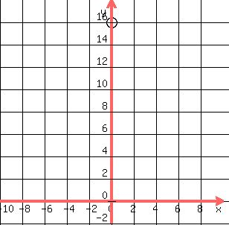
Example 3
Find the quadratic function f such that f(4)=f(−2)=0 and f(0)=16.
Solution
Since 4 and −2 are solutions to the quadratic equation f($x$)=0, we have
f($x$)=d(x+2) (x−4)
Since f(0)=16, we obtain
16 =d(2) (−4) → 16=d(−8)
∴ d =−2
Hence f($x$) = =−2($x$−4)($x$+2)=−2($x^{2}$−2$x$−8)=−2$x^{2}$+4$x$+16
a= –2, b=4

Slide 7
Example 4
Find the quadratic function f such that f(4)=f(−2)=0 and Maximum =18.
Solution
Since 4 and −2 are solutions to the quadratic equation f($x$)=0, we have
f($x$)=d(x+2) (x−4)
Symmetry line between −2 &4, x= $\frac{−2+4}{2}=1$
Since Max=18, f(1)=18
18 =d(3) (−3) → 18=d(−9)
∴ d =−2
Hence f($x$) = =−2($x$−4)($x$+2)=−2($x^{2}$−2$x$−8)=−2$x^{2}$+4$x$+16
a= –2, b=4

Slide 8
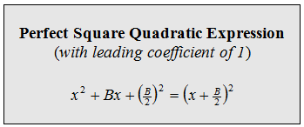
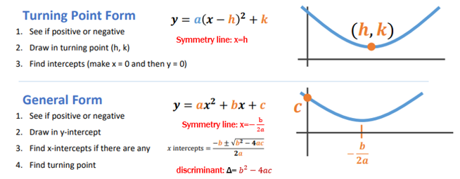
Another way to find Max or Min?
Find minimum value for f(x)=$x^{2}−8x+18$
f(x)= $x^{2}−8x$+16 $−$16 +18
f(x)= ${(x−4)}^{2}−$16 +18
f(x)= ${(x−4)}^{2}$+2
Minimum value =2

