Slide 1
Solving harder financial problems
8G
Notes:
https://create.kahoot.it/details/312d4b93-6016-4c7c-a837-76ed8bd1e86a

Slide 2
Learning intentions
To be able to find the value of an investment when the regular payment changes.
To be able to analyse the impact of a change in the interest rate on a reducing balance loan, an annuity and an investment.

Slide 3

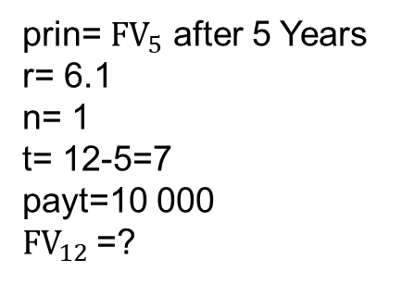
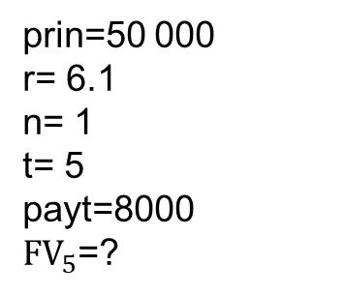
Finding the value of an investment when the regular payment changes
Derek invests $50 000 into a compound interest investment paying 6.1% per annum, compounding annually. Derek invests an additional $8000 per year immediately after interest is calculated.
After five years, Derek increases his additional investment to $10 000 per year.
Calculate the value of Derek’s investment after twelve years (in total).
prin=50 000
r= 6.1
n= 1
t= 5
payt=8000
$FV_{5}$=?
Plus sign for FV ↑
prin=$FV_{5}$=112414
r= 6.1
n= 1
t= 7
payt=10 000
$FV_{12}$=?
prin= $FV_{5}$ after 5 Years
r= 6.1
n= 1
t= 12-5=7
payt=10 000
$FV_{12}$=?
The value of Derek’s investment is $254 343.

