Slide 1
Set notation and sets of numbers
5A

Slide 2
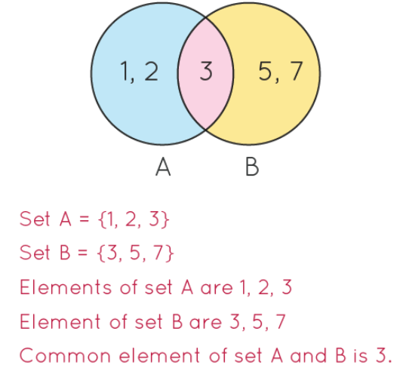
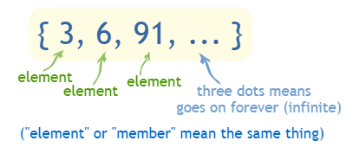
Sets & Elements
C =
3 ∊ C
4 ∉ C
15 ∉ C

Slide 4
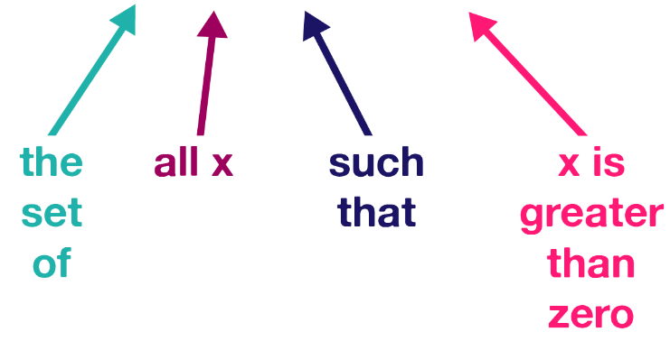

Slide 5
What is a set?
In maths, it’s often useful to represent a collection of items.
We use curly braces to indicate a set of items...
!
𝐴={−3,3}={𝑥 :${ x}^{2}$=9}
A set is a collection of items with 2 properties:
a. It doesn’t contain duplicates.
?
b. The order of the elements does not matter. (but we usually write the items in ascending order)
?
Note: {𝑥:…} is read as ‘the set of all 𝑥 such that …’.
Notes:
Note: {𝑥:…}{x:…} is read as ‘the set of all 𝑥 such that …’.

Slide 6
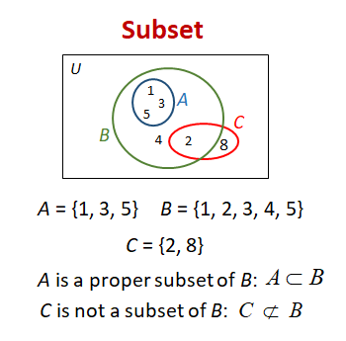
Subsets
A
B

Slide 7
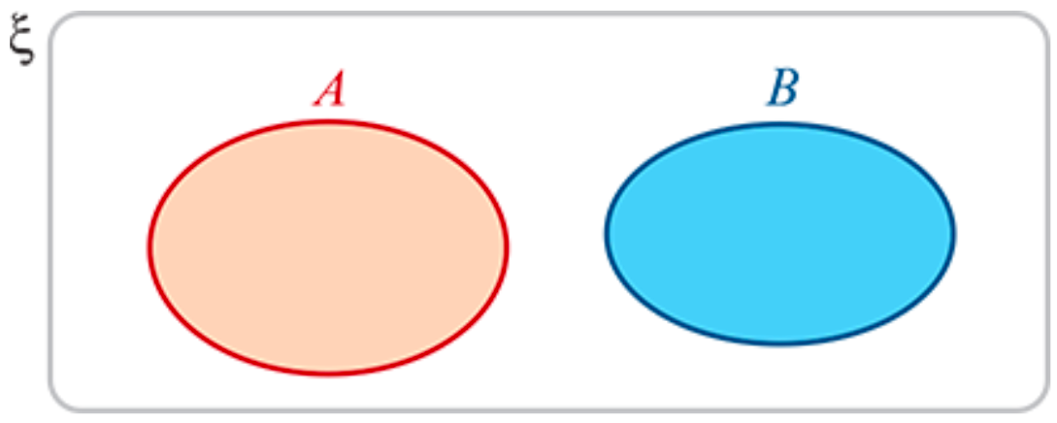
Venn diagrams
Venn diagrams are used to illustrate sets.
Disjoint: Two sets have no elements in common.

Slide 8
Union
The union of two sets A and B is the set of all elements x such that x is in A OR x is in B
Notation: A ∪ B = { x | x ∊ A or x ∊ B}
A
B
A ∪ B

Slide 9
Intersection
The intersection of two sets A and B is the set of all elements x such that x is in A AND x is in B
Notation: A ∩ B = { x | x ∊ A and x ∊ B}
A
B
A ∩ B

Slide 10
The complement of a set
If 𝜉={1,2,3,4,5,6,7,8,9,10} and 𝐴={1,3,5,7,9}, then 𝐴′={2,4,6,8,10}.
𝜉

Slide 11
Numbers

Slide 12
Numbers
The numbers of the form $\frac{p}{\text{q}}$, with 𝑝 and 𝑞 integers, 𝑞≠0

Slide 13
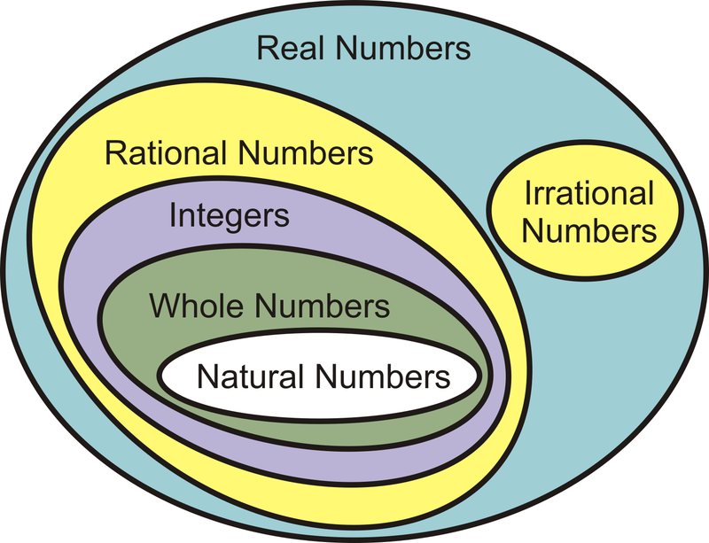
Numbers
Recall that the elements of {1,2,3,4,…} are called natural numbers, and the elements of {…,−2,−1,0,1,2,…} are called integers.
The numbers of the form $\frac{p}{\text{q}}$, with 𝑝 and 𝑞 integers, 𝑞≠0, are called rational numbers.
The real numbers which are not rational are called irrational. Some examples of irrational numbers are $\sqrt{2}$, $\sqrt{3}$, 𝜋, 𝜋+2 and $\sqrt{6}$+$\sqrt{7}$. These numbers cannot be written in the form $\frac{p}{\text{q}}$, for integers 𝑝,𝑞; the decimal representations of these numbers do not terminate or repeat.

Slide 14
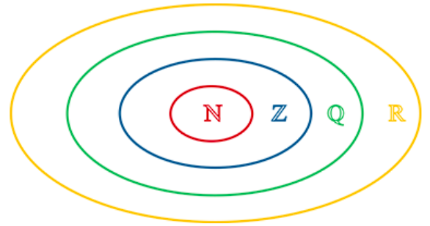
Numbers
The set of real numbers is denoted by ℝ.
The set of rational numbers is denoted by ℚ.
The set of integers is denoted by ℤ.
The set of natural numbers is denoted by ℕ.
It is clear that ℕ⊆ℤ⊆ℚ⊆ℝ, and this may be represented by the diagram on the right.

Slide 15
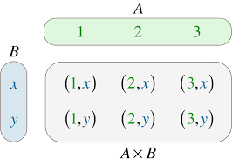
Cartesian product
We can use set notation to describe subsets of the real numbers.
For example:
{𝑥: 0<𝑥<1} is the set of all real numbers strictly between 0 and 1
{𝑥: 𝑥>0, 𝑥∈ℚ} is the set of all positive rational numbers
{2𝑛: 𝑛=0,1,2,…} is the set of all non-negative even numbers.
The set of all ordered pairs of real numbers is denoted by ${\text{ℝ}}^{2}$. That is,
${\text{ℝ}}^{2}$ ={(𝑥,𝑦): 𝑥,𝑦∈ℝ}
This set is known as the Cartesian product of ℝ with itself.

Slide 16
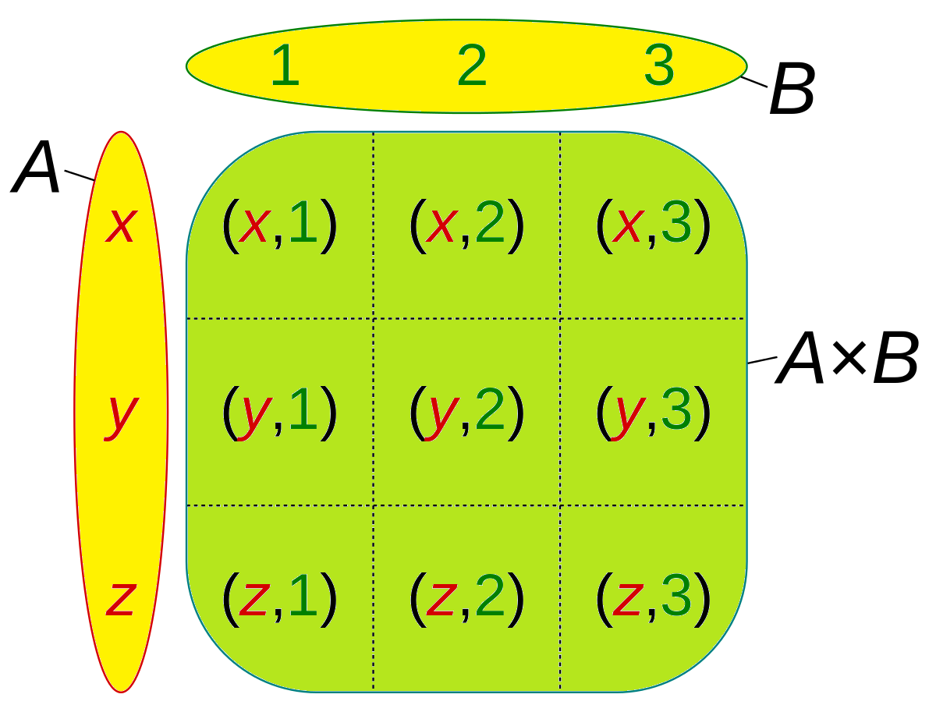

Slide 17
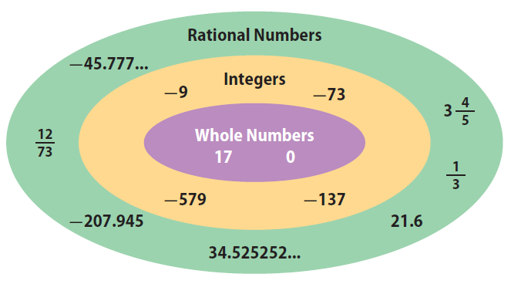
Rational numbers
Every rational number can be expressed as a terminating or recurring decimal.
To find the decimal representation of a rational number $\frac{m}{n}$, perform the division 𝑚÷𝑛.
For example, to find the decimal representation of $\frac{3}{7}$, divide 3.0000000… by 7.
Therefore $\frac{3}{7}$=0.$\dot{\text{4}}$2857$\dot{\text{1}}$.

Slide 18
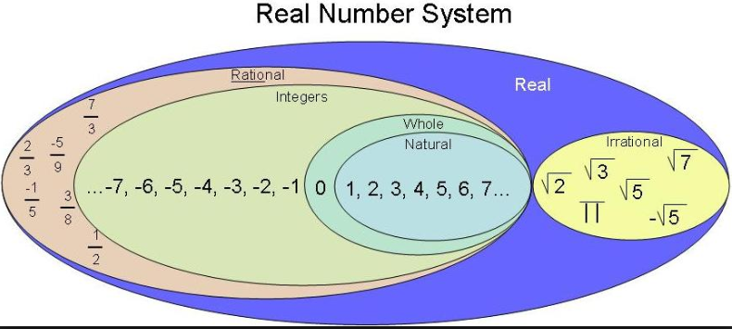
Example: Write each of the following in the form $\frac{m}{n}$, where 𝑚 and 𝑛 are integers:
0.05
0.$\dot{\text{4}}$2857$\dot{\text{1}}$
0.05= $\frac{5}{100}$= $\frac{1}{20}$
0.$\dot{\text{4}}$2857$\dot{\text{1}}$=0.428571428571428571…(1)
Multiply both sides by ${10}^{6}$:
0.$\dot{\text{4}}$2857$\dot{\text{1}}$× ${10}^{6}$=428571.428571428571…(2)
Subtract (1) from (2): → 0.$\dot{\text{4}}$2857$\dot{\text{1}}$×(${10}^{6}$−1)=428571
∴0.$\dot{\text{4}}$2857$\dot{\text{1}}$= $\frac{\text{428571}}{{10}^{6}\text{−1}}$= $\frac{3}{7}$

Slide 19
Real numbers
The set of real numbers is made up of two important subsets: the algebraic numbers and the transcendental numbers.
An algebraic number is a solution to a polynomial equation of the form
$a_{n}x^{n}$+ $a_{n−1}x^{n−1}$+⋯+ $a_{1}$𝑥+ $a_{0}$=0, where $a_{0}$, $a_{1}$,…, $a_{n}$ are integers
Every rational number is algebraic. The irrational number $\sqrt{2}$ is algebraic, as it is a solution of the equation
$x^{2}$−2=0
It can be shown that 𝜋 is not an algebraic number; it is a transcendental number. The proof is too difficult to be given here.

Slide 20
Real numbers

Slide 21
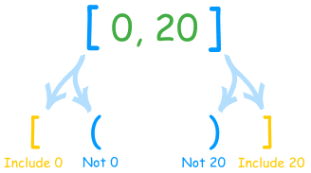
Interval notations
Closed interval: [a,b] is the set of all numbers not smaller than a and not bigger than b
[a,b] = {x: a≤x≤b}
Example:
[-1,3]
-1
3
x

Slide 22
Interval notations
Open intervals: (a,b) is the set of all numbers bigger than a and smaller than b
(a,b) = {x: a<x<b}
Example:
(-1,3)
-1
3
x

Slide 23
Interval notations
Half-Open (half-closed) intervals: (a,b] is the set of all numbers bigger than a and smaller than or equal to b
(a,b] = {x: a<x≤b}
Example:
(-1,3]
The interval [a,b) is defined similarly
-1
3
x

Slide 24
Infinite intervals
[a,∞) = {x: a≤x}
(a, ∞) = {x: a<x}
(-∞,a] = {x: x≤a}
(-∞,a) = {x: x<a}
The whole real line R = (-∞, ∞)
a
a
a
a
Note: ∞ is not a number!

Slide 25
Interval notation
Among the most important subsets of ℝ are the intervals. We suppose that 𝑎 and 𝑏 are real numbers with 𝑎<𝑏.
(a, b) = {x: a < x < b} [a, b] = {x: a ≤ x ≤ b}
(a, b] = {x: a < x ≤ b}. [a, b) = {x: a ≤ x < b}
(a, ∞) = {x: a < x} [a, ∞) = {x: a ≤ x}
(-∞, a) = {x: x < a} (-∞, a] = {x: x ≤ a}
The ‘closed’ circle (∙) indicates that the number is included.
The ‘open’ circle (∘) indicates that the number is not included.
The following are subsets of the real numbers for which we have special notation:
Positive real numbers: ${\text{ℝ}}^{+}$ ={𝑥: 𝑥 > 0}
Negative real numbers: ${\text{ℝ}}^{−}$ ={𝑥: 𝑥 < 0}
Real numbers excluding zero: ℝ∖ {0}

Slide 26
Illustrate each of the following intervals of real numbers:
[−2,3]
(−3,4]
(−∞,2]
(−2,4)
(−3,∞)

Slide 27
Section summary
If x is an element of a set A, we write x∈A.
If x is not an element of a set A, we write x∉A.
If every element of B is an element of A, we say B is a subset of A and write B⊆A.
The set A∩B is the intersection of A and B, where x∈A∩B if and only if x∈A and x∈B.
The set A∪B is the union of A and B, where x∈A∪B if and only if x∈A or x∈B.
The set A∖B is the set difference of A and B, where A∖B={x:x∈A, x∉B}.
If the sets A and B have no elements in common, we say A and B are disjoint and write A∩B=∅. The set ∅ is called the empty set.
Sets of numbers:
Real numbers: R
Rational numbers: Q
Integers: Z
Natural numbers: N
For real numbers a and b with a<b, we can consider the following intervals:
(a,b) ={x:a<x<b} (a,b] ={x:a<x≤b} (a,∞) ={x:a<x} (−∞,b) ={x:x<b}
[a,b] ={x:a≤x≤b} [a,b) ={x:a≤x<b} [a,∞) ={x:a≤x} (−∞,b] ={x:x≤b}

