Slide 1
Relations, domain and range
5B
Notes:
https://create.kahoot.it/details/49477f89-7e27-47e4-953d-575b54805de4
https://create.kahoot.it/details/4f20949e-e120-4114-9340-f8934c66695f
https://create.kahoot.it/details/21f288db-d99f-4d8c-99af-667a79f30eef
https://create.kahoot.it/details/2520f82f-5388-40ee-b1cd-5d5fa1159a25
https://create.kahoot.it/details/d878278a-3664-43c6-8e2b-0b3fe8057ccd

Slide 2
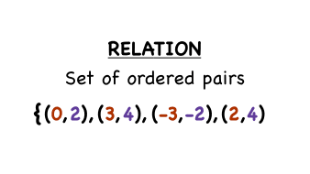
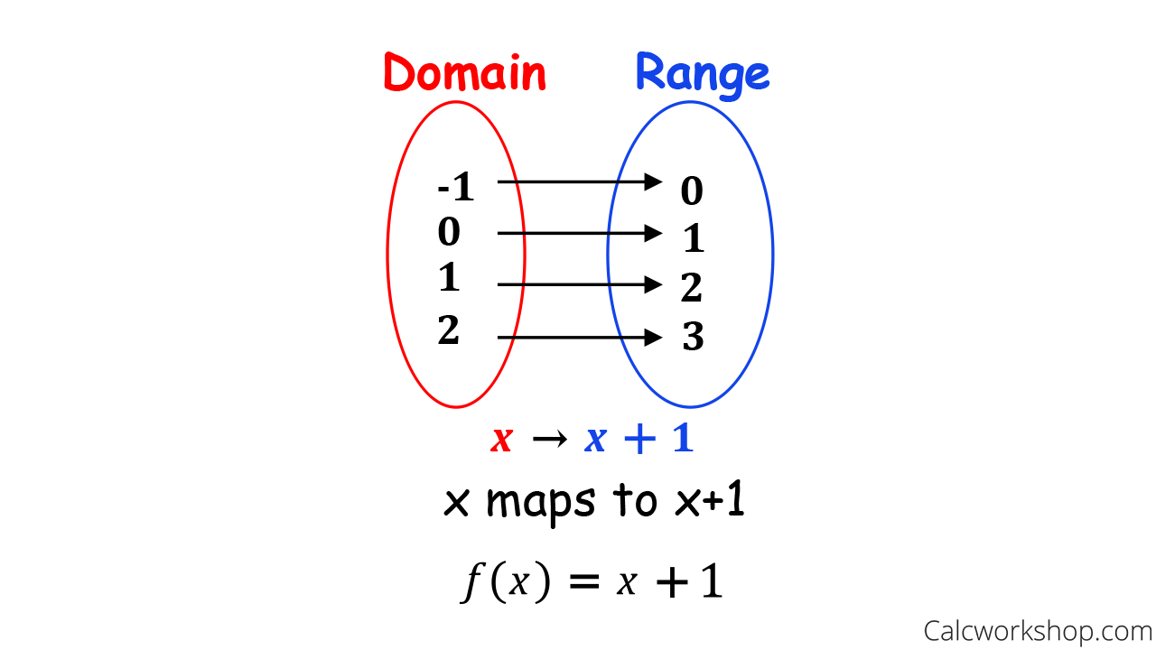
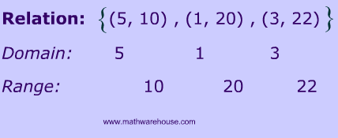
Domain, Range Relations

Slide 3
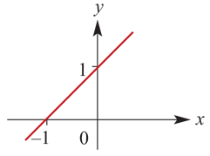
Domain, Range Graphing Relations
{(x,y):y=x+1, x∈{1,2,3,4}}
{(x,y):y=x+1, x∈R}

Slide 4
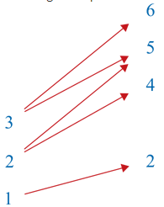
Arrow diagrams
A relation may also be represented by an arrow diagram.
This diagram represents the relation {(3,6),(3,5),(2,5),(2,4),(1,2)}:

Slide 5
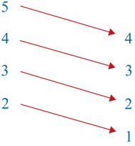
Arrow diagrams
This diagram represents the relation {(5,4),(4,3),(3,2),(2,1)}:

Slide 6
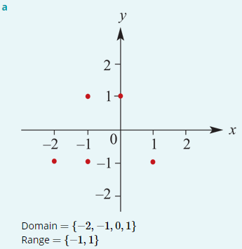
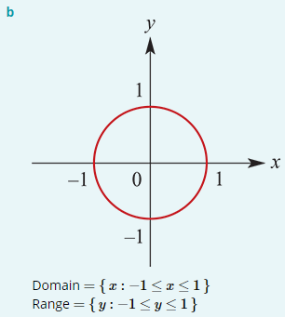
Examples
Sketch a graph of each of the following relations and state its domain and range:
a. {(−2,−1),(−1,−1),(−1,1),(0,1),(1,−1)}
b. {(x,y): $x^{2}$+ $y^{2}$=1, x∈[−1,1]}

Slide 7
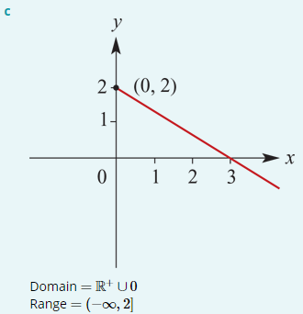
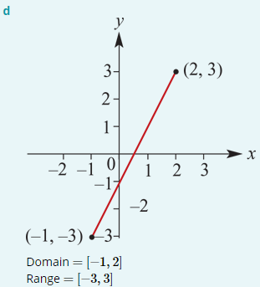
Examples
Sketch a graph of each of the following relations and state its domain and range:
c.{(x,y):2x+3y=6, x≥0}
d. {(x,y):y=2x−1, x∈[−1,2]}

Slide 8
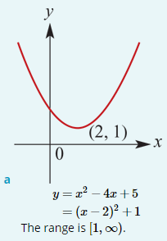
Examples
For each of the following, complete the square, sketch the graph and state the range. The domain is R.
a. y= $x^{2}$−4$x$+5
Complete the square:
$x^{2}$−4$x$+5= $x^{2}$−4$x$+4−4+5= (${x−2)}^{2}$+1
The vertex is at (2,1). The minimum value of y= $x^{2}$− 4$x$+5 is 1.

Slide 9
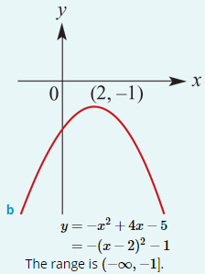
Examples
For each of the following, complete the square, sketch the graph and state the range. The domain is R.
b. y= − $x^{2}$+4$x$−5
Complete the square:
− $x^{2}$+4$x$−5 =−($x^{2}$− 4$x$+5)=−[$x^{2}$− 4$x$+4+1]=−[ ${(x−2)}^{2}$+1]=− ${(x−2)}^{2}$−1
The vertex is at (2,−1). The maximum value is −1.

Slide 10
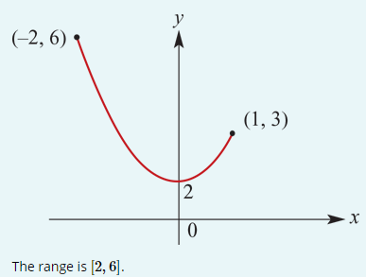
Examples
Sketch the graph of the relation y= $x^{2}$+2 for $x$∈[−2,1] and state the range.
Note that the range is not determined by considering the endpoints alone. The minimum value is 2, not 3.

Slide 11
Implied (maximal) domain
When the rule for a relation is written and no domain is stipulated, then it is understood that the domain taken is the largest for which the rule has meaning. This domain is called the maximal or implied domain.
For example, the implied domain of y= $x^{2}$ is R, and the implied domain of $x^{2}$+ $y^{2}$=1 is [−1,1].

Slide 12
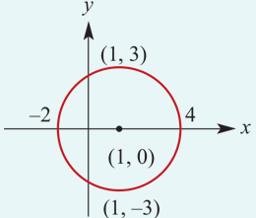
Examples
For each of the following relations, state the implied domain and the range:
a. (${x−1)}^{2}$+ $y^{2}$=9
This relation is a circle with centre (1,0) and radius 3. The implied domain is [−2,4] and the range is [−3,3].

Slide 13
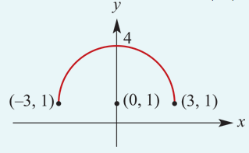
Examples
For each of the following relations, state the implied domain and the range:
b. $y =\sqrt{{9−x}^{2}}$+1
This relation is a semicircle with centre (0,1) and radius 3. The implied domain is [−3,3] and the range is [1,4].

Slide 14
{($x$, $y$): $y=x^{2}$, $x$∈[–1, $∞)$}

Slide 16
Section summary
An ordered pair, denoted (x,y), is a pair of elements x and y in which x is considered to be the first coordinate and y the second coordinate.
A relation is a set of ordered pairs.
The set of all the first coordinates of the ordered pairs is called the domain.
The set of all the second coordinates of the ordered pairs is called the range.
Some relations may be defined by a rule relating the elements in the domain to their corresponding elements in the range. In order to define the relation fully, we need to specify both the rule and the domain. For example:
{(x,y):y=x+1, x∈ $R^{+}$∪ {0}}
For a relation described by a rule with y in terms of x, the domain is the x-values and the range is the y-values.
The maximal or implied domain is the largest domain for which the rule of the relation has meaning.

