Slide 1
One-to-one functions and implied domain
5D
Notes:
Rearranging formulae matching task
https://slideplayer.com/slide/9372399/
Rearranging formulae RAG
https://www.tutor2u.net/maths/reference/rearranging-formulae-safecracker-activity

Slide 4
One-to-one functions
We have seen that a function is a special type of relation such that each x-value maps to only one y-value.
A function is said to be one-to-one if different x-values map to different y-values. That is, a function f is one-to-one if a≠b implies f(a)≠f(b), for all a,b∈dom f. Another way to say this is that a one-to-one function cannot contain two different ordered pairs with the same second coordinate.

Slide 5
Examples
Which of the following functions is one-to-one?
a. {(1,4),(2,2),(3,4),(4,6)}
b. {(1,4),(2,3),(3,2),(4,1)}
Solution
a. {(1,4),(2,2),(3,4),(4,6)} is not one-to-one, as both 1 and 3 map to 4.
b. {(1,4),(2,3),(3,2),(4,1)} is one-to-one, as different x-values map to different y-values.

Slide 6
Horizontal-line test
The vertical-line test can be used to determine whether a relation is a function or not. Similarly, there is a geometric test that determines whether a function is one-to-one or not.
If a horizontal line can be drawn anywhere on the graph of a function and it only ever intersects the graph a maximum of once, then the function is one-to-one.

Slide 7
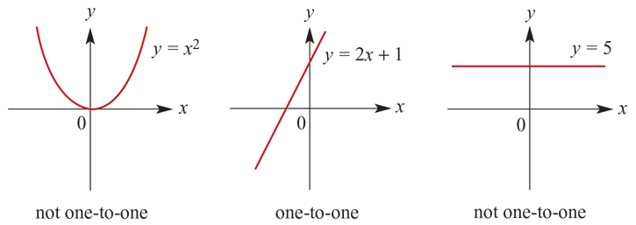
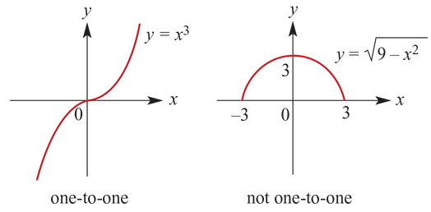
Horizontal-line test

Slide 8
Implied (maximal) domains
The implied (maximal) domain of a function is the set of all real numbers for which the rule of the function has meaning.
For example:
f(x) =3$x^{2}$−2$x$ has implied domain R
g(x)= $\sqrt{x}$has implied domain [0,∞)

Slide 9
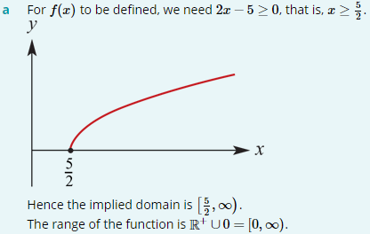
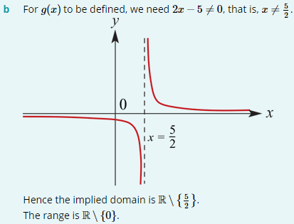
Examples
State the implied domain, sketch the graph and find the corresponding range of each of the following:
a. f(x)= $\sqrt{2x−5}$
b. g(x)=$\frac{1}{2x−5}$

Slide 10
Section summary
A function f is one-to-one if different x-values map to different y-values, that is, if a≠b implies f(a)≠f(b), for all a, b ∈ dom f.
Horizontal-line test: If a horizontal line can be drawn anywhere on the graph of a function and it only ever intersects the graph a maximum of once, then the function is one-to-one.
When the domain of a function is not explicitly stated, it is assumed to consist of all real numbers for which the rule has meaning. We refer to the implied (maximal) domain of a function, because the domain is implied by the rule.

