Slide 1
Functions and modelling exercises
5H

Slide 2
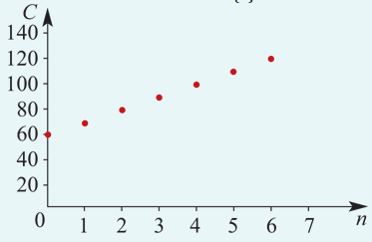
Example 1
A book club has a membership fee of $60.00 and each book purchased is $10.00. Construct a cost function that can be used to determine the cost of different numbers of books, then sketch its graph.
Solution
Let C(n) denote the cost (in dollars) when n books are purchased. Then
C(n)=60+10n
The domain of this function is N∪{0}, the set of non-negative integers, and its graph will be as shown.
The range of this function is {10x:x∈ N and x≥6}. Sometimes to simplify the situation we represent such functions by a continuous line. Strictly, this is not mathematically correct, but it may aid our understanding of the situation.

Slide 3
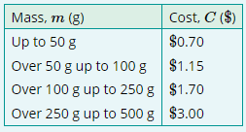
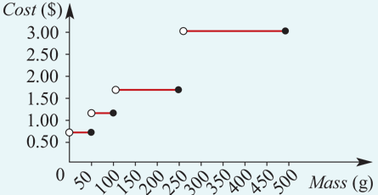
Example 2
The following table shows the Younanistan Post rates for sending letters.
Sketch a graph of the cost function, C, giving its domain and range and the rules that define it.
Domain =(0,500]
Range ={0.70,1.15,1.70,3.00}

Slide 4
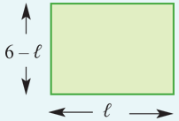
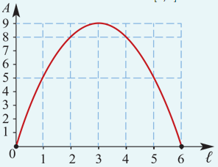
Example 3
A householder has six laying hens and wishes to construct a rectangular enclosure to provide a maximum area for the hens, using a 12 m length of fencing wire. Construct a function that will give the area of the enclosure, A, in terms of its length, ℓ. By sketching a graph, find the maximum area that can be fenced.
Let ℓ = length of the enclosure
Then width =$\frac{\text{12−2ℓ}}{2}$=6−ℓ
The area is
A(ℓ)=ℓ(6−ℓ)=6ℓ−${\text{ℓ}}^{2}$
The domain of A is the interval [0,6].
The maximum area is 9 ${\text{m}}^{2}$ and occurs when ℓ=3 m, i.e. when the enclosure is a square.

