Slide 1
Chapter 5 Functions and relations
Review

Slide 2
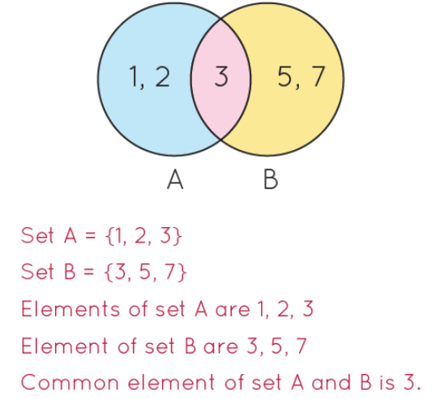
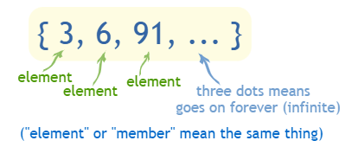
Sets & Elements
C =
  3 ∊ C
  4 ∉ C
  15 ∉ C

Slide 3
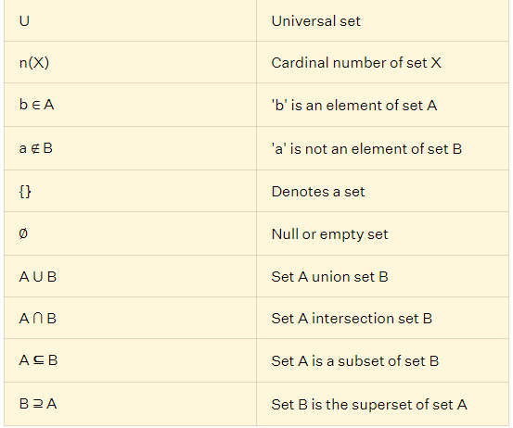
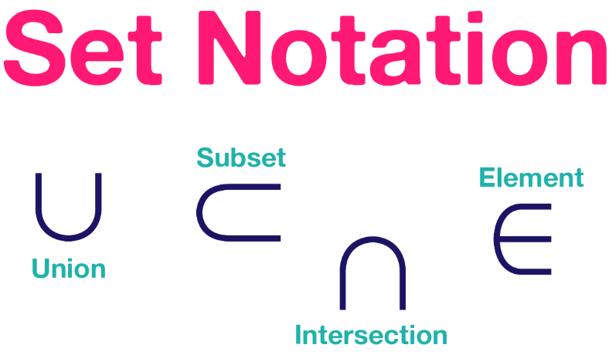


Slide 4

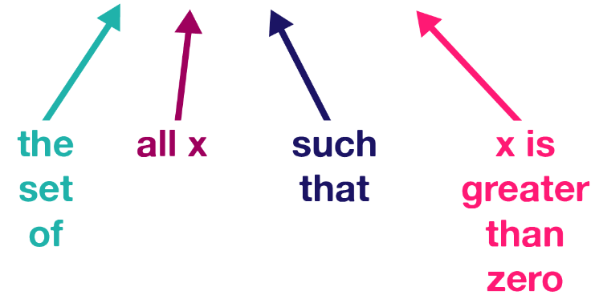

Slide 5
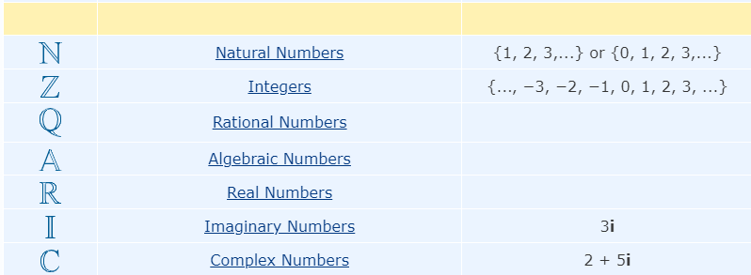

Numbers
The numbers of the form $\frac{p}{\text{q}}$, with 𝑝 and 𝑞 integers, 𝑞≠0

Slide 6
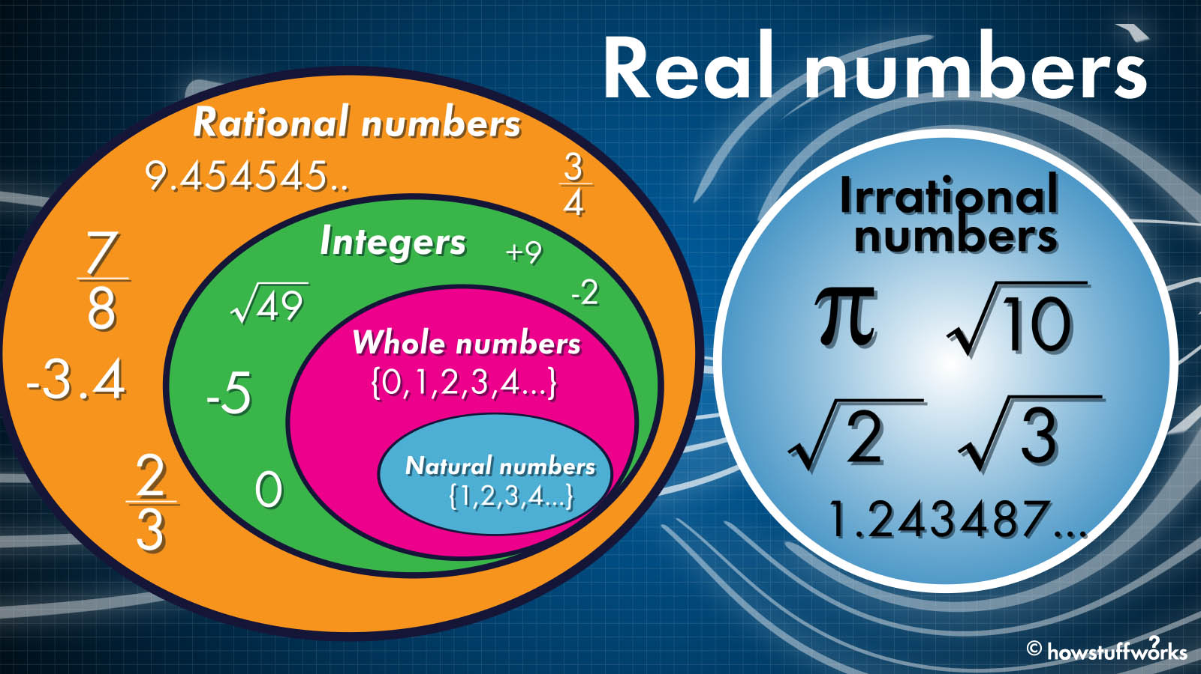
Sets of numbers
N Natural numbers Z Integers
Q Rational numbers R Real numbers

Slide 7





Illustrate each of the following intervals of real numbers:
[−2,3]
(−3,4]
(−∞,2]
(−2,4)
(−3,∞)

Slide 8
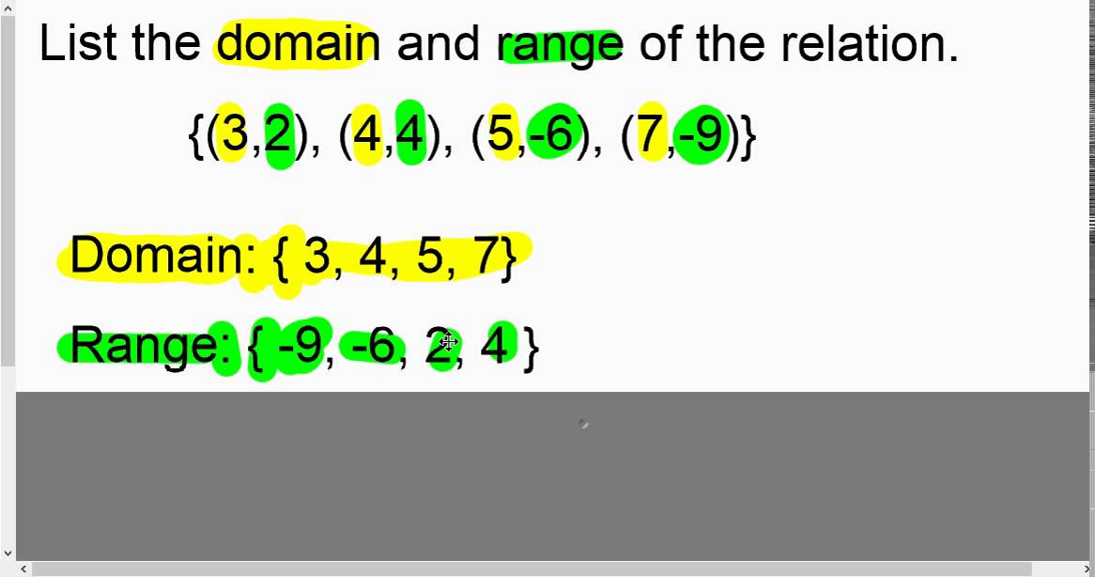
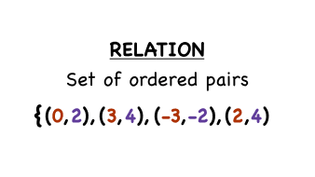
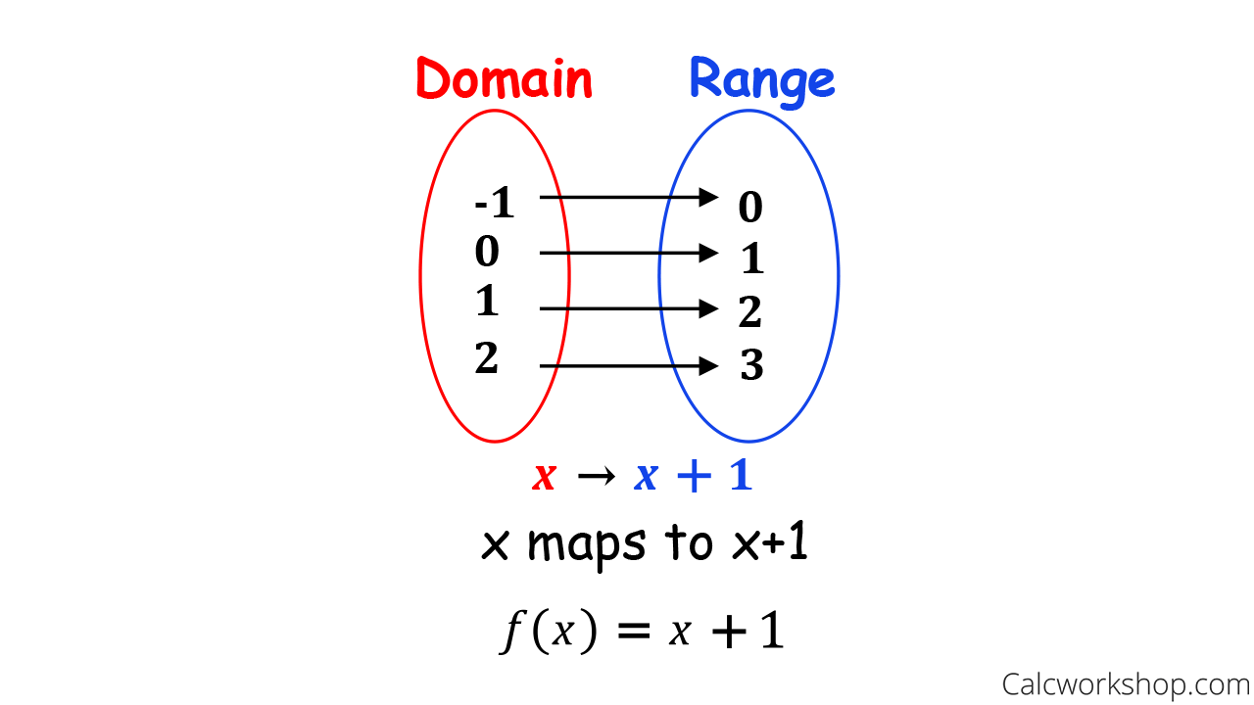
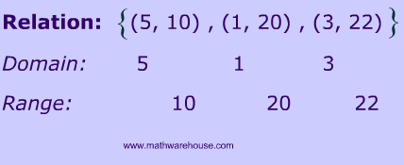
Domain, Range Relations

Slide 9

Implied (maximal) domain
When the rule for a relation is written and no domain is stipulated, then it is understood that the domain taken is the largest for which the rule has meaning. This domain is called the maximal or implied domain.
For example, the implied domain of y= $x^{2}$ is R, and the implied domain of $x^{2}$+ $y^{2}$=1 is [−1,1].

Slide 10
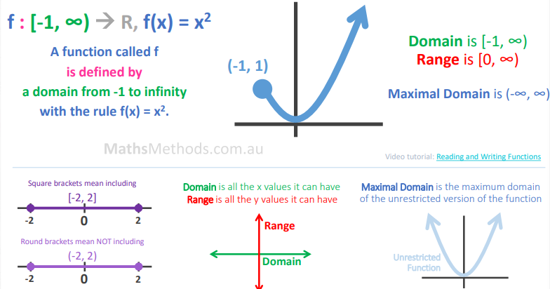
{($x$, $y$): $y=x^{2}$, $x$∈[–1, $∞)$}

Slide 11
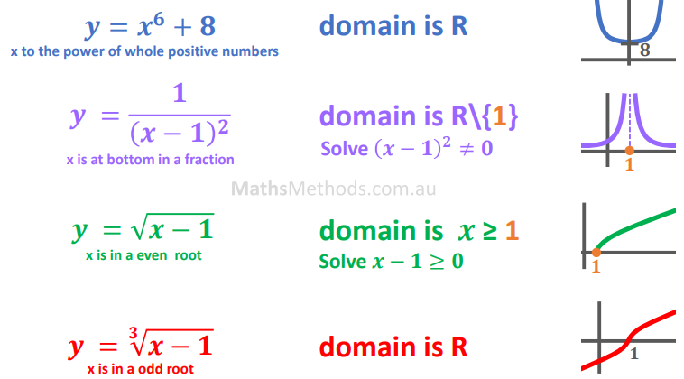

Slide 12
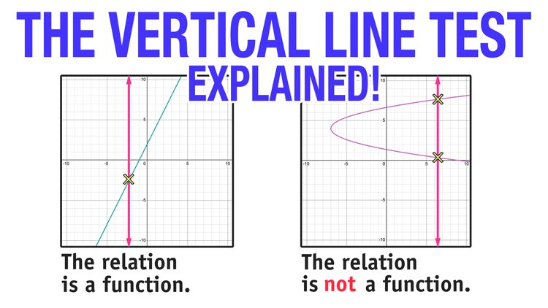

Slide 13
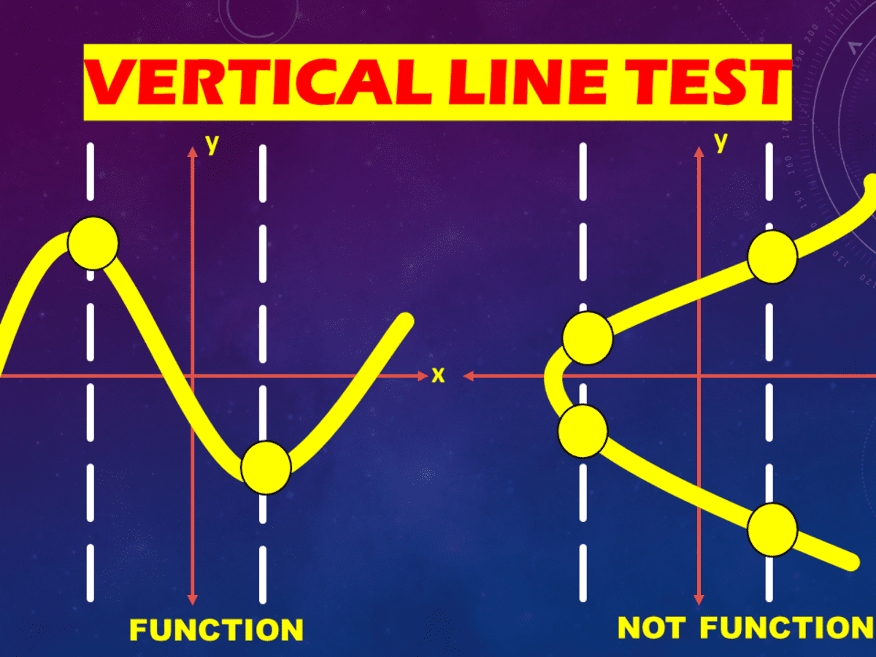
functions
A function is a relation such that for each x-value there is only one corresponding y-value. This means that, if (a,b) and (a,c) are ordered pairs of a function, then b=c. In other words, a function cannot contain two different ordered pairs with the same first coordinate.

Slide 14
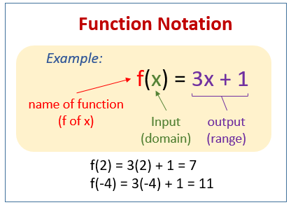
Function notation
Functions are usually denoted with lowercase letters such as f, g, h.
If f is a function, then for each x in the domain of f there is a unique element y in the range such that (x,y)∈f. The element y is called ‘the image of x under f’ or ‘the value of f at x’, and the element x is called ‘a pre-image of y’.
Since the y-value obtained is a function of the x-value, we use the notation f(x), read as ‘f of x’, in place of y.
For example, instead of y=2x+1 we can write f(x)=2x+1. Then f(2) means the y-value obtained when x=2.
e.g. f(2) =2(2)+1=5
f(−4) =2(−4)+1=−7
f(a) =2a+1

Slide 15
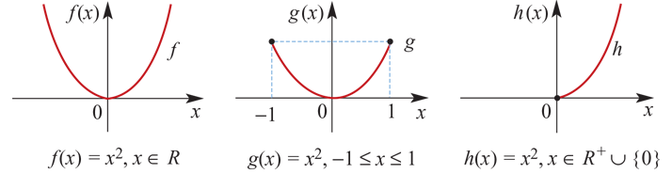
Restriction of a function
Consider the following functions:
The different letters, f, g and h, used to name the functions emphasise the fact that there are three different functions, even though they all have the same rule. They are different because they are defined for different domains. We say that g and h are restrictions of f, since their domains are subsets of the domain of f.

Slide 16
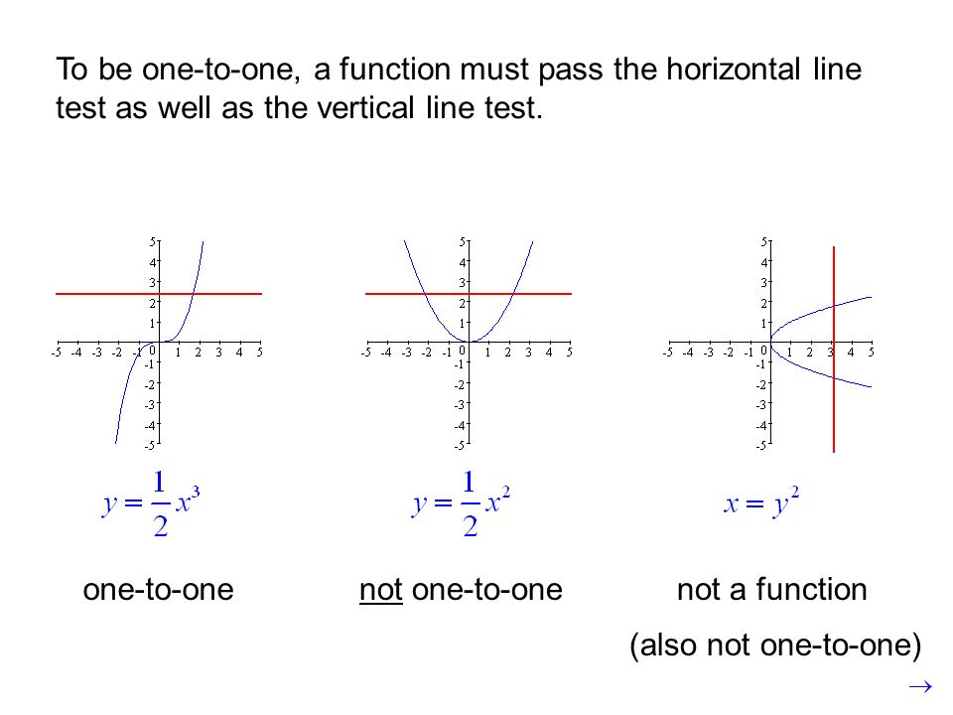

Slide 17
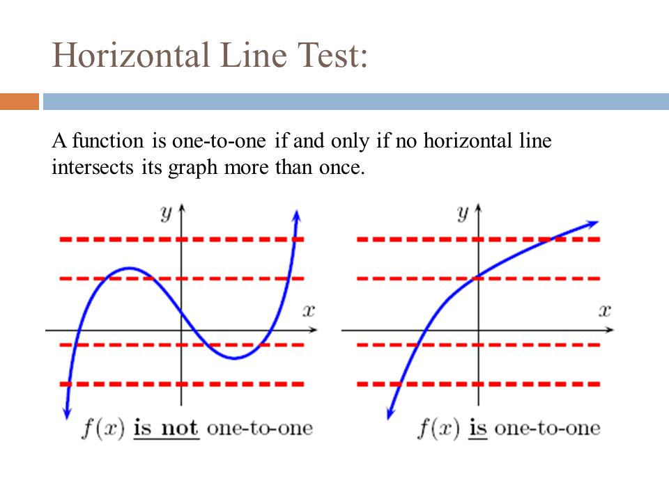

Slide 18
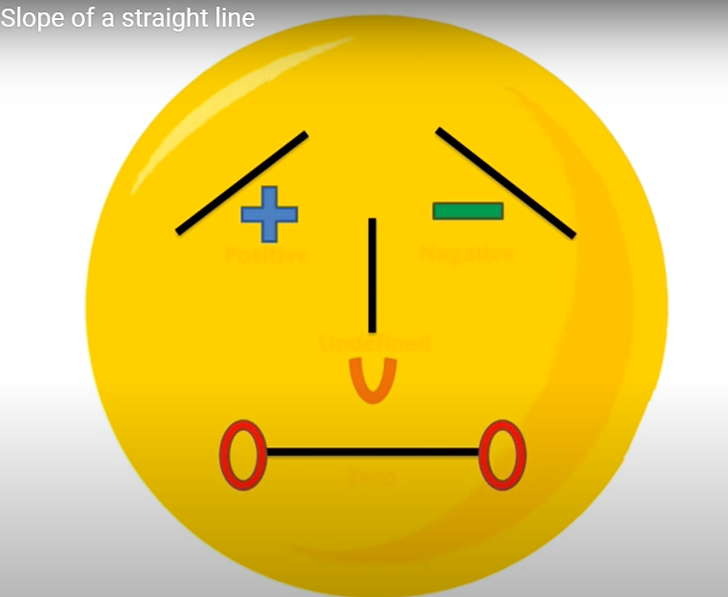
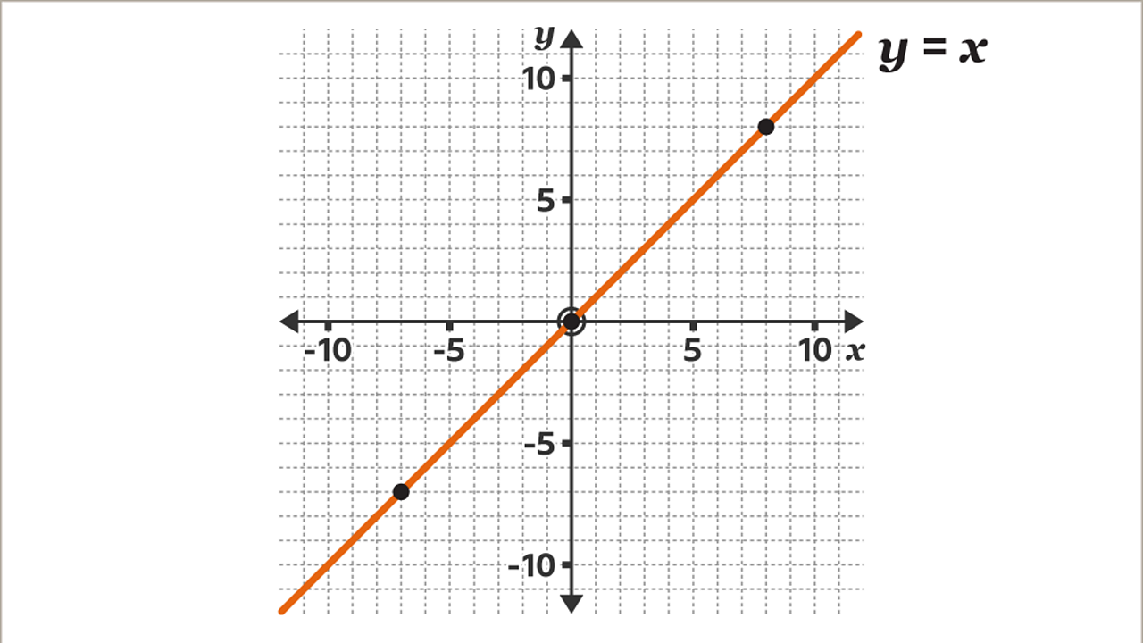
What is gradient?
Gradient is the measure of how steep a line is. The bigger the gradient, the steeper the line.

Slide 19
The way we work out the gradient of any line is by the formula:
change in y
Gradient =
change in x
Rise
Gradient = Slope =
Run

Slide 20
The equation of any straight line is of the form:
y = mx + c
Gradient
(steepness)
y-intercept
(where is crosses the y-axis)

Slide 21
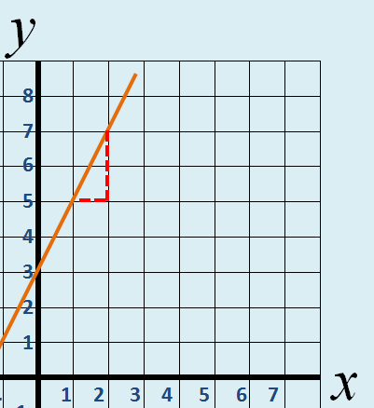
y = mx + c
Gradient of 2
crosses y-axis
Gradient
Increase of 2 up the y-axis
For 1 along the x-axis
Crosses y-axis at 3
y = 2x + 3

Slide 22
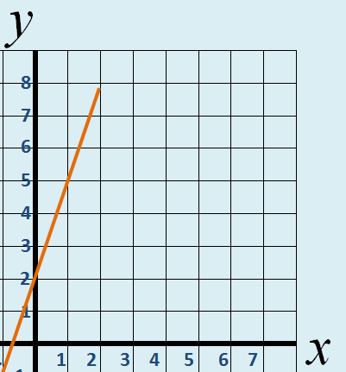
y = mx + c
Gradient of 3
crosses y-axis
Gradient
Increase of 3 up the y-axis
Crosses y-axis at 2
For 1 along the x-axis
y = 3x + 2

Slide 23
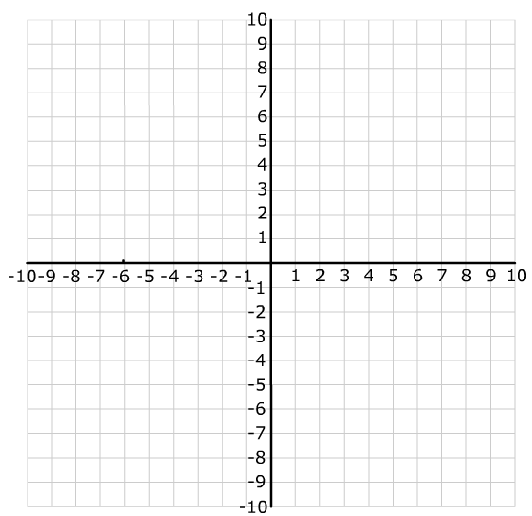
Parallel and Perpendicular Lines.
Wednesday, 29 March 2023
ALL will be able to identify parallel lines from their equations.
MOST will be able to identify perpendicular lines from their equations.
SOME will be able to solve problems involving parallel and perpendicular lines.
Lesson Objective: To be able to find the equation of graphs parallel or perpendicular to others and passing through a specific point.
The lines are parallel
Investigation (Part 1):
Draw the graphs of the following –
y = 2x
y = 2x – 4
y = 2x + 3
y = 2x - 9
They’ll never meet!
What do you notice about the lines…?
Keywords: Equation → y = mx + c → Negative Reciprocal → Parallel → Perpendicular.

Slide 24
Parallel and Perpendicular Lines.
Wednesday, 29 March 2023
ALL will be able to identify parallel lines from their equations.
MOST will be able to identify perpendicular lines from their equations.
SOME will be able to solve problems involving parallel and perpendicular lines.
Lesson Objective: To be able to find the equation of graphs parallel or perpendicular to others and passing through a specific point.
They are perpendicular
Investigation (Part 2):
The graph drawn has a gradient of 2. What is the equation of that line?
y = 2x – 1
Draw the graph of y = -½x – 1.
They meet at right angles!
What do you notice about the lines…?
Keywords: Equation → y = mx + c → Negative Reciprocal → Parallel → Perpendicular.

Slide 25
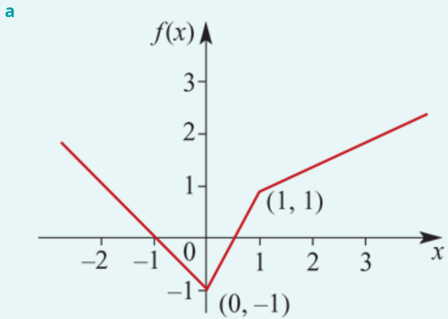
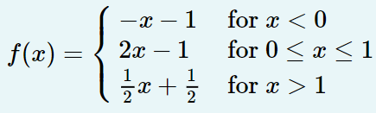

Piecewise Examples
a. Sketch the graph of the function f given by:
b. State the range of f.
The graph of y=−x−1 is sketched for x<0. Note that when x=0, y=−1 for this rule.
The graph of y=2x−1 is sketched for 0≤x≤1. Note that when x=0, y=−1 and when x=1, y=1 for this rule.
The graph of y=$\frac{1}{2}$x+ $\frac{1}{2}$ is sketched for x>1. Note that when x=1, y=1 for this rule.
b. The range is [−1,∞).

Slide 26
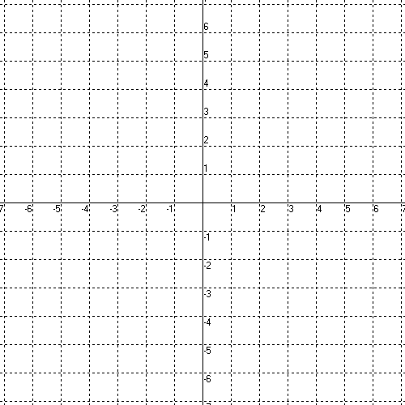
Graphing Piecewise Functions
Domain -
Range -

Slide 27
Domain -
(-7, 7]
Range -
(-4, -2), [-1, 4]

Slide 28
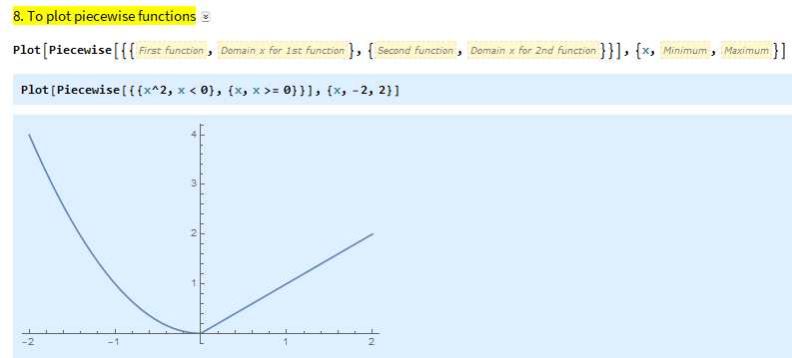
$$f\left(x\right)=\left\{\begin{matrix}x^{2}, x<0 \\ x, x≥0\end{matrix}\right.$$

Slide 29
Functional Notation: Find the following

Slide 30
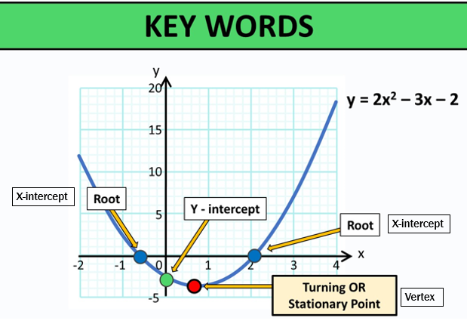

Slide 31
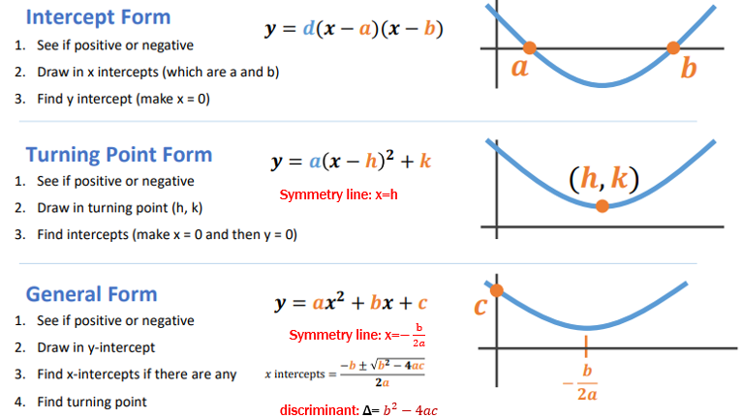

Slide 32
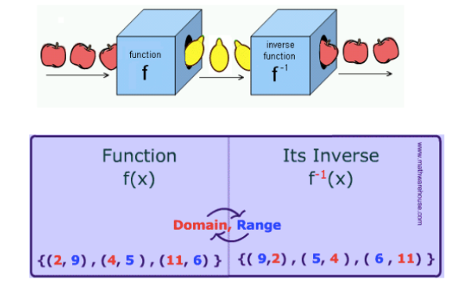
Remember we talked about functions---taking a set X and mapping into a Set Y
An inverse function would reverse that process and map from SetY back into Set X

Slide 33
Notice that the x and y values traded places for the function and its inverse.
These functions are reflections of each other about the line y = x
Let’s consider the function and compute some values and graph them.
This means “inverse function”
x f (x)
(2,8)
-2 -8
-1 -1
0 0
1 1
2 8
(8,2)
x f ⁻¹(x)
-8 -2
-1 -1
0 0
1 1
8 2
Let’s take the values we got out of the function and put them into the inverse function and plot them
(-8,-2)
(-2,-8)
Is this a one-to-one function?
Yes, so it will have an inverse function
What will “undo” a cube?
A cube root

Slide 34
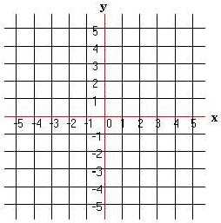
Draw the inverse. Compare to the line y = x. What do you notice?

Slide 35
Graph the inverse of the following:
The function and
its inverse are
symmetric with
respect to the
Line y = x.
x
y
0
-3
1
1
-5
-4
2
4

Slide 36
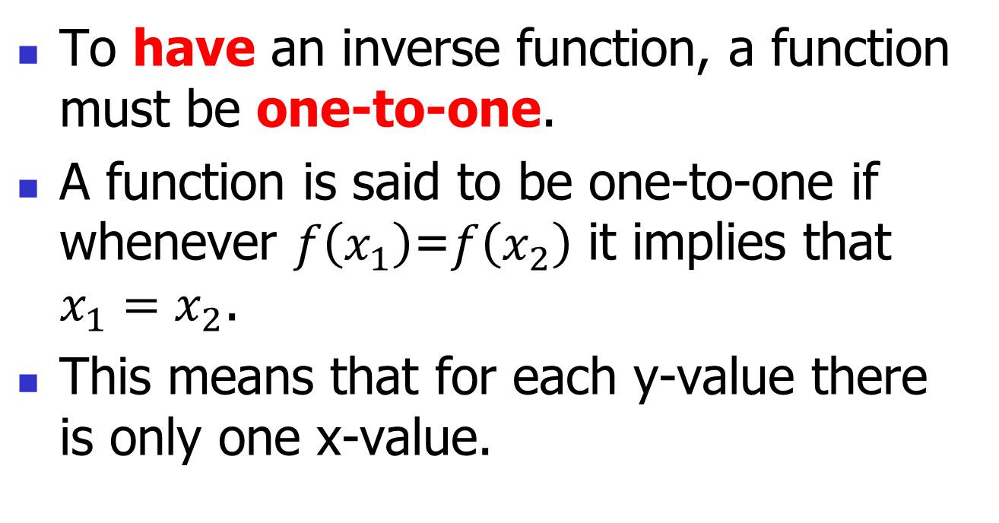
How Does an Inverse Exist

Slide 37
Verify that the functions f and g are inverses of each other.
If we graph (x - 2)² it is a parabola shifted right 2.
Is this a one-to-one function?
This would not be one-to-one but they restricted the domain and are only taking the function where x is greater than or equal to 2 so we will have a one-to-one function.

Slide 38
Steps for Finding the Inverse of a One-to-One Function
y = f ⁻¹(x)
Solve for y
Trade x and y places
Replace f(x) with y

Slide 39
Find the inverse of
y = f ⁻¹(x)
or
Solve for y
Trade x and y places
Replace f(x) with y
Ensure f(x) is one to one first. Domain may need to be restricted.

