Slide 1
Perpetuities
8I

Slide 2
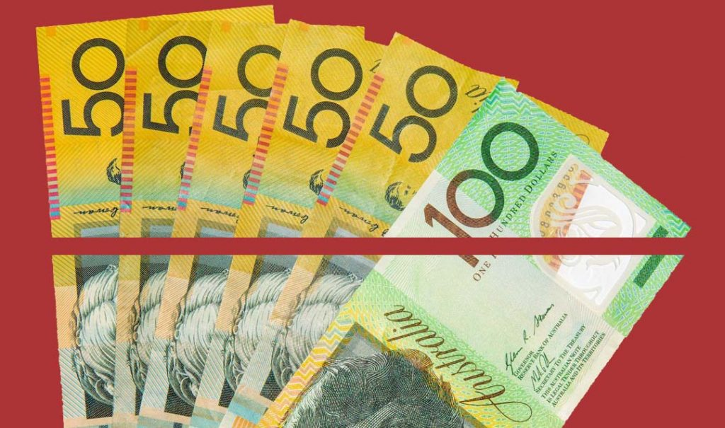
Perpetuities: Special annuity
Reducing Balance Loan
Loan
identical
Annuities
Fixed term pension
interest-only loan
Loan
identical
payment received=interest earned
Perpetuities
Investment
Notes:
https://www.youtube.com/watch?v=mUVwvw2toXM

Slide 3
Perpetuities
Let $V_{0}$ be the initial value of the annuity.
Let 𝑟 be the interest rate per compounding period.
Let 𝐷 be the regular payment received.
For perpetuities:
payment received=interest earned
so
𝐷=$\frac{r}{100}$× $V_{0}$

Slide 5
Calculating the withdrawal from a perpetuity
Elizabeth invests her superannuation payout of $500 000 into a perpetuity that will provide a monthly income without using any of the initial investment.
If the interest rate for the perpetuity is 6% per annum, what monthly payment will Elizabeth receive?
$V_{0}$=500000.
𝑟=$\frac{6}{12}$=0.5.
𝐷= $\frac{r}{100}$× $V_{0}$= $\frac{0.5}{100}$×500000=2500
Elizabeth will receive $2500 every month from her investment.

Slide 6
Calculating the investment required to establish a perpetuity
How much money will need to be invested in a perpetuity account, earning interest of 4.2% per annum compounding monthly, if $200 will be withdrawn every month? Write your answer to the nearest dollar.
r=$\frac{4.2}{12}$%=0.35%.
The amount withdrawn each month is $200 so 𝐷=200.
𝐷= $\frac{r}{100}$×$V_{0}$
200= $\frac{0.35}{100}$×$V_{0}$= 0.0035× $V_{0}$
$V_{0}$= $\frac{200}{0.0035}$=57142.867
$57143 will need to be invested to establish the perpetuity investment.

Slide 7
Calculating the interest rate of a perpetuity
A university mathematics faculty has $30000 to invest. It intends to award an annual mathematics prize of $1500 with the interest earned from investing this money in a perpetuity.
What is the minimum interest rate that will allow this prize to be awarded indefinitely?
Prize=𝑟% of investment
1500= 𝑟%×30000
1500 =$\frac{r}{100}$×30000
1500=𝑟×300
𝑟= $\frac{1500}{300}$=5
The minimum annual interest rate to award this prize indefinitely is 5%.

Slide 8
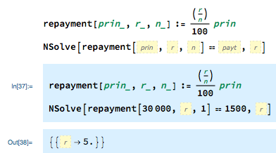
Calculating the interest rate of a perpetuity
A university mathematics faculty has $30000 to invest. It intends to award an annual mathematics prize of $1500 with the interest earned from investing this money in a perpetuity.
What is the minimum interest rate that will allow this prize to be awarded indefinitely?
Alternatively, Using a financial solver
The minimum annual interest rate to award this prize indefinitely is 5%.

