Slide 1
Measuring angles in degrees and radians
14A

Slide 2
Angles
Consequently, the applications of trigonometry expanded to include a vast number of physical phenomena involving rotations and vibrations, including the following.
  sound waves
  light rays
  planetary orbits
  vibrating strings
  pendulums
  orbits of atomic particles

Slide 3
Angles
An angle is determined by rotating a ray (half-line) about its endpoint. The starting position of the ray is the initial side of the angle, and the position after rotation is the terminal side, as shown in Figure 4.1.
Figure 4.1

Slide 4
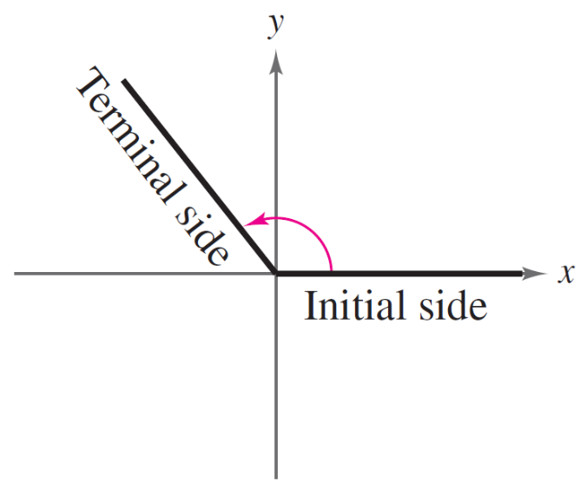
Angles
The endpoint of the ray is the vertex of the angle. This perception of an angle fits a coordinate system in which the origin is the vertex and the initial side coincides with the positive x-axis. Such an angle is in standard position, as shown in Figure 4.2.
Figure 4.2

Slide 5
Angles
Positive angles are generated by counterclockwise rotation, and negative angles by clockwise rotation, as shown in Figure 4.3.
Figure 4.3

Slide 6
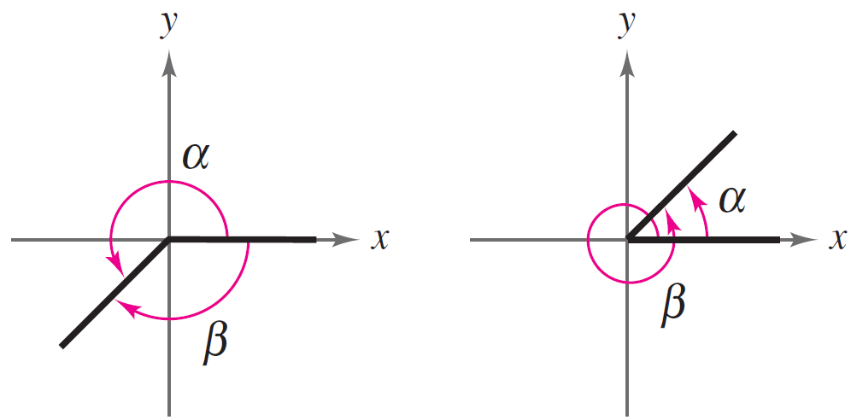
Angles
Angles are labeled with Greek letters such as α (alpha), β (beta), and (theta), as well as uppercase letters such as A,B, and C. In Figure 4.4, note that angles α and β have the same initial and terminal sides. Such angles are coterminal.
Figure 4.4

Slide 7
Radian Measure
The measure of an angle is determined by the amount of rotation from the initial side to the terminal side. One way to measure angles is in radians.
This type of measure is
especially useful in calculus.
To define a radian, you can
use a central angle of a circle.
Figure 4.5

Slide 8
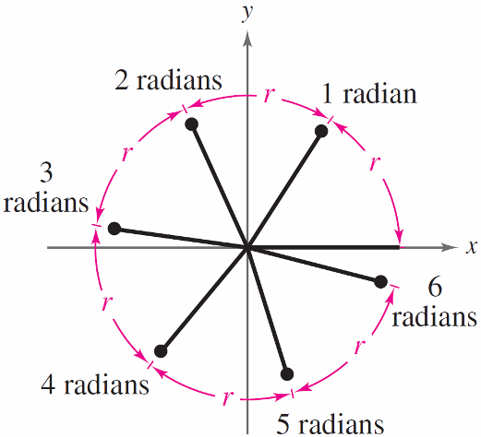
Radian Measure
Moreover, because
2π ≈ 6.28
there are just over six radius lengths in a full circle, as shown in Figure 4.6.
Figure 4.6

Slide 9
Radian Measure
The four quadrants in a coordinate system are numbered I, II, III, and IV. Figure 4.8 shows which angles between 0 and 2π lie in each of the four quadrants.
Figure 4.8

Slide 10
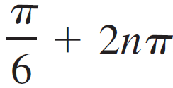
Radian Measure
Two angles are coterminal when they have the same initial and terminal sides. For instance, the angles 0 and 2π are coterminal, as are the angles π/6 and 13π/6.
A given angle θ has infinitely many coterminal angles. For instance θ = π/6, is coterminal with
, where is n an integer.

Slide 11

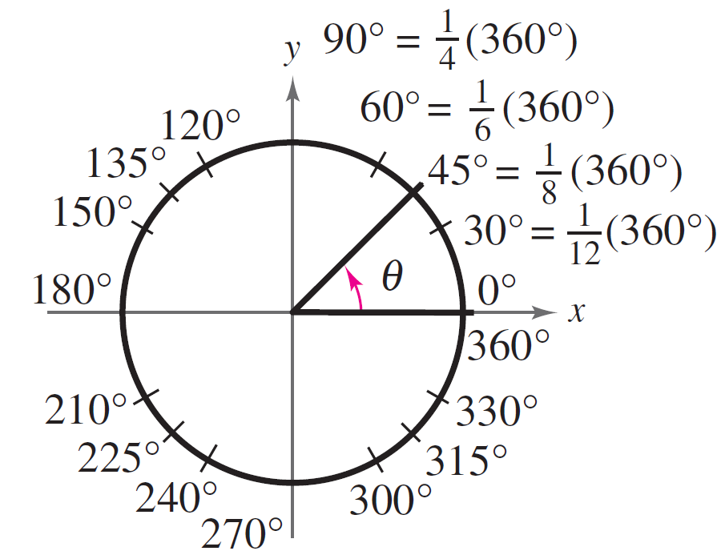
Degree Measure
A second way to measure angles is in terms of degrees, denoted by the symbol °. A measure of one degree (1°) is equivalent to a rotation of of a complete revolution about the vertex.
Figure 4.12

Slide 12
Degree Measure
So, a full revolution (counterclockwise) corresponds to 360° a half revolution to 180°, a quarter revolution to 90 ° and so on.
Because 2π radians corresponds to one complete revolution, degrees and radians are related by the equations
360° = 2π rad and 180° = π rad.

Slide 13
Degree Measure
From the second equation, you obtain
1 ° = rad and 1 rad =

Slide 14

Angles and Angle Measure
Converting Degree Measure to Radian Measure
One half a rotation is
180⁰ or π rad
Convert to radian measure:
a) 210⁰
b) - 315⁰
Exact radian
≈ 3.67
Approximate radian
To convert from degrees
to radians, multiply by

Slide 15
Converting Radian Measure to Degree Measure
Convert to degree measure:
a)
b)
= 120⁰
= -15⁰
To convert from radians
to degrees, multiply by
c) 1.68
= 96.26⁰

Slide 16
Benchmark Conversions
Degrees
Radians
Degrees
Radians
0⁰
30⁰
90⁰
45⁰
180⁰
60⁰
57.3
270⁰
720⁰
360⁰
Angles in Standard Position

Slide 17

Determining the Sector Angle or the Arc Length
Determine the measure of the sector angle:
θ is measured
in radians
5 cm
6.1 cm
Determine the arc length.
Convert 70⁰ to radians:
8 cm
70⁰
a = 9.77
The arc length is 9.77 cm.

Slide 18


Notes:
https://www.transum.org/software/SW/Starter_of_the_day/starter_March8.asp

Slide 19
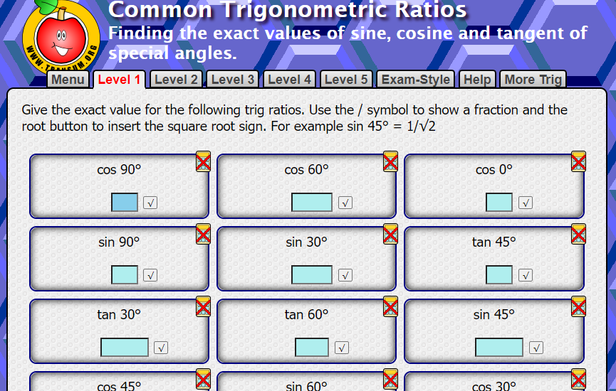
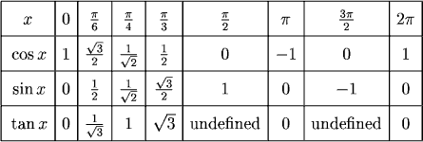
Values to remember
Notes:
https://www.transum.org/Maths/Activity/Trig/Common.asp

Slide 20
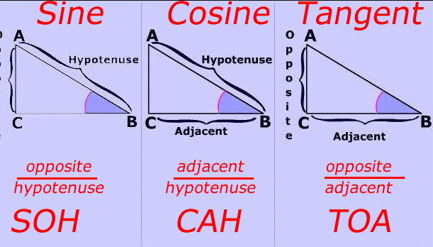
Trig rules to remember

Slide 21
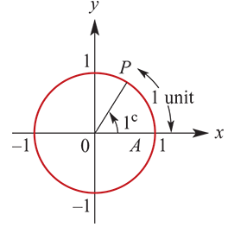
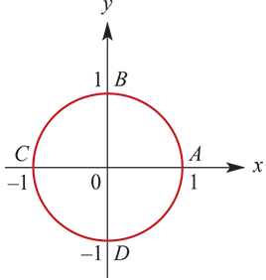
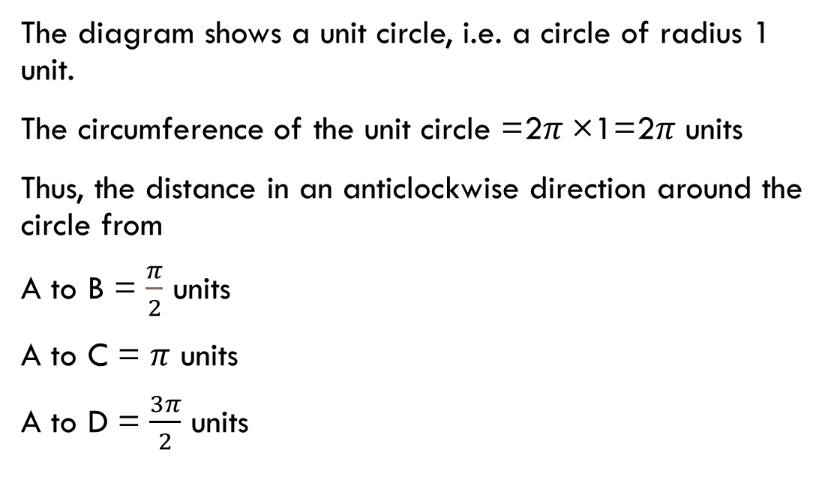
unit circle
The diagram shows a unit circle, i.e. a circle of radius 1 unit.
The circumference of the unit circle =2$π$×1=2$π$ units
Thus, the distance in an anticlockwise direction around the circle from
A to B = $\frac{π}{2}$ units
A to C = $π$ units
A to D = $\frac{3π}{2}$ units

Slide 22
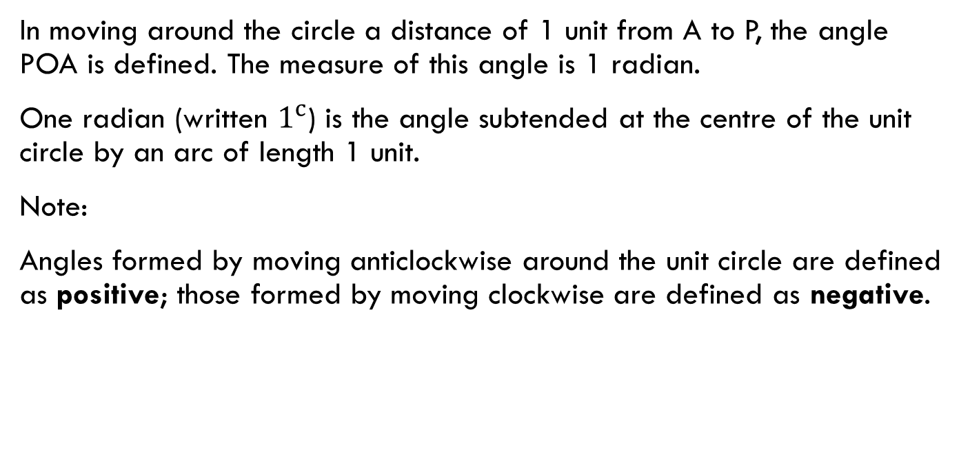
Definition of a radian
In moving around the circle a distance of 1 unit from A to P, the angle POA is defined. The measure of this angle is 1 radian.
One radian (written $1^{c}$) is the angle subtended at the centre of the unit circle by an arc of length 1 unit.
Note:
Angles formed by moving anticlockwise around the unit circle are defined as positive; those formed by moving clockwise are defined as negative.

Slide 23

Degrees and radians
The angle, in radians, swept out in one revolution of a circle is ${2π}^{c}$.
${2π}^{c}$ =360°
∴ $π^{c}$ =180°
∴ $1^{c}$=$\frac{\text{180°}}{π}$ or 1°= $\frac{π^{c}}{\text{180}}$

Slide 24

example
Convert 30° to radians.
Multiply by $\frac{π}{\text{180}}$ and simplify by cancelling.
1°= $\frac{π^{c}}{\text{180}}$
∴30°= $\frac{{\text{30×}π}^{c}}{\text{180}}$= $\frac{π^{c}}{\text{6}}$

Slide 25
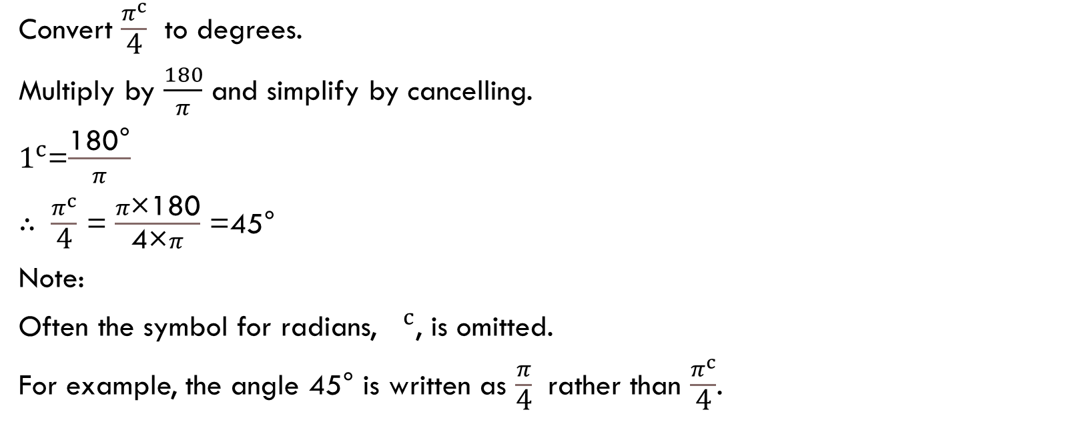
example
Convert $\frac{π^{c}}{\text{4}}$ to degrees.
Multiply by $\frac{180}{π}$ and simplify by cancelling.
$1^{c}$=$\frac{\text{180°}}{π}$
∴ $\frac{π^{c}}{\text{4}}$ = $\frac{π\text{×}\text{180}}{\text{4×}π}$ =45°
Note:
Often the symbol for radians, $1^{c}$, is omitted.
For example, the angle 45° is written as $\frac{π}{\text{4}}$ rather than $\frac{π^{c}}{\text{4}}$.

Slide 26
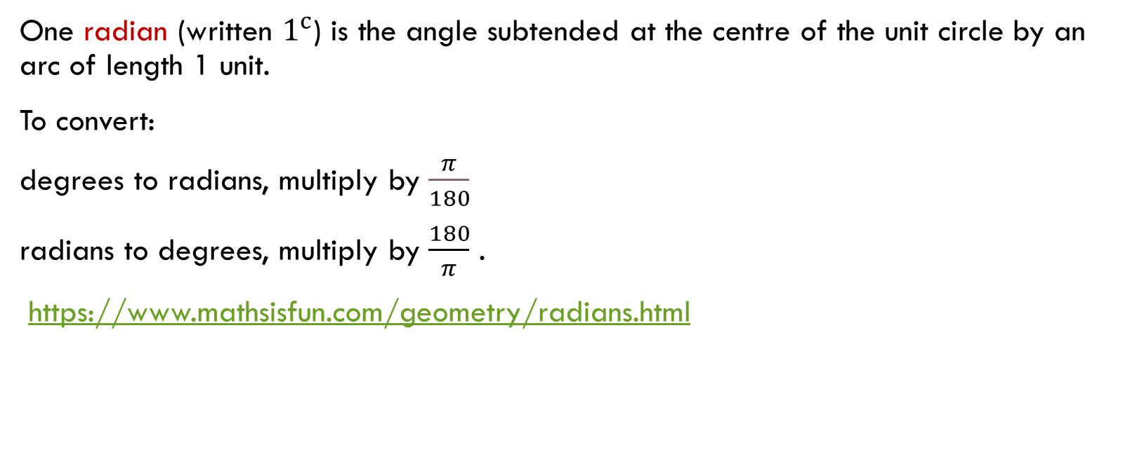
Section summary
One radian (written $1^{c}$) is the angle subtended at the centre of the unit circle by an arc of length 1 unit.
To convert:
degrees to radians, multiply by $\frac{π}{180}$
radians to degrees, multiply by $\frac{180}{π}$ .
https://www.mathsisfun.com/geometry/radians.html

