Slide 1
Solution of trigonometric equations
14H

Slide 2
Notes:
https://www.transum.org/software/Online_Exercise/Transumometry/WhichSide/

Slide 3
Solving equations of the form sin(t)=b and cos(t)=b
1. First find the solutions in the interval [0,2π]. This can be done using your knowledge of exact values and symmetry properties, or with the aid of a calculator.
2. Further solutions can be found by adding and subtracting multiples of 2π.

Slide 4
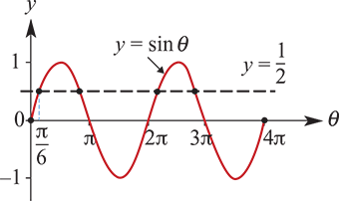
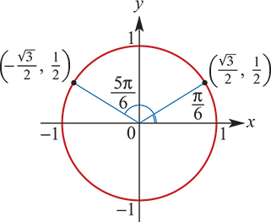
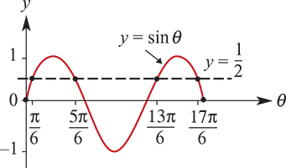
Example
Find all solutions to the equation sinθ=$\frac{1}{2}$ for θ∈[0,4π].
By sketching a graph, we can see that there are four solutions in the interval [0,4π].
The 1st solution → $\sin^{−1}{0}$ on your calculator.
The 2nd solution → using symmetry. The sine is +tive in the 2nd quadrant sin(π−θ)=sinθ.
The solution for θ∈[0,$\frac{π}{2}$] is θ= $\frac{π}{6}$.
The second solution is θ=π− $\frac{π}{6}$= $\frac{5π}{6}$.
The third solution is θ=2π+ $\frac{π}{6}$= $\frac{13π}{6}$.
The fourth solution is θ=2π+ $\frac{5π}{6}$= $\frac{17π}{6}$.

Slide 5
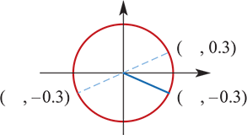
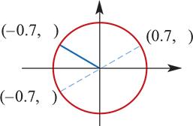
Example
Find two values of x:
a. sinx=−0.3 with 0≤x≤2π
b. cosx°=−0.7 with 0°≤x°≤360°
First solve the equation sinα=0.3 for α∈[0, $\frac{π}{2}$]. Use your calculator to find the solution α=0.30469…
Now the value of sinx is negative for P(x) in the 3rd and 4th quadrants. From the symmetry relationships (or from the graph of y=sinx):
3rd quadrant: x =π+0.30469… =3.446 (to 3 d.p.)
4th quadrant: x=2π−0.30469…=5.978 (to 3 d.p.)
∴ If sinx=−0.3, then x=3.446 or x=5.978.
First solve the equation cosα°=0.7 for α°∈[0°,90°]. Use your calculator to find the solution α°=45.57°.
Now the value of cosx° is negative for P(x°) in the 2nd and 3rd quadrants.
2nd quadrant: x° =180°−45.57°=134.43°
3rd quadrant: x°=180°+45.57°=225.57°
∴ If cosx°=−0.7, then x°=134.43° or x°=225.57°.

Slide 6
Example
Find all the values of θ° between 0° and 360° for which:
a. cosθ°=$\frac{\sqrt{3}}{2}$
b. sinθ°=− $\frac{1}{2}$
c. cosθ°− $\frac{1}{\sqrt{2}}$=0
cosθ° is positive, and so P(θ°) lies in the 1st or 4th quadrant. → cos(360°−θ°)=cosθ°
cosθ°= $\frac{\sqrt{3}}{2}$ → θ° =30° or θ°=360°−30° → θ° =30°or θ° =330°
sinθ° is negative, and so P(θ°) lies in the 3rd or 4th quadrant. → sin(180°+θ°) =−sinθ° sin(360°−θ°) =−sinθ°
sinθ°= − $\frac{1}{2}$ → θ° =180°+30° or θ° =360°−30° → θ° =210° or θ° =330°
cosθ° is positive, and so P(θ°) lies in the 1st or 4th quadrant.
cosθ°− $\frac{1}{\sqrt{2}}$=0 ∴cosθ° = $\frac{1}{\sqrt{2}}$ → θ° =45° or θ° =360°−45° → θ° =45°or θ° =315°

Slide 7
Solving equations of the form asin(nt)=b and acos(nt)=b
First substitute x=nt. Work out the interval in which solutions for x are required. Then proceed as in the case above to solve for x.
Once the solutions for x are found, the solutions for t can be found.
For example: To solve sin(3t)= $\frac{1}{2}$ for t∈[0,2π], first let x=3t. The equation becomes sin x= $\frac{1}{2}$ and the required solutions for x are in the interval [0,6π].

Slide 8
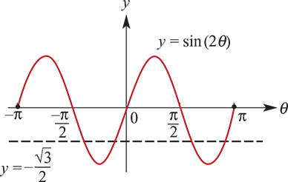
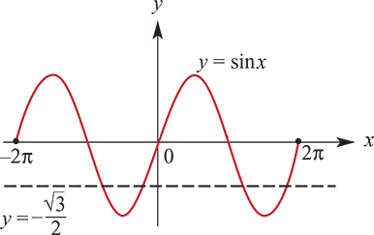
Example
Solve the equation sin(2θ)=− $\frac{\sqrt{3}}{2}$ for θ∈[−π,π].
It is clear from the graph that there are four solutions.
To solve the equation, let x=2θ.
Note:
If θ∈[−π,π], then we have x=2θ∈[−2π,2π].
Now consider the equation
sinx=− $\frac{\sqrt{3}}{2}$ for x∈[−2π,2π]
The 1st quadrant solution to the equation sinα= $\frac{\sqrt{3}}{2}$ is α= $\frac{π}{3}$.
Using symmetry, the solutions to sinx=− $\frac{\sqrt{3}}{2}$ for x∈[0,2π] are
x=π+ $\frac{π}{3}$ and x=2π− $\frac{π}{3}$
i.e. x= $\frac{4π}{3}$ and x= $\frac{5π}{3}$
The other two solutions (obtained by subtracting 2π) are x= $\frac{4π}{3}$−2π and x= $\frac{5π}{3}$−2π.
∴ The required solutions for x are − $\frac{2π}{3}$, − $\frac{π}{3}$, $\frac{4π}{3}$ and $\frac{5π}{3}$.
∴ The required solutions for θ are − $\frac{π}{3}$, − $\frac{π}{6}$, $\frac{2π}{3}$ and $\frac{5π}{6}$.

