Slide 1
Sketch graphs of y=asinn(t±ε) and y=acosn(t±ε)
14I

Slide 2
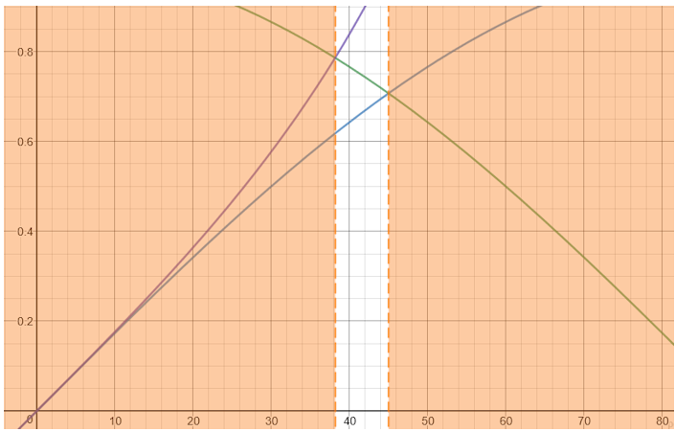
Notes:
https://www.transum.org/Software/MathsMenu/Starter.asp?ID_Starter=52

Slide 3
Notes:
https://www.transum.org/Software/SW/Starter_of_the_day/starter_June3.ASP

Slide 4
f(t)=asin(nt) and g(t)=acos(nt)
Consider translations of graphs of functions of the form f(t)=asin(nt) and g(t)=acos(nt) in the direction of the t-axis.
When a translation of $\frac{π}{4}$ units in the positive direction of the t-axis is applied to the graph of y=f(t), the resulting image has equation
y=f(t− $\frac{π}{4}$ )
For example, the graph of f(t)=3sin(2t) is mapped to the graph of y=3sin2(t− $\frac{π}{4}$ ).

Slide 5
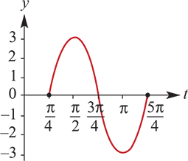
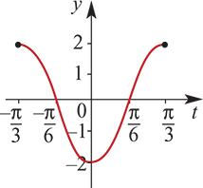
Example
On separate axes, draw the graphs of the following functions. Use a calculator to help establish the shape. Set the window appropriately by noting the range and period.
y=3sin2(t− $\frac{π}{4}$ ), $\frac{π}{4}$ ≤t≤ $\frac{5π}{4}$
y=2cos3(t+ $\frac{π}{3}$ ), − $\frac{π}{3}$ ≤t≤ $\frac{π}{3}$
Solution
The range is [−3,3] and the period is π.
The range is [−2,2] and the period is $\frac{2π}{3}$ .

Slide 6
Observations from the example
a. The graph of y=3sin2(t− $\frac{π}{4}$ ) is the same shape as y=3sin(2t), but is translated $\frac{π}{4}$ units in the positive direction of the t-axis.
b. The graph of y=2cos3(t+ $\frac{π}{3}$ ) is the same shape as y=2cos(3t), but is translated $\frac{π}{3}$ units in the negative direction of the t-axis.
The effect of ±ϵ is to translate the graph parallel to the t-axis. (Here ±ϵ is called the phase.)

Slide 7
Dilation Translation
To determine the sequence of transformations, the techniques from previous can also be used. The graph of y=sint is transformed to the graph of y=3sin2(t− $\frac{π}{4}$ ).
Write the second equation as $\frac{y′}{3}$ =sin2(t′− $\frac{π}{4}$ ).
From this it can be seen that y= $\frac{y′}{3}$ and t=2(t′− $\frac{π}{4}$ ). Thus y′=3y and t′= $\frac{t}{2}$ + $\frac{π}{4}$.
Hence the sequence of transformations is:
- dilation of factor 3 from the t-axis
- dilation of factor $\frac{1}{2}$ from the y-axis
- translation of $\frac{π}{4}$ units in the positive direction of the t-axis.
Alternatively, we can find this sequence by observing that graph of y=f(t) is transformed to the graph of y=3f(2(t− $\frac{π}{4}$ )), where f(t)=sint.

