Slide 1
Sketch graphs of y=asinn(t±ε)±b and y=acosn(t±ε)±b
14J

Slide 2
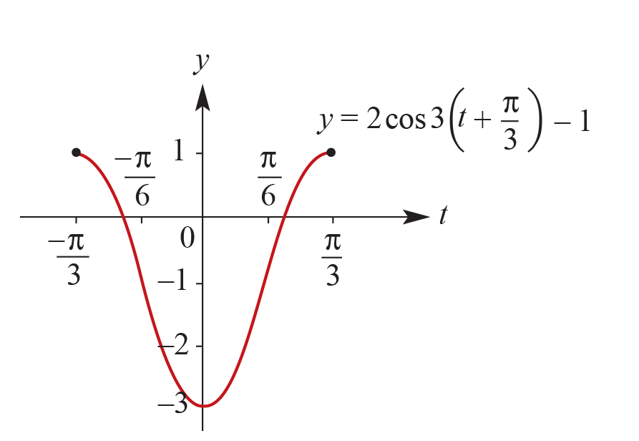
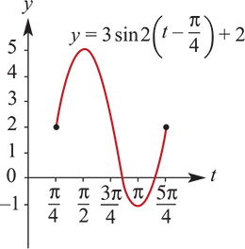
Example
We now consider translations parallel to the y-axis. Sketch each of the following graphs. Use a calculator to help establish the shape.
y=3sin2(t−$\frac{π}{4}$)+2, $\frac{π}{4}$≤t≤ $\frac{5π}{4}$
y=2cos3(t+ $\frac{π}{3}$)−1, − $\frac{π}{3}$≤t≤ $\frac{π}{3}$

Slide 3
Observations from the example
a. The graph of y=3sin2(t− $\frac{π}{4}$)+2 is the same shape as the graph of y=3sin2(t− $\frac{π}{4}$), but is translated 2 units in the positive direction of the y-axis.
b. The graph of y=2cos3(t+ $\frac{π}{3}$)−1 is the same shape as the graph of y=2cos3(t+ $\frac{π}{3}$), but is translated 1 unit in the negative direction of the y-axis.
In general, the effect of ±b is to translate the graph ±b units parallel to the y-axis.

Slide 4
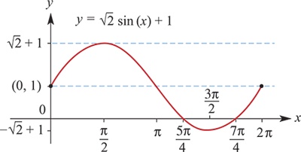
Example
Sketch the graph of each of the following for x∈[0,2π]. Clearly indicate axis intercepts.
y=$\sqrt{2}$sin(x)+1
Solution
To determine the x-axis intercepts, the equation $\sqrt{2}$sin(x)+1=0 must be solved.
$\sqrt{2}$sin(x)+1 =0
∴ sinx = − $\frac{1}{\sqrt{2}}$
∴ x=π+ $\frac{π}{4}$ or 2π− $\frac{π}{4}$
∴ x = $\frac{5π}{4}$ or $\frac{7π}{4}$
The x-axis intercepts are $\frac{5π}{4}$ and $\frac{7π}{4}$ .

Slide 5
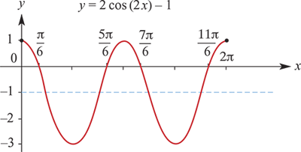
Example
Sketch the graph of each of the following for x∈[0,2π]. Clearly indicate axis intercepts.
y=2cos(2x)−1
2cos(2x)−1 =0
∴ cos(2x) = $\frac{1}{2}$
∴ 2x = $\frac{π}{3}$, $\frac{5π}{3}$, $\frac{7π}{3}$ or $\frac{11π}{3}$
∴ x = $\frac{π}{6}$, $\frac{5π}{6}$, $\frac{7π}{6}$ or $\frac{11π}{6}$
The x-axis intercepts are $\frac{π}{6}$, $\frac{5π}{6}$, $\frac{7π}{6}$ and $\frac{11π}{6}$.

Slide 6
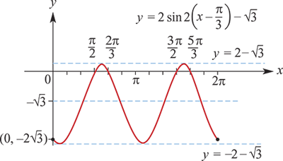
Example
Sketch the graph of each of the following for x∈[0,2π]. Clearly indicate axis intercepts.
y=2sin2(x− $\frac{π}{3}$)− $\sqrt{3}$
Solution
sin2(x− $\frac{π}{3}$)= $\frac{\sqrt{3}}{2}$
∴ 2(x− $\frac{π}{3}$) = $\frac{π}{3}$, $\frac{2π}{3}$, $\frac{7π}{3}$ or $\frac{8π}{3}$
∴ x− $\frac{π}{3}$= $\frac{π}{6}$, $\frac{π}{3}$, $\frac{7π}{6}$ or $\frac{4π}{3}$
∴ x = $\frac{π}{2}$, $\frac{2π}{3}$, $\frac{3π}{2}$ or $\frac{5π}{3}$
The x-axis intercepts are $\frac{π}{2}$, $\frac{2π}{3}$, $\frac{3π}{2}$ and $\frac{5π}{3}$.

