Slide 1
Further symmetry properties and the Pythagorean identity
14K

Slide 2
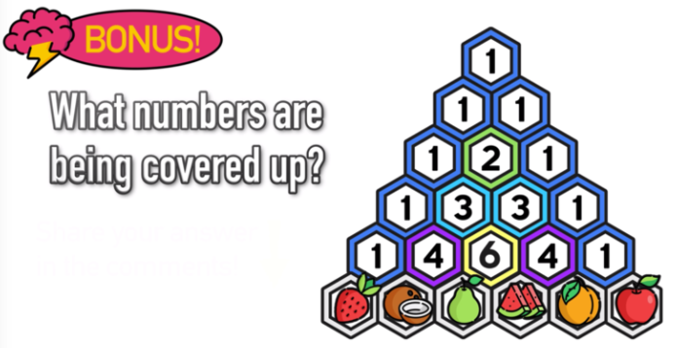
Notes:
Lesson starter 2 marks!

Slide 3
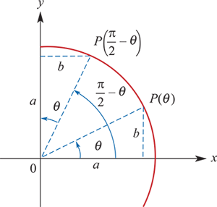
Complementary relationships
From the diagram
sin($\frac{π}{2}$ −θ)=a
and, since a=cosθ,
sin($\frac{π}{2}$ −θ)=cosθ
From the same diagram,
cos($\frac{π}{2}$ −θ)=b
and, since b=sinθ,
cos($\frac{π}{2}$ −θ)=sinθ

Slide 4
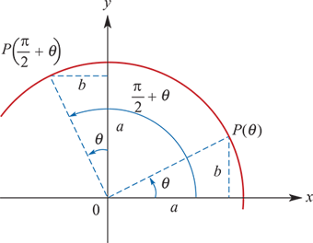
Complementary relationships
From the diagram:
sin($\frac{π}{2}$ +θ) =a=cosθ
cos($\frac{π}{2}$ +θ) =−b=−sinθ

Slide 5
Example
If sinθ=0.3 and cosα=0.8, find the values of:
sin($\frac{π}{2}$ −α)
cos($\frac{π}{2}$ +θ)
sin(−θ)
Solution
sin($\frac{π}{2}$ −α)=cosα=0.8
cos($\frac{π}{2}$ +θ)=−sinθ=−0.3
sin(−θ)=−sinθ=−0.3

Slide 6
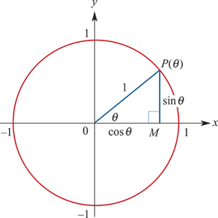
The Pythagorean identity
Consider a point, P(θ), on the unit circle.
By Pythagoras' theorem,
$OP^{2}$ = $OM^{2}$+ $MP^{2}$
∴1 = ${(cos\text{θ})}^{2}$+ ${(\text{sin}\text{θ})}^{2}$
Now ${(cos\text{θ})}^{2}$and ${(\text{sin}\text{θ})}^{2}$may be written as $\cos^{2}{θ}$ and $\sin^{2}{θ}$.
∴1= $\cos^{2}{θ}$ + $\sin^{2}{θ}$
As this is true for all values of θ, it is called an identity. In particular, this is called the Pythagorean identity:
$\cos^{2}{θ}$ + $\sin^{2}{θ}$=1

Slide 7
Example
Given that sinx= $\frac{3}{5}$ and $\frac{π}{2}$ <x<π, find:
a. cosx
b. tanx
Solution
a. Substitute sinx= $\frac{3}{5}$ into the Pythagorean identity:
$\cos^{2}{x}$ + $\sin^{2}{x}$=1
$\cos^{2}{x}$ + $\frac{9}{25}$ =1
$\cos^{2}{x}$ =1− $\frac{9}{25}$ = $\frac{16}{25}$
Therefore cosx=± $\frac{4}{5}$. But x is in the 2nd quadrant, and so cosx= − $\frac{4}{5}$.
b. Using part a, we have
tanx= $\frac{sinx}{cosx}$= $\frac{3}{5}$÷(−$\frac{4}{5}$)= $\frac{3}{5}$×(− $\frac{5}{4}$) = − $\frac{3}{4}$

Slide 8
Section summary
Complementary relationships
sin($\frac{π}{2}$ −θ)=cosθ cos($\frac{π}{2}$ −θ)=sinθ
sin($\frac{π}{2}$ +θ) =cosθ cos($\frac{π}{2}$ +θ) =−sinθ
Pythagorean identity
$\cos^{2}{θ}$ + $\sin^{2}{θ}$=1

