Slide 1
The tangent function
14L

Slide 2
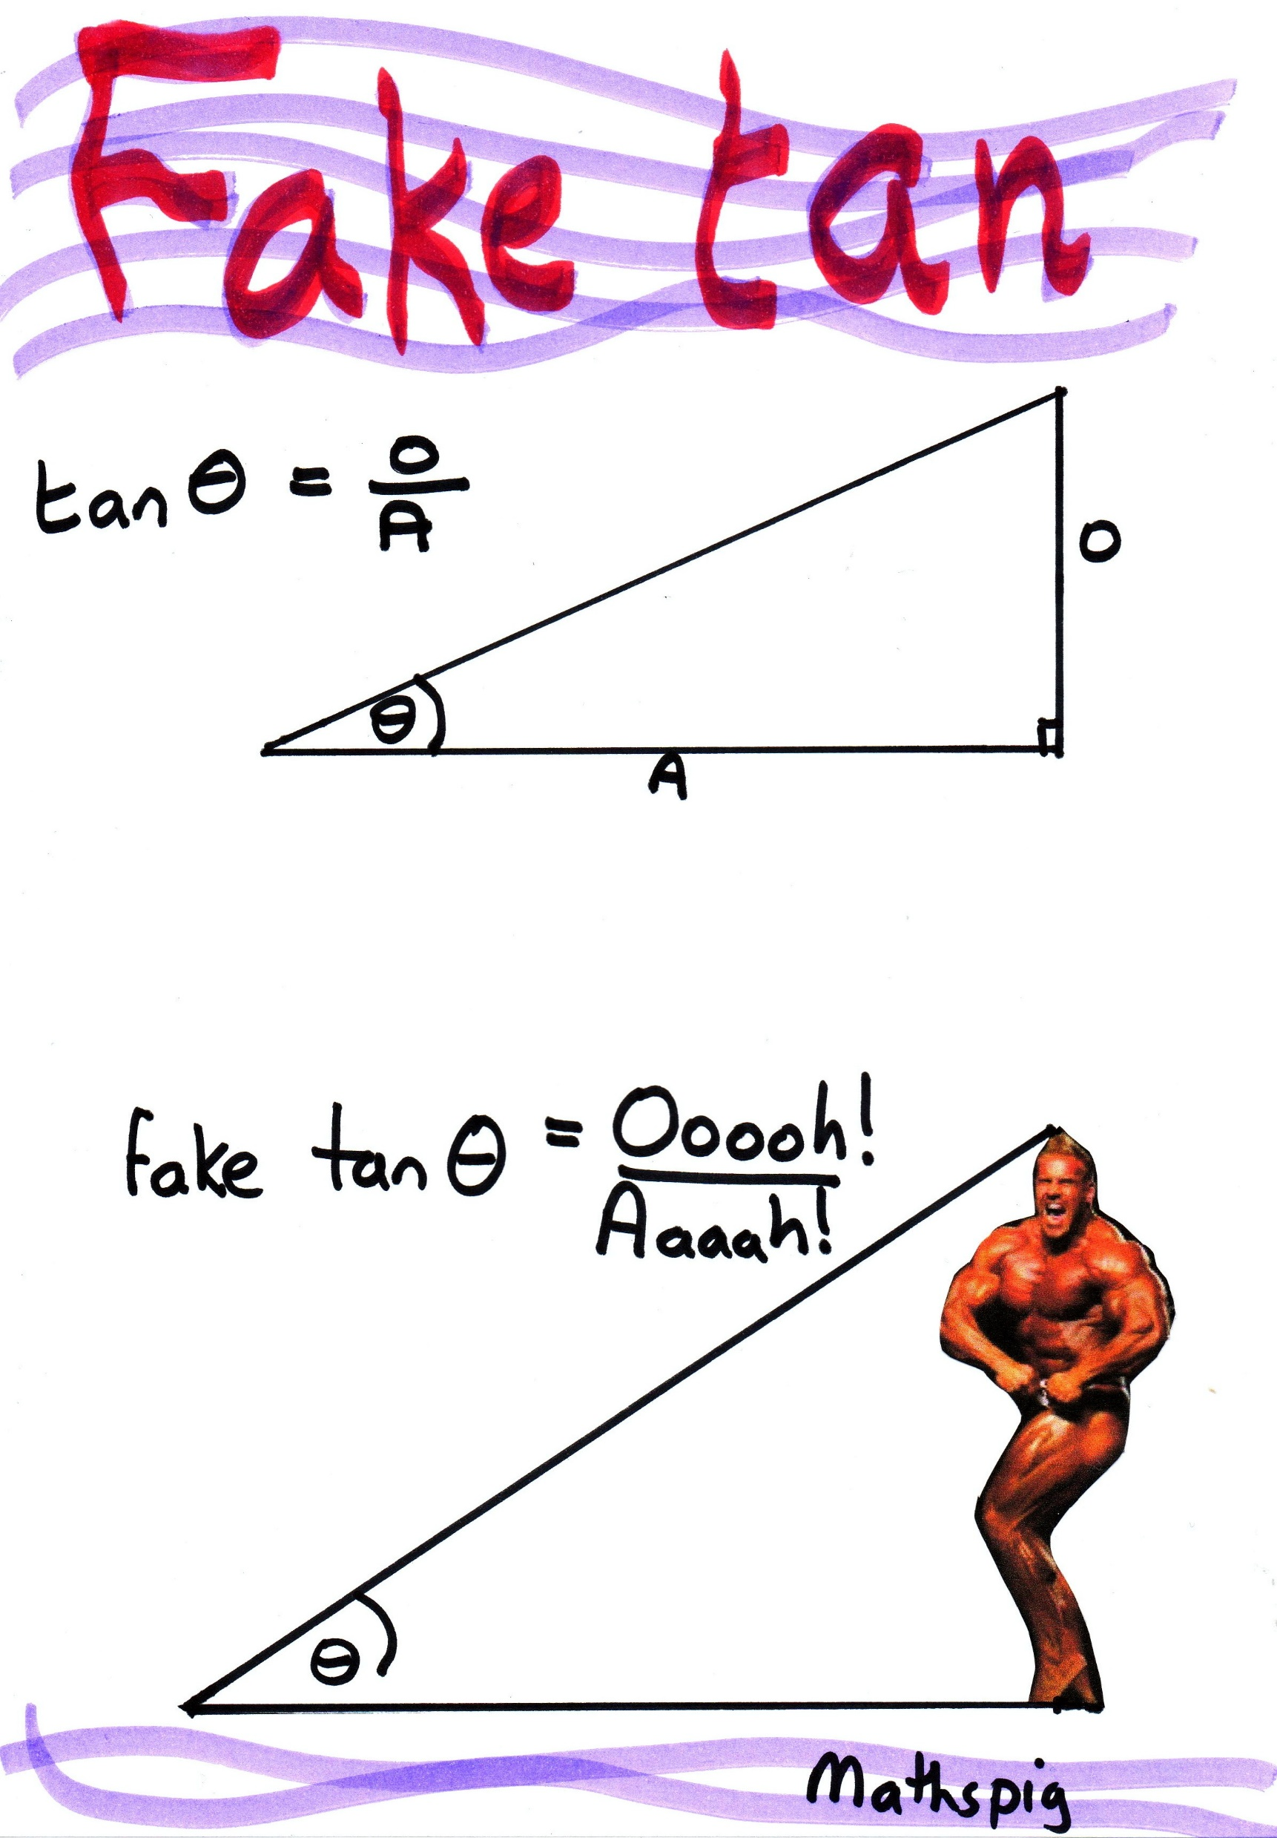
Tan lines

Slide 3
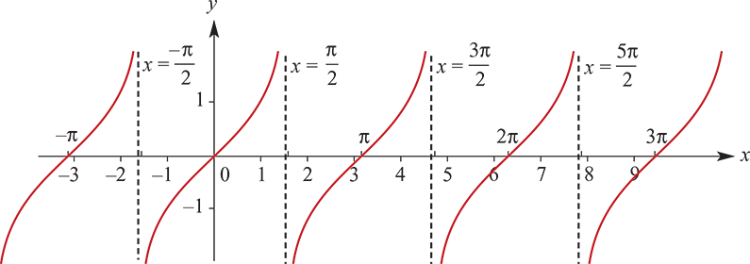
The tangent function
A table of values for y=tanx is given below. Use a calculator to check these values and plot the graph of y=tanx.
x | −π | − $\frac{3π}{4}$ | − $\frac{π}{2}$ | − $\frac{π}{4}$ | 0 | $$\frac{π}{4}$$ | $$\frac{π}{2}$$ | $$\frac{3π}{4}$$ | π | $$\frac{5π}{4}$$ | $$\frac{3π}{2}$$ | $$\frac{7π}{4}$$ | 2π | $$\frac{9π}{4}$$ | $$\frac{5π}{2}$$ | $$\frac{11π}{4}$$ | 3π
y | 0 | 1 | ud | −1 | 0 | 1 | ud | −1 | 0 | 1 | ud | −1 | 0 | 1 | ud | −1 | 0

Slide 4
The tangent function
Note:
The lines x=− $\frac{π}{2}$, x= $\frac{π}{2}$, x= $\frac{3π}{2}$ and x= $\frac{5π}{2}$ are asymptotes.
The x-axis intercepts occur when sinx=0, which is for x=0,π,2π, etc. In general, x=kπ, where k is an integer.

Slide 5
Observations from the graph of y=tan x
The graph repeats itself every π units, i.e. the period of tan is π.
The range of tan is R.
The equations of the asymptotes are of the form x= $\frac{(2k+1)π}{2}$, where k is an integer.
The x-axis intercepts occur for x=kπ, where k is an integer.

Slide 6
Transformations of y=tan x
Consider a dilation of factor $\frac{1}{2}$ from the y-axis and a dilation of factor 3 from the x-axis:
(x,y)→($\frac{1}{2}$x,3y)
If the image of (x,y) under the transformation is (x′,y′), then x′= $\frac{1}{2}$x and y′=3y. Hence x=2x′ and y=$\frac{y′}{3}$.
Thus the graph of y=tanx is transformed to the graph of $\frac{y′}{3}$=tan(2x′). That is, it is transformed to the graph of y=3tan(2x). The period of the graph will be $\frac{π}{2}$.

Slide 7
Graphs of y=atan(nt)
In general, for a and n positive numbers, the graph of y=atan(nt) is obtained from the graph of y=tant by a dilation of factor a from the t-axis and a dilation of factor $\frac{1}{n}$ from the y-axis.
The following are important properties of the function f(t)=atan(nt):
The period is $\frac{π}{n}$.
The range is R.
The asymptotes have equations t= $\frac{(2k+1)π}{2n}$, where k is an integer.
The t-axis intercepts are t= $\frac{kπ}{n}$, where k is an integer.

Slide 8
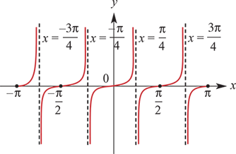
Example
Sketch the graph of each of the following for x∈[−π,π]:
y=3tan(2x)
Solution
Period= $\frac{π}{n}$= $\frac{π}{2}$
Asymptotes: x =$\frac{(2k+1)π}{4}$, k∈Z
Axis intercepts: x= $\frac{kπ}{2}$, k∈Z

Slide 9
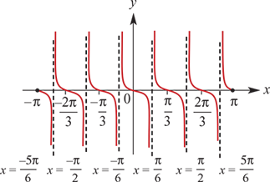
Example
Sketch the graph of each of the following for x∈[−π,π]:
y=−2tan(3x)
Solution
Period= $\frac{π}{n}$= $\frac{π}{3}$
Asymptotes: x= $\frac{(2k+1)π}{6}$, k∈Z
Axis intercepts: x= $\frac{kπ}{3}$, k∈Z

Slide 10
Solution of equations
The techniques for solving equations of the form a tan(nt)=b are similar to those for solving equations of the form a sin(nt)=b and a cos(nt)=b discussed in Section 14H. An important difference is that the period of tan is π. The method for obtaining further solutions is to add and subtract multiples of π.

Slide 11
Example
Solve each of the following equations for x∈[−π,π]:
tanx=−1
Solution
Since tanx is negative, the point P(x) lies in the 2nd or 4th quadrant. Solutions are required for x∈[−π,π].
Use tan(π−x)=−tanx and tan(−x)=−tanx.
tanx =−1
∴ x = $\frac{3π}{4}$or − $\frac{π}{4}$

Slide 12
Example
Solve each of the following equations for x∈[−π,π]:
tan(2x)=$\sqrt{3}$
Consider solutions for a∈[−2π,2π].
Since tan(a) is positive, the point P(a) lies in the 1st or 3rd quadrant.
Use tan(π+x)=tanx.
Subtract π from each of the first two solutions to obtain the second two.
tan(2x)= $\sqrt{3}$
Let a=2x. The equation becomes
tan(a) = $\sqrt{3}$
∴ a = $\frac{π}{3}$ or $\frac{4π}{3}$or − $\frac{2π}{3}$or − $\frac{5π}{3}$
∴ x = $\frac{π}{6}$ or $\frac{4π}{6}$or − $\frac{2π}{6}$or − $\frac{5π}{6}$ = $\frac{π}{6}$ or $\frac{2π}{3}$or − $\frac{π}{3}$or − $\frac{5π}{6}$

Slide 13
Example
Solve each of the following equations for x∈[−π,π]:
2tan(3x)=0
Solution
The solutions for 3x are to be in the interval [−3π,3π].
2tan(3x)=0
3x=−3π, −2π, −π, 0, π, 2π or 3π
∴x=−π, − $\frac{2π}{3}$, − $\frac{π}{3}$, 0, $\frac{π}{3}$, $\frac{2π}{3}$ or π

Slide 14
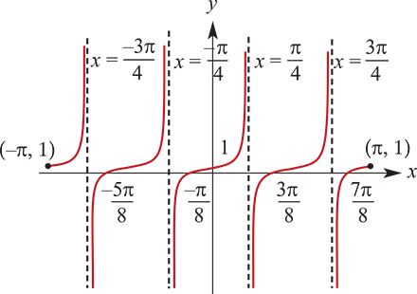
Example
Sketch the graph of y=tan(2x)+1 for x∈[−π,π].
The graph of y=tan(2x)+1 is obtained from the graph of y=tan(2x) by a translation of 1 unit in the positive direction of the y-axis.
For the y-axis intercept, let x=0. Then y=tan0+1=1.
For the x-axis intercepts, consider tan(2x)+1=0.
This implies tan(2x)=−1.
Hence 2x = $\frac{3π}{4}$, − $\frac{π}{4}$, $\frac{7π}{4}$ or − $\frac{5π}{4}$
and so x = $\frac{3π}{8}$, − $\frac{π}{8}$, $\frac{7π}{8}$ or − $\frac{5π}{8}$
The asymptotes are the same as those for y=tan(2x),
that is, x= $\frac{(2k+1)π}{4}$, k∈Z

