Slide 1
Numerical methods with a CAS calculator
14M

Slide 3
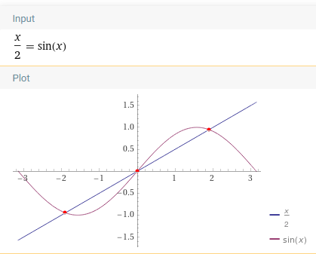
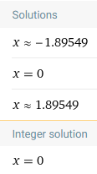
Example
Solve the equation $\frac{x}{2}$=sin$x$, giving your answer correct to two decimal places.
https://www.wolframalpha.com/input/?i=x%2F2%3Dsinx

Slide 4
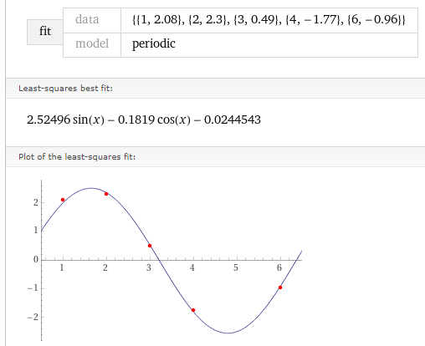
Fitting data Example
Fit a sine curve to the points (1,2.08),
(2,2.3), (3,0.49), (4,−1.77) and (6,−0.96).
https://www.wolframalpha.com/widgets/view.jsp?id=a96a9e81ac4bbb54f8002bb61b8d3472

