Slide 1

General solution of trigonometric equations
14N

Slide 2

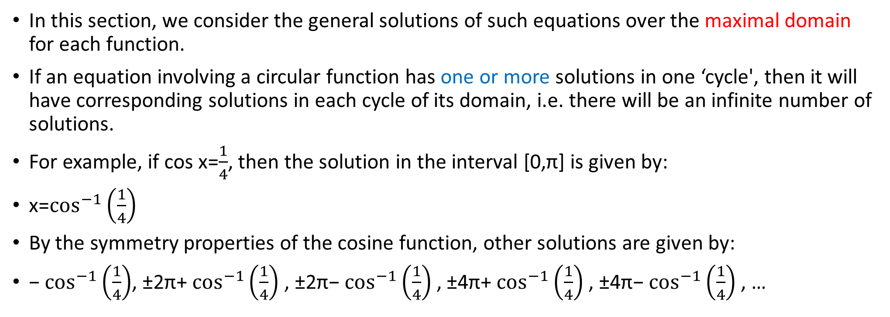
Solution of equations
In this section, we consider the general solutions of such equations over the maximal domain for each function.
If an equation involving a circular function has one or more solutions in one ‘cycle', then it will have corresponding solutions in each cycle of its domain, i.e. there will be an infinite number of solutions.
For example, if cos x=$\frac{1}{4}$, then the solution in the interval [0,π] is given by:
x=$\cos^{−1}\left(\frac{1}{4}\right)$
By the symmetry properties of the cosine function, other solutions are given by:
− $\cos^{−1}\left(\frac{1}{4}\right)$, ±2π+ $\cos^{−1}\left(\frac{1}{4}\right)$, ±2π− $\cos^{−1}\left(\frac{1}{4}\right)$, ±4π+ $\cos^{−1}\left(\frac{1}{4}\right)$, ±4π− $\cos^{−1}\left(\frac{1}{4}\right)$, …

Slide 3
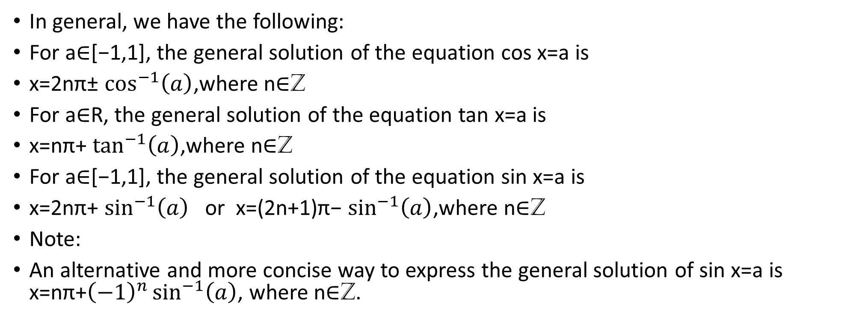
Solution of equations
In general, we have the following:
For a∈[−1,1], the general solution of the equation cos x=a is
x=2nπ± $\cos^{−1}\left(a\right)$,where n∈Z
For a∈R, the general solution of the equation tan x=a is
x=nπ+ $\tan^{−1}\left(a\right)$,where n∈Z
For a∈[−1,1], the general solution of the equation sin x=a is
x=2nπ+ $\sin^{−1}\left(a\right)$or x=(2n+1)π− $\sin^{−1}\left(a\right)$,where n∈Z
Note:
An alternative and more concise way to express the general solution of sin x=a is x=nπ+${\left(−1\right)}^{n}\sin^{−1}\left(a\right)$, where n∈Z.

Slide 4
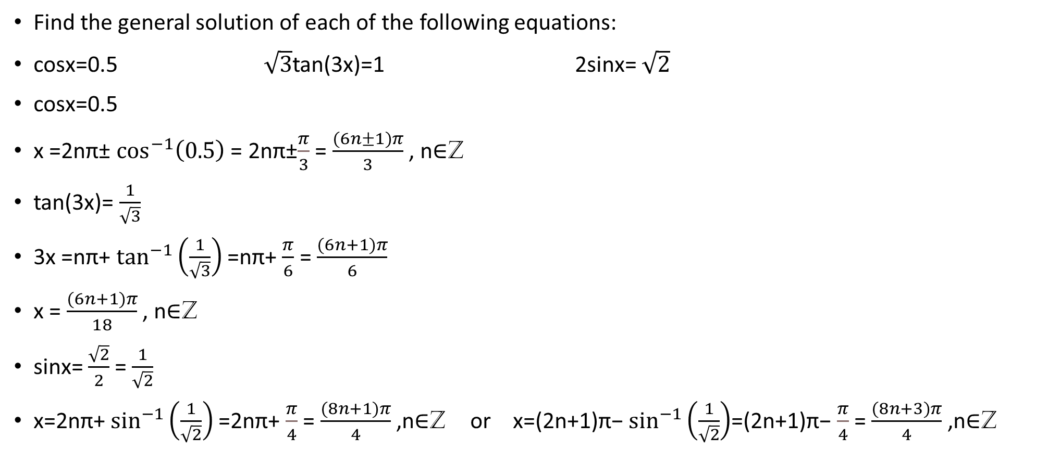
Example
Find the general solution of each of the following equations:
cosx=0.5 $\sqrt{3}$tan(3x)=1 2sinx= $\sqrt{2}$
cosx=0.5
x =2nπ± $\cos^{−1}\left(0.5\right)$ = 2nπ±$\frac{π}{3}$ = $\frac{(6n±1)π}{3}$ , n∈Z
tan(3x)= $\frac{1}{\sqrt{3}}$
3x =nπ+ $\tan^{−1}\left(\frac{1}{\sqrt{3}}\right)$=nπ+ $\frac{π}{6}$ = $\frac{(6n+1)π}{6}$
x = $\frac{(6n+1)π}{18}$ , n∈Z
sinx= $\frac{\sqrt{2}}{2}$= $\frac{1}{\sqrt{2}}$
x=2nπ+ $\sin^{−1}\left(\frac{1}{\sqrt{2}}\right)$=2nπ+ $\frac{π}{4}$ = $\frac{(8n+1)π}{4}$ ,n∈Z or x=(2n+1)π− $\sin^{−1}\left(\frac{1}{\sqrt{2}}\right)$=(2n+1)π− $\frac{π}{4}$ = $\frac{(8n+3)π}{4}$ ,n∈Z

Slide 5
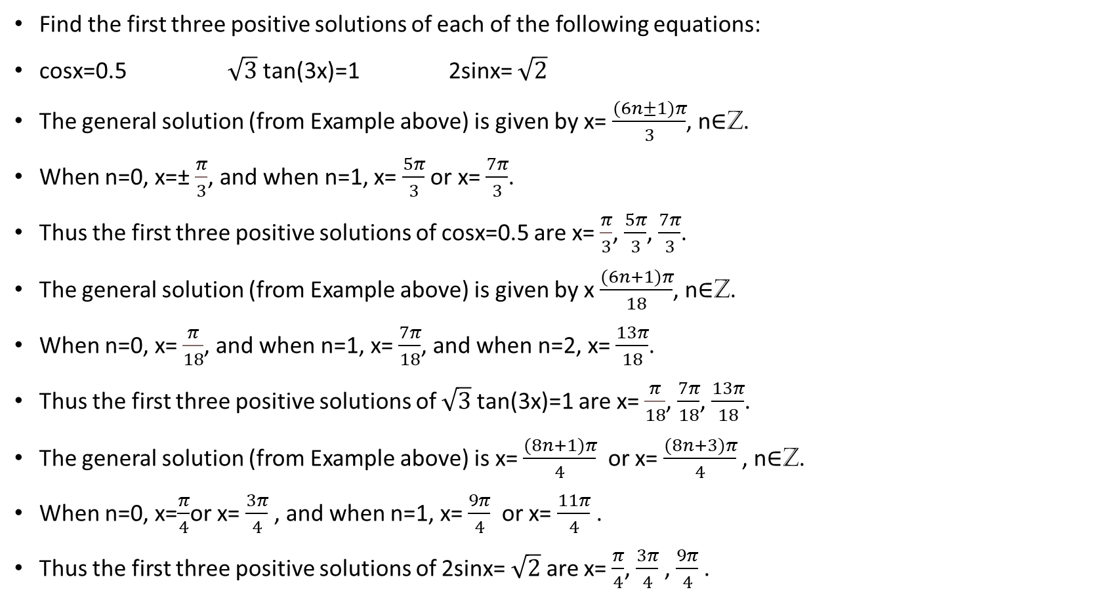
Example
Find the first three positive solutions of each of the following equations:
cosx=0.5 $\sqrt{3}$tan(3x)=1 2sinx= $\sqrt{2}$
The general solution (from Example above) is given by x= $\frac{(6n±1)π}{3}$, n∈Z.
When n=0, x=± $\frac{π}{3}$, and when n=1, x= $\frac{5π}{3}$ or x= $\frac{7π}{3}$.
Thus the first three positive solutions of cosx=0.5 are x= $\frac{π}{3}$, $\frac{5π}{3}$, $\frac{7π}{3}$.
The general solution (from Example above) is given by x $\frac{(6n+1)π}{18}$, n∈Z.
When n=0, x= $\frac{π}{18}$, and when n=1, x= $\frac{7π}{18}$, and when n=2, x= $\frac{13π}{18}$.
Thus the first three positive solutions of $\sqrt{3}$tan(3x)=1 are x= $\frac{π}{18}$, $\frac{7π}{18}$, $\frac{13π}{18}$.
The general solution (from Example above) is x= $\frac{(8n+1)π}{4}$ or x= $\frac{(8n+3)π}{4}$ , n∈Z.
When n=0, x=$\frac{π}{4}$or x= $\frac{3π}{4}$, and when n=1, x= $\frac{9π}{4}$ or x= $\frac{11π}{4}$.
Thus the first three positive solutions of 2sinx= $\sqrt{2}$ are x= $\frac{π}{4}$, $\frac{3π}{4}$, $\frac{9π}{4}$.

Slide 6
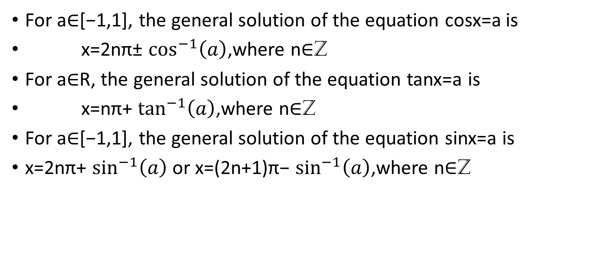
Section summary
For a∈[−1,1], the general solution of the equation cosx=a is
x=2nπ± $\cos^{−1}\left(a\right)$,where n∈Z
For a∈R, the general solution of the equation tanx=a is
x=nπ+ $\tan^{−1}\left(a\right)$,where n∈Z
For a∈[−1,1], the general solution of the equation sinx=a is
x=2nπ+ $\sin^{−1}\left(a\right)$ or x=(2n+1)π− $\sin^{−1}\left(a\right)$,where n∈Z

